Slide 1
Vigilancia macroprudencial;
El caso europeo y su extrapolación.
Carlos Montalvo Rebuelta
Executuive Director, EIOPA
XV Conferencia ASSAL
Asunción, 23-IV-2014

Slide 2
Indice
Pasado
Presente
Futuro

Slide 3
El Pasado

Slide 4


11 April 2014

Slide 5
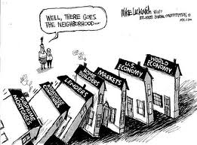
11 April 2014

Slide 6
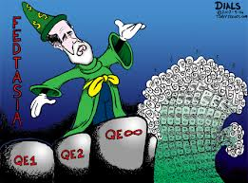
11 April 2014

Slide 7
El Presente

Slide 8
Credit Risk – High Yield Spreads
Source: Thomson Reuters Datastream
Last Observation: 25 March 2014
Notes:
This graph tells many stories and poses the question are current yields sustainable?
During the spike in yields around 2008, there was an increase in the leverage (debt/income) ratio for high yielding corporates driven by falling revenues. Recently, this ratio has climbed driven by an increase in debt.
There has been considerable corporate debt issuance in the last year reflecting strong demand from investors who are chasing yield. This has been the driver for the compression of yields evident in the last 18 months.
The key question whether this is sustainable and whether we will see a sharp reversal of this compression.

Slide 9
Crecimiento (?)
        GWP projection for the Eurozone
Source: EIOPA and ECB survey of professional forecasters
Note: Data corresponds to aggregates for the Eurozone, dashed lines represent the projection using macro s scenario based on ECB SPF.
Notes:
Weak real GDP growth projected for EU in the region of 1.5% per annum over the next couple years. Dispersion around this with some countries showing very weak growth.
This is reflected in the outlook for unemployment which is projected to hover just under the 12% level for the EU over the next 2-3 years. Combined with weak economic activity this will hit the performance of the life sector in particular

Slide 10
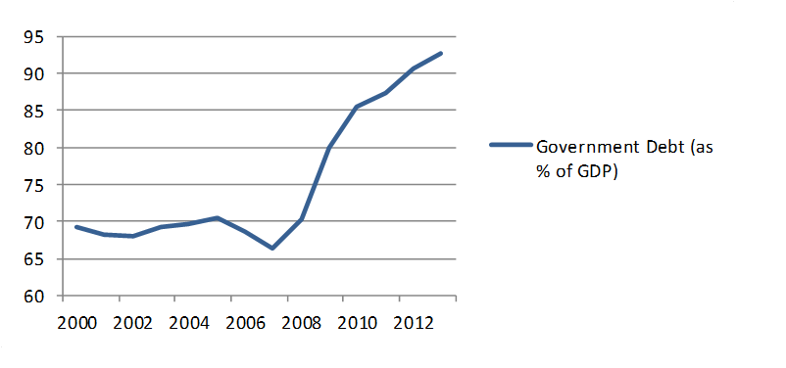
Desempleo y endeudamiento
Notes:
Unemployment reflects the weak growth outlook and does not show much decline in the short term
Experience in the past in the EU was of “jobless growth” and persistently high unemployment. A worry is that this pattern will be repeated and this presents a significant challenge to policymakers.
High social welfare spending will have an impact on the ability of governments to complete fiscal corrections and to comply with the Excessive Deficit Procedure. The countries with the greatest need to make fiscal corrections are, of course, these facing significant unemployment problems.

Slide 11
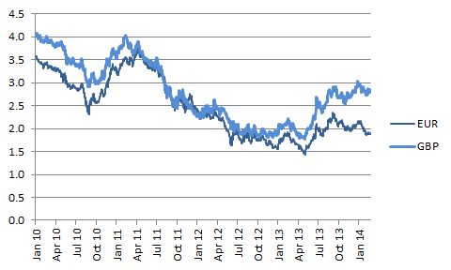
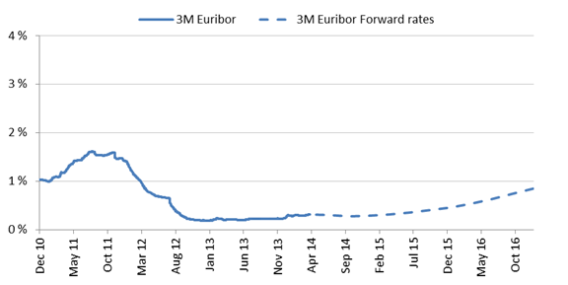
Escenario de tipos bajos
Podemos hablar de cambio de tendencia?
10 Y swap rates 3M EURIBOR
Source: Bloomberg Source: Bloomberg
Note: Forecast is based on the forward 3M EURIBOR rate
Notes:
There is no clear direction in market rates and they remain low by historical standards
Nevertheless, there is some uncertainty as to their likely direction and the speed of any change. Low growth, high unemployment and the risk of deflation in some jurisdictions argue in favour of official rates remaining quite low. By comparison, weak fiscal fundamentals and an overbought corporate bond market suggest the possibility of a rapid reversal in some yields.

Slide 12

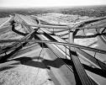

Slide 13

Mercados emergentes: oportunidades y riesgos
Share of GWP abroad
Source: EIOPA
Note: Data corresponds to aggregates for the Eurozone, dashed lines represent projection using macro
scenario based on the IMF World Economic Outlook.
Notes:
The aggregated Government Debt to GDP ratio for the EU as a whole has shown a dramatic increase and is well ahead of where it should be under the EDP.
The aggregate figures hide some particularly dramatic increases and a small number of jurisdictions have even higher debt-GDP ratios that will require them to run primary surpluses to bring them under control.
Looking at the underlying fiscal arithmetic in some cases raises the question of whether government bond spreads may adjust rapidly upwards from current levels.
This would have a clear impact on insurers on a mark to market basis.

Slide 14

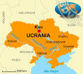

Otros riesgos

Slide 15
Futuro

Slide 16

“Life can only be understood backwards;
but it must be lived forwards”

Slide 17
Muchas gracias!

