Slide 1


Monitoring the Insurance Industry
The Costa Rican Experience
Celia González Haug
Directora, División de Normativa y Autorizaciones
OECD-ASSAL Regional Expert Seminar
September 26 and 27, 2013

Slide 2

Agenda
Background and recent developments in the Costa Rican insurance market.
Context of monitoring and insurance market statistics
  Legal framework
  Insurance market monitoring strategy
  Applicable regulations
Current situation: What do we have?
What are we working on to enhance transparency and monitoring of the insurance market?

Slide 3
Background and recent developments in the Costa Rican insurance market

Slide 4
Costa Rican Insurance Market Background
5 years since insurance market opening
A unique state agency operated as a monopoly during 84 years, and currently maintains about 90% of the total market share.
A limited insurance culture in most of the population
Limited banking and financial inclusion.
Sectorial monitoring (banking, insurance, pensions and stocks) coordinated by a single direction board.
IFRS adopted for the financial system prior to market opening, with some exceptions approved by the National Supervision Council.
Existence of a uniform accounting manual for all supervised institutions in the financial system and information transparency norms established.

Slide 5
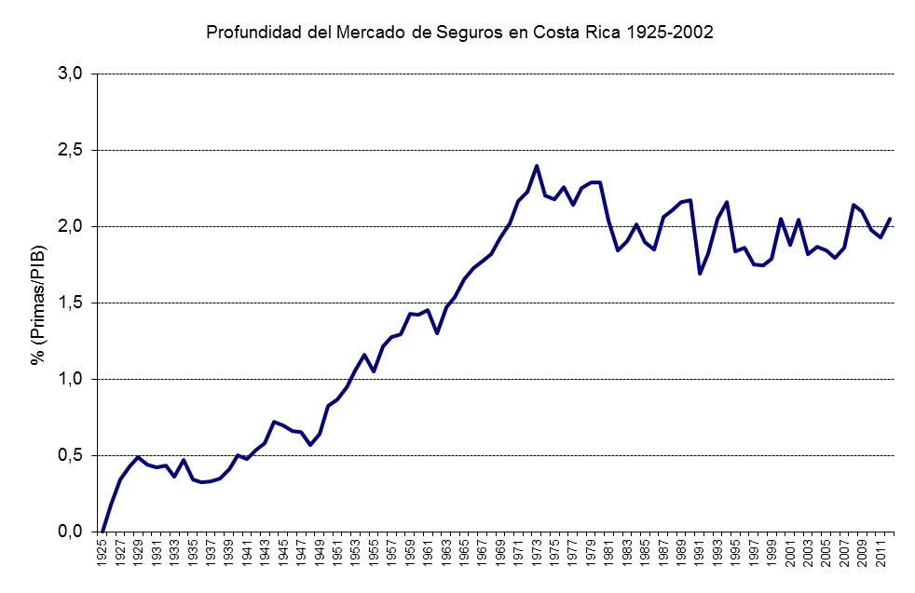
Premiums/GDP 1925-2012
2,43%
2,05%
Source: Hasta 2003, Estudio del mercado de Seguros, Gilberto Arce; 2004 , actualizad by SUGESE

Slide 6
Premiums/GDP & Premiums per capita
Latin America: Premiums/GDP, 2011
Latin America: Premiums P.C., 2011
Premiums/GDP (average):
2.52% (2009), 2.49% (2010), 2.43% (2011)
Premiums p.c. (average): US$190 (2009), US$204 (2010), US$236 (2011).
Costa Rica: Under the average, but around it. Increasing performance on premiums per capita is opposed to Latin America’s trend.

Slide 7
Total Received Premiums
Voluntary Insurance
Total
Growing rate (US$)

Slide 8
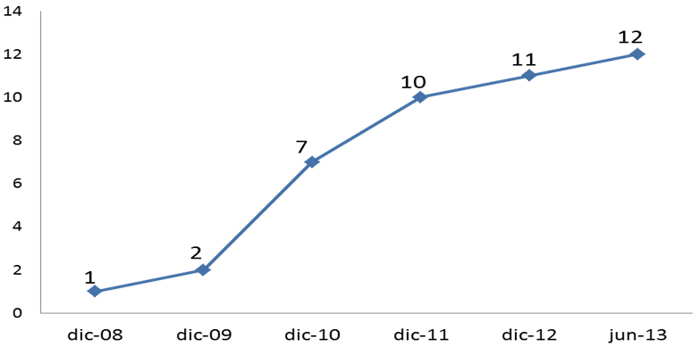
Insurers (June 2013)
Insurer | Owner | Category | Licensed
Instituto Nacional de Seguros | Government | Composite | N.A.
MAPFRE | Seguros Costa Rica, S.A. | Foreign private capital (Spain, Panama) | Composite | 2010
Assa Compañía de Seguros, S.A. | Foreign private capital (Panama) | Composite | 2010
Seguros Bolívar Aseguradora Mixta S.A. | Foreign private capital (Colombia) | Composite | 2011
Aseguradora Sagicor Costa Rica, S.A. | Composite private capital (CR, Jamaica/Barbados) | Composite | 2013
Seguros del Magisterio, S.A. | CR private capital | Personal Insurance* | 2009
Pan American Life Insurance de Costa Rica, S.A. | Foreign private capital (New Orleans) | Personal Insurance | 2010
Aseguradora del Istmo ADISA, S.A. | Composite private capital (CR, Panama) | Personal Insurance | 2010
Best Meridian Insurance Company (Branch) | Foreign private capital (Florida) | Personal Insurance | 2011
Atlantic Southern Insurance Company (Branch) | Foreign private capital (Puerto Rico) | Personal Insurance | 2012
Quálitas Compañía de Seguros (Costa Rica), S.A. | Foreign private capital (Mexico) | Property and Casualty | 2011
Oceánica de Seguros, S.A. | Foreign private capital (Venezuela) | Property and Casualty | 2013

Slide 9
Context of monitoring and insurance market statistics

Slide 10
Context: Legal Framework(1)
Insurer obligations
Provide to SUGESE correct and complete information within the time limits and formalities required.
Define control policies and procedures. Establish accounting, financial, informatics, communications and internal control systems.
Properly carry, accounting or legally required registries.
Refer and publish complete and correct information required by the public.

Slide 11
Context: Legal Framework (2)
Superintendency Functions
Make available to the public all the relevant information about insurance market and insurance companies activities.
Propose general norms for accounting registry and the preparations and presentation of financial statements.
Dictate all other technical or operative rules and guidelines.
Propose accounting manuals to allow the accounting information to reasonably reflect the situation.

Slide 12

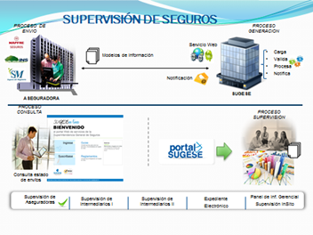
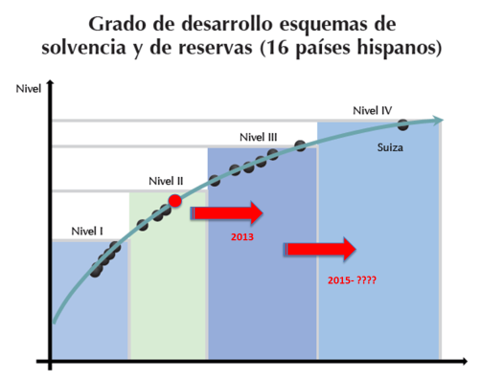
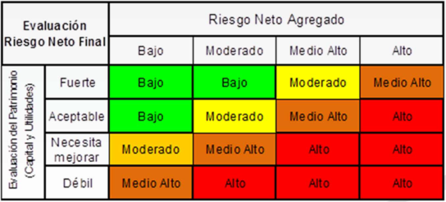
Context: Insurance market monitoring strategyt
Information Infrastructure
Solvency Capital Requirement
SBR
Evaluation Model SBR
Accounting Norm Reform
In force 2014
Integral Solvency Reform
In force 2014
Pilot Scheme
(october 2012 )

Slide 13
Context: Applicable Regulations
Referral information Standards
General Accounting disposition for Financial System.
IFRS Adoption
External Auditor Regulation
Accounting Plan for the Insurance Market
Insurer´s Financial Statements Model Standards.
Audited Statements publishing norms.

Slide 14
Current situation: What do we have?

Slide 15
Current situation: What do we have?
Information submission through excel files, market´s basic information revelation
Implementation of Insurance Supervision System began, for remission, processing and storage of financial and accounting information from insurer companies.
Monthly publication of information for the public through website.
Availability of financial statements in website.
  Audited (annual and intermediate)
  Monthly summary of financial statements in website

Slide 16
Current situation: What do we have?
Accounting Balances-M
(Trial Balance
Financial Statements (T)
Direct premiums, by branch, by insurer (M)
Ceded and retroceded reinsurance information. (M)
solvency and minimum equity information. (M)
Clains by branch, by insurer. (M)
Available Information

Slide 17
Current situation: What do we have?
Current Admonitory for supervisory tasks
Accounting registry and consistency revision.
Accounting registry reasonability
Solvency and minimum capital regimes monitoring.
Basic indicators construction.

Slide 18
¿What are we working on to enhance transparency and monitoring of the insurance market?

Slide 19
What are we working on to enhance transparency and monitoring of the insurance market?
Insurance Supervision System
Early Warning Indicator System
Improve information revelation for the public

Slide 20














Insurance supervision
Remittance Procedure
PROCESO GENERACION
Web Service
Charge
Validate
Process
Notify
Information Models
Notification
Insurer
SUGESE
Consultation Procedure
Supervision Procedure
Consultation of Remittance Status
Insurer Supervision
Intermediary Supervision I
Intermediary Supervision II
Electronic Fle
Managerial Info. Panel
In Site Supervision

Slide 21
What are we working on to enhance transparency and monitoring of the insurance market?
Stages of Insurance Supervision System (SSS)
1
IV T 2013
Marketing Channels information (T)
2
I T 2014
Accounting Balances (trial balance) (M)
3
2014
Run off (T)
Production Information: contracts, insured and premiums (T)
Technical Account by branch(T)
Solvency information detail (M)
4
2014
Insurance companies information for Central Bank (national accounts, monetary statistics and Balance of Payments)
Financial Intermediaries Information (T)
Information for equity adequacy(M)

Slide 22
What are we working on to enhance transparency and monitoring of the insurance market?
Early Warning Indicator System (SIAT)
Product generated from the development of the Insurance Supervision System. (SSS)
System synthesizes indicators of early warning with the one that assesses identified risk areas for monitoring purposes of the insurance company.
Relevant areas are established:
  Capital and debt adequacy.
  Management and profitability.
  Liquidity and asset management.

Slide 23
What are we working on to enhance transparency and monitoring of the insurance market?
Early Warning Indicator System (SIAT) (1)
Total Debt
Liquidity and asset management.
Financial Debt
Net equity loss gross provision.
Net equity loss net provision.
Gross risk rate
Equity retaining or net risk rate.
Minimum capital index
Capital adequacy index
Capital adequacy index variation
Liquidity Ratio
Technical provision coverage.
Capital and debt adequacy

Slide 24
What are we working on to enhance transparency and monitoring of the insurance market?
Sistema de Indicadores de Alerta Temprana (SIAT) (2)
Management and profitability.
Direct insurance premium growth.
Return on Investements
Return on equity (ROE)
Sinister Index
Expenses index
Combined Ratio
Run off Indicator
Sinister average cost
Liquidation average velocity
Rescue index
Reinsurance Concentration index
Rescue amount divided by average mathematic provision.

Slide 25
Concluding Remarks…
Costa Rica has many pending statistic tasks and much more to learn.
The country has sought to establish the basis to build a system of statistics and an integral and adjusted to international practices monitoring.
Having a proper statistical system will require coordination and negotiation of the Superintendency with the Insurance Industry.

Slide 26


¡Thank You!

