Slide 1
Insurance Regulation and Supervision in Latin America and IAIS-ASSAL Conference
ICP 21 - Countering Fraud in Insurance
Commissioner Adam Hamm
North Dakota Insurance Department
NAIC President
Notes:
Insurance Core Principles 21:
“The supervisor requires that insurers and intermediaries take effective measures to deter, prevent, detect, report and remedy fraud in insurance.”

Slide 2
US Perspective
What is Insurance fraud?
Insurance fraud costs the American economy 80 to 230 billion dollars each year
Why is insurance fraud committed?
Insurance fraud causes injury and humiliation
Studies have shown one in four people feel insurance fraud is okay

Slide 3

Insurance Fraud Schemes

Slide 4

Claimant Fraud
Staged burglaries and thefts
Arson for profit
Murder for profit
Application fraud
Workers compensation fraud

Slide 5

Health Care Fraud
Billing for treatment as payable when it is not payable
Charges inconsistent with services provided
Unlicensed personnel performing services
Illegally obtaining prescription drugs

Slide 6
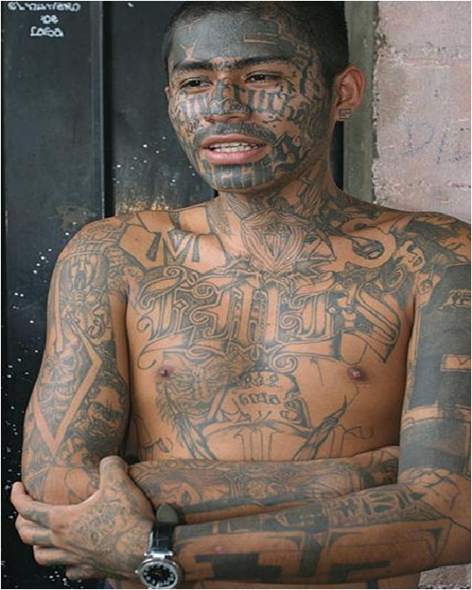

Organized Fraud Groups

Slide 7

Insurance Agent Fraud
Filing false claims with insurers
Clean sheeting
Backdating
Kickbacks

Slide 8
Fraud Prevention Efforts
Information sharing between insurance companies and government
  Stop ongoing frauds
  Discourage future frauds
Prevention programs for government and insurance companies
Insurance fraud awareness for the public
More pro-active project

Slide 9
Information Sharing & Systems
Pro’s VS Con’s
Systems
IFB Fraud Alerts System
NHCAA PERC System
NICB’s FOREWARN System
NAIC Life Insurance Alert System
National Equipment Registry
Cargo Theft Alerts
Law Enforcement Online

Slide 10
State Insurance Departments
All states have insurance departments, but not all insurance departments have an Insurance Fraud Bureau
Fraud Bureaus investigate and fight insurance fraud
44 States have dedicated Fraud Units, either within the Departments of Insurance (34) or other Agencies (10)

Slide 11
Administrative, Civil or Criminal Actions
State agencies may take a variety of actions when “bad behavior” is found:
  Administrative: internal agency, commissioner has authority, hearing officers assigned
  Civil: court system, commissioner files a case against entity is state court
  Criminal: commissioner asks prosecutor to take criminal action against individual or entity

Slide 12
Enforcement on Fraud
State and Federal working together
Conduct administrative investigations
Action is typically pursued against the individual/ entity involved
Fraud Units typically conduct criminal investigations
The investigations usually focus on insurance agents, consumers, third parties, and healthcare providers who are committing insurance fraud
Fraud investigators frequently work with local, state and federal law enforcement agencies
Depending on state laws, criminal cases may be referred to local, state and federal prosecutors

Slide 13
NAIC Antifraud Task Force Members
Representatives from state departments of insurance represent their insurance commissioner
All NAIC members and their staff may participate, only Antifraud Task Force (AFTF) members may vote
Limited membership on task forces encouraged
Our members are very active and supportive

Slide 14
NAIC Insurance Fraud Prevention Model Act
NAIC - Insurance Fraud Prevention Model Act - 18 USC 1033/1034:
  Enacted in 1994
  Federal criminalization of insurance fraud
  Increased participation from organized crime
  Persons convicted of a felony crime of dishonesty or breach of trust cannot participate in the business of insurance without commissioner’s permission

Slide 15
Anti-Money Laundering
The United States Federal Government has ultimate authority over AML and CFT activities:
  Agency: Financial Crimes Enforcement Network (FinCEN) of the US Department of Treasury
  Laws:
    The Bank Secrecy Act (BSA) of 1970
    The Money Laundering Control Act 0f 1986
    The Suspicious Activity Report Act of 1996
    The USA PATRIOT Act of 2001
NAIC Financial Examination Handbook

Slide 16
Thank You

