Slide 1
XXV Asamblea Annual de ASSAL
XV Conferencia sobre Regulación y Supervisión de Seguros en América Latina IAIS - ASSAL
Adecuación del Capital
Andrea E. Keenan
Managing Director – Latin America
April 23, 2014 A.M. Best – Ciudad de México

Slide 2
Disclaimer
© AM Best Company (AMB) and/or its licensors and affiliates. All rights reserved. ALL INFORMATION CONTAINED HEREIN IS PROTECTED BY COPYRIGHT LAW AND NONE OF SUCH INFORMATION MAY BE COPIED OR OTHERWISE REPRODUCED, REPACKAGED, FURTHER TRANSMITTED, TRANSFERRED, DISSEMINATED, REDISTRIBUTED OR RESOLD, OR STORED FOR SUBSEQUENT USE FOR ANY SUCH PURPOSE, IN WHOLE OR IN PART, IN ANY FORM OR MANNER OR BY ANY MEANS WHATSOEVER, BY ANY PERSON WITHOUT AMB’s PRIOR WRITTEN CONSENT. All information contained herein is obtained by AMB from sources believed by it to be accurate and reliable. Because of the possibility of human or mechanical error as well as other factors, however, all information contained herein is provided “AS IS” without warranty of any kind. Under no circumstances shall AMB have any liability to any person or entity for (a) any loss or damage in whole or in part caused by, resulting from, or relating to, any error (negligent or otherwise) or other circumstance or contingency within or outside the control of AMB or any of its directors, officers, employees or agents in connection with the procurement, collection, compilation, analysis, interpretation, communication, publication or delivery of any such information, or (b) any direct, indirect, special, consequential, compensatory or incidental damages whatsoever (including without limitation, lost profits), even if AMB is advised in advance of the possibility of such damages, resulting from the use of or inability to use, any such information. The credit ratings, financial reporting analysis, projections, and other observations, if any, constituting part of the information contained herein are, and must be construed solely as, statements of opinion and not statements of fact or recommendations to purchase, sell or hold any securities, insurance policies, contracts or any other financial obligations, nor does it address the suitability of any particular financial obligation for a specific purpose or purchaser. Credit risk is the risk that an entity may not meet its contractual, financial obligations as they come due. Credit ratings do not address any other risk, including but not limited to, liquidity risk, market value risk or price volatility of rated securities. NO WARRANTY, EXPRESS OR IMPLIED, AS TO THE ACCURACY, TIMELINESS, COMPLETENESS, MERCHANTABILITY OR FITNESS FOR ANY PARTICULAR PURPOSE OF ANY SUCH RATING OR OTHER OPINION OR INFORMATION IS GIVEN OR MADE BY AMB IN ANY FORM OR MANNER WHATSOEVER. Each credit rating or other opinion must be weighed solely as one factor in any investment or purchasing decision made by or on behalf of any user of the information contained herein, and each such user must accordingly make its own study and evaluation of each security or other financial obligation and of each issuer and guarantor of, and each provider of credit support for, each security or other financial obligation that it may consider purchasing, holding or selling.

Slide 3
Agenda
ICP 17: Capital Adequacy
Ratings Approach to Capital Adequacy
Introduction to Ratings
Establishing Capital Adequacy
Moving Forward
XXV Asamblea Anual de ASSAL

Slide 4
Agenda
ICP 17: Capital Adequacy
Ratings Approach to Capital Adequacy
Introduction to Ratings
Establishing Capital Adequacy
Moving Forward
XXV Asamblea Anual de ASSAL

Slide 5
Capital Adequacy
IAIS ICP 17:
“The supervisor establishes capital adequacy requirements for solvency purposes so that insurers can absorb significant unforeseen losses and to provide for degrees of supervisory intervention.”
Best’s Financial Strength Rating:
“is an independent opinion of an insurer's financial strength and ability to meet its ongoing insurance policy and contract obligations.”
XXV Asamblea Anual de ASSAL
Notes:
.

Slide 6
Ratings Illustrated
XXV Asamblea Anual de ASSAL

Slide 7
Agenda
ICP 17: Capital Adequacy
Ratings Approach to Capital Adequacy
Introduction to Ratings
Establishing Capital Adequacy
Moving Forward
XXV Asamblea Anual de ASSAL

Slide 8
Philosophy to Capital Adequacy
3. Business Profile
2. Operating Performance
1. Balance Sheet Strength
3. Protect Consistency of Earnings
2. Tomorrow’s Capital
1. Present Day Situation

Slide 9
1. Balance Sheet Strength
Capitalization
Capital Structure
Quality
Financial Leverage
Underwriting Leverage
Premium Writing, Reinsurance & Loss/Policy Reserve Practices
Asset Allocation, Quality & Diversification of Portfolio
Asset Leverage-exposure to investment & credit risk
Best’s Capital Adequacy Ratio (BCAR)
U/W, Financial & Asset Leverage
Liquidity
Quality/Appropriateness/Soundness of Reinsurance
Adequacy of Policy/Loss/Claim Reserves
XXV Asamblea Anual de ASSAL

Slide 10
2. Operating Performance
Operating performance is important as profitability is the engine that ultimately drives capital
Analysis centers on the stability and sustainability of the company’s sources of earnings in relation to liabilities that the company retains
Areas reviewed include underwriting, investments, capital gains/losses and total operating earnings, both before and after tax
Length and nature of insurance liability risks and how these elements relate to the company’s operating mission are also important in evaluating profitability
Analysis focuses on the degree of volatility in earnings and the impact this could have on capitalization and balance sheet strength
XXV Asamblea Anual de ASSAL

Slide 11
3. Business Profile
Business Profile impacts current and future operating performance and long-term financial strength
Key business profile tests:
Spread of risk
Revenue composition
Competitive market position
Management
Insurance market risk
Event risk
XXV Asamblea Anual de ASSAL

Slide 12
Managing Risk
Strong Operating Performance (2) Builds Balance Sheet Strength (1)
Business Profile (3) Drives
Strong & Sustainable
Operating Performance (2)
Rating / Capital Adequacy
BCAR Guideline
Weak Operating Performance (2) Erodes Balance Sheet Strength (1)
Date of last balance sheet
Future
Time
XXV Asamblea Anual de ASSAL

Slide 13
A.M. Best’s Capital Model
NET REQUIRED CAPITAL
TOTAL ADJUSTED CAPITAL
(B1) Fixed-Income Securities
(B2) Equity Securities
(B3) Interest Rate
(B4) Credit
(B5) Loss Reserves
(B6) Net Written Premium
(B7) Off Balance Sheet Risks
COVARIANCE
Shareholders funds
Positive adjustments. Typically:
Discounting of reserves
Difference between market and book values
Value of In-Force Business (VIF)
Economic Reserves e.g. RfBs
Hybrid Equity
Negative adjustments:
Deduction of one cat PML
DAC
BCAR SCORE = TOTAL ADJUSTED CAPITAL / NET REQUIRED CAPITAL
XXV Asamblea Anual de ASSAL

Slide 14
BCAR: Investment Risk
Economic view
Charges applied to investment assets depending on the risk profile of investment
Bonds: risk of default
Stocks: market decline
Mortgage Loans: illiquidity
Real Estate: improper value
Can reduce asset risk charges for policyholder participation
XXV Asamblea Anual de ASSAL

Slide 15
BCAR: Interest Rate Risk
Calculates the capital required for the risk of a rise in interest rates
Risk of having to sell fixed income assets when market values are low
Life: risk is consumer driven - search for higher returns with other carriers
Non-life: risk is driven by sudden shock event (usually natural catastrophe, could be man-made)
XXV Asamblea Anual de ASSAL

Slide 16
BCAR: Credit Risk
Calculates required capital for counterparty credit risk
Charges for risk of default on non-investment assets
Agents balances
Other debtors
Charges for reinsurers’ share of technical reserves
Credit risk charge based on quality of reinsurer (FSR)
XXV Asamblea Anual de ASSAL

Slide 17
BCAR: Non-Life Reserve Risk
Capital required for the risk of under reserving
Captures unanticipated adverse reserve development
Where anticipated there is a charge for expected reserve deficiency
Input is undiscounted reserves. The model discounts these and includes reserve equity in total adjusted capital
Capital factors depend on
Industry experience by line of business
Company stability
Size
Charges increased in case of excessive growth
Diversification credit given
XXV Asamblea Anual de ASSAL

Slide 18
BCAR: Life/Annuity Reserve Risk
Mortality risk for life products
Risk is dying sooner/more people dying than expected
Longevity risk for annuity (or annuity-like) products
Risk is living longer than expected
Non-proportional life reinsurance (XS)
Exposure is reserve amount
XXV Asamblea Anual de ASSAL

Slide 19
BCAR: Premium Risk
Capital required for risk of underpricing during next year
Capital factors (non-life)
Industry experience by line of business
Company profitability and size
Stage of underwriting cycle
Charges increased in case of excessive growth
Diversification credit
For life, annuities, pensions only new business written during the year is included (in-force business captured on reserves page)
XXV Asamblea Anual de ASSAL

Slide 20
BCAR: Derivatives
Positive considerations
Hedging
Direct match to owned asset
High correlation with index being hedged
Similar time to maturity of hedge versus owned asset
High quality credit rating of counterparty
Negative considerations
Speculative
Volatile
Illiquid
Worst case loss scenario
XXV Asamblea Anual de ASSAL

Slide 21
BCAR: Miscellaneous
Employee benefit liabilities
Asset charges vary by country
Cash
Bonds
Equities
Real Estate
XXV Asamblea Anual de ASSAL

Slide 22
BCAR: Stress Testing
Stress-Testing for Unforeseen Events including:
Financial market dislocation
Natural Catastrophe Risks
Sovereign Defaults
Changes in Capital Requirements
Changes in Regulatory Environment
XXV Asamblea Anual de ASSAL

Slide 23
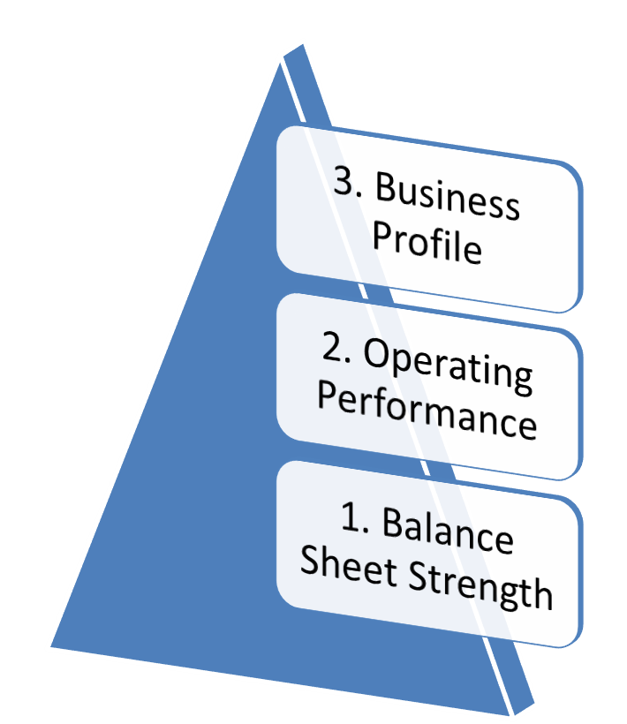
Bringing it all Together
Enterprise Risk Management
Alternative Risk Transfer
Terrorism Risk
Surety Companies
Contingent Capital Facilities
Catastrophe Analysis
Country Risk Assessment
Reinsurance Pools
Captive Companies
Operating Leverage
Transfer & Convertibility Risk
Runoff Specialists
Lloyd’s Syndicates
Holding Company Analysis
Evaluating Surplus Notes
Members of Groups
XXV Asamblea Anual de ASSAL

Slide 24
Agenda
ICP 17: Capital Adequacy
Ratings Approach to Capital Adequacy
Introduction to Ratings
Establishing Capital Adequacy
Moving Forward
XXV Asamblea Anual de ASSAL

Slide 25
Moving Forward
Global insurance sector struggling with efficiency and profitability versus policyholder protection.
Stronger regulation can sometimes work against access to insurance objectives.
One model not necessarily better than another model, merely another perspective of the risk being assessed.
Caution against reliance on quantitative metrics. Models are tools, not answers.
Ongoing development of regulatory capital standards can develop in tandem with ratings capital standards.
Rating contribute through stratified view of strength.

Slide 26
Moving Forward
Each company has a unique profile that must be considered when evaluating capital.
Despite close attention individual company analysis, global perspective provides essential tools, checks and balances and an expert assessment on best practices in the insurance industry.
Common sense / feasibility checks contribute to the analysis.
XXV Asamblea Anual de ASSAL

Slide 27
Information & Regulation
Ratings contribute to transparency and understanding across global insurance markets.
Offers a probability of default (VAR) metric
Partnering with other stakeholders achieves a common goal of a transparent and stable marketplace
Regulators
Associations
Educational institutions
Other third parties (brokers, investors, agents)
Always, but especially in emerging markets, more reliable information is needed.
XXV Asamblea Anual de ASSAL

Slide 28
Thank You
Andrea E. Keenan
Andrea.Keenan@ambest.com

