Slide 1


Capital management under Solvency II: Reinsurance is an essential part of the CFO toolkit
Richard Schneider Kladt, Swiss Re
April 2013

Slide 2
Agenda
Reinsurance
Captives
Insurance Linked Securities and the use of SPV´s
Examples of capital management under Solvency II
Reinsurance as a pro-active capital and risk management tool

Slide 3
Reinsurance

Slide 4
Reinsurance is a catalyst for economic growth
 | What Reinsurers do | Benefit to society | Pre-requisites
Risk transfer function | Diversify risks on a global basis | Make insurance more broadly available and less expensive | Global mobility of premiums and capital
Capital market function (as institutional investors) | Invest premium income according to expected pay-out | Provide long-term capital to the economy on a continuous basis | Ability to invest in real economy (equity, corporate bonds, etc)
Information function | Put a price tag on risks | Set incentives for risk-adequate behaviour | Market- and risk-based pricing
Reinsurers absorb shocks, provide capital for the real economy and
support risk prevention

Slide 5
How do insurers transfer risks to reinsurers?
Reinsurers’ products are designed to meet primary insurers’ needs for balance sheet protection and capital relief.
Traditional reinsurance contracts primarily accept insurers’ underwriting risks in return for the payment of a reinsurance premium.
There are two forms of traditional cover:
  Treaty reinsurance is used to reinsure entire, precisely defined portfolios.
  Facultative reinsurance encompasses mainly large-scale risks that do not fit in the treaty portfolio and need to be individually evaluated and reinsured.
In both forms, a distinction is made between proportional and non-proportional coverage.

Slide 6
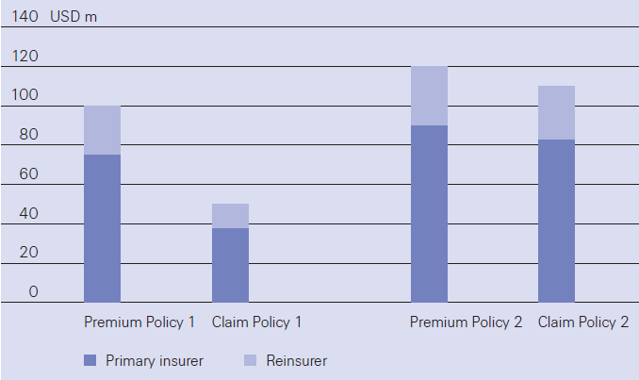
Proportional reinsurance
The direct insurer and the reinsurer divide premiums and losses between them at a contractually defined ratio.
The reinsurer’s share of the premiums is therefore directly proportionate to its obligation to pay any claims.
For instance, if the reinsurer accepts 25% of a particular portfolio of risks, and the direct insurer retains 75%, the premiums and claims are apportioned in the ratio of 25:75
Types of proportional reinsurance: QS (graph) and Surplus
Source: Swiss Re, "Understanding reinsurance: How reinsurers create value and manage risk"

Slide 7
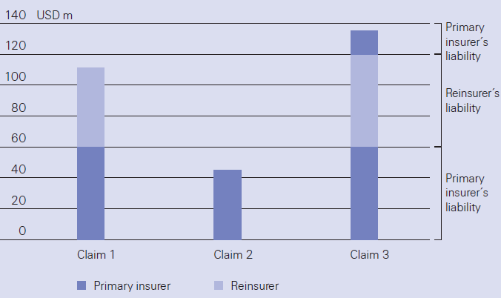
Non-proportional reinsurance
Structured like a conventional insurance policy: the reinsurer pays all or a predetermined percentage of the claims which fall between a defined lower and upper cover limit.
For the parts of claims below or above the limits, the primary insurer has to carry the risk on its own or it may reinsure it under other contracts.
Types of proportional reinsurance: Excess of Loss (graph) and Stop Loss
Source: Swiss Re, "Understanding reinsurance: How reinsurers create value and manage risk"

Slide 8
Captives

Slide 9
Captives: the concept
"Captive insurance companies are insurance companies that are owned and controlled by their insureds.
A captive insurance company is described as single parent captive if it is owned and controlled by one company and insures that company and/or its subsidiaries.
A group captive is an insurance company owned and controlled by two or more non-affiliated organizations the captive insures.
In theory, all mutual insurance companies are captives that are controlled by their policyholders."
(www.captive.com)

Slide 10
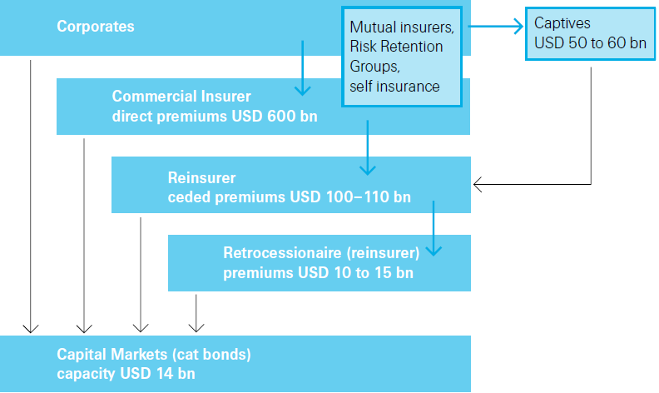
The global volume of captive premiums is estimated at USD 50-60 billion
Illustration of a supply chain for commercial insurance, 2010 data
Source: Swiss Re Economic Research & Consulting

Slide 11
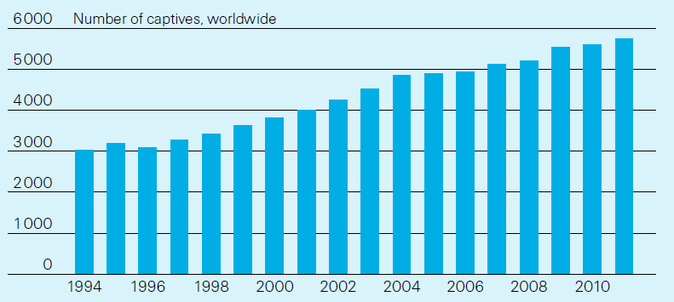
There were 5745 captive insurance companies worldwide in 2011
The ever-growing number of captives
Source: Business Insurance Research Center (www.businessinsurance.com/research)
The global volume of captive premiums is estimated at approx. USD 55 billion.
US corporations account for more than half the global volume of captive premiums.

Slide 12
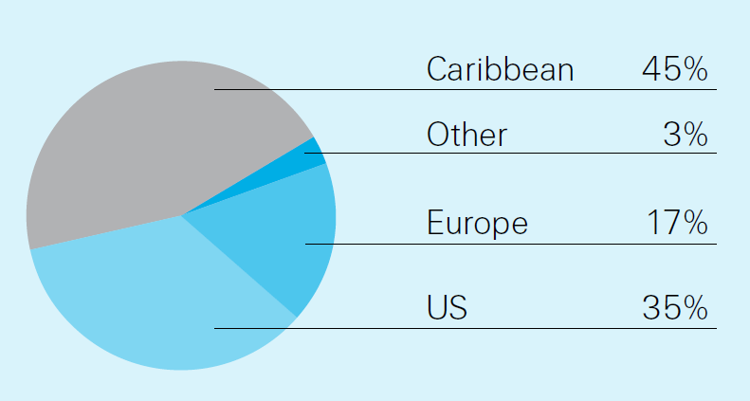
Caribbean off-shore locations are still in the lead, but dominance has declined
Captive locations, 2011
US on-shore captives have become increasingly popular over the last decade
About half of the captives in Europe are located in Guernsey, the Isle of Man, and Gibraltar.
Source: Business Insurance Research Center (www.businessinsurance.com/research)

Slide 13
Insurance Linked Securities and the use of SPV´s

Slide 14
Insurance-Linked Securities (ILS):
Overview
Insurance Linked Securities (ILS)
  transfer insurance-related risk, including natural catastrophe, aviation, event cancellation, and many more, to the capital markets
  performance depends on the occurrence (or non-occurrence) of an insured event (i.e., Earthquake in Japan)
ILS have gained acceptance among the largest global fixed-income investors
  offer investors stable and attractive returns
  diversify investment portfolios, relatively uncorrelated to other asset classes / financial markets
ILS serve two primary purposes for sponsors
  manage and hedge insurance risk
  increase capital efficiency by drawing on alternative sources of financing

Slide 15
Product Basics:
Typical Cat Bond Structure
The Reinsured (i.e. Sponsor) enters into a risk transfer contract with a Special Purpose Vehicle (SPV)
The SPV hedges the reinsurance contract by issuing Notes to Investors in the capital markets.
Proceeds from the securities offering are invested in assets to provide a stable return on the collateral
If no trigger event occurs during risk period, full principal returned to investors at maturity;
If a trigger event occurs during risk period, sponsor obtains the claims payment and any remaining principal is returned to investors at maturity
1
2
Counterparty Contract
Sponsor
(Insurance Company)
SPV
Note Proceeds
Investors
Premium
Collateral Trust
Interest Payment
Bond Payout
Return of Remaining Principal
4
Investments
Investment Return
3
Investment Earnings

Slide 16
Catastrophe Bonds Triggers Deployed
Sponsors have increasingly looked at Indemnity triggers in the past year, as they look to minimize their basis risk
Industry index is still the largest trigger outstanding
Industry index transactions will typically price tighter than indemnity transactions
However, an indemnity trigger will offer a sponsor the lowest basis risk in a cat bond
Investors have also taken parametric index, modelled loss, and MITT triggers recently
Catastrophe Bond Trigger Breakdown
(Natural Catastrophe Bonds Only)
Source: Swiss Re Capital Markets.
As of July 17, 2012 with percentages calculated based on notional amount

Slide 17
Capital management under Solvency II

Slide 18
Capital management:
What's our industry facing today?
Capital markets
Low interest rates
Volatile share markets
Financial debt crisis
Creditor protection
Significance of rating
Increased importance of disclosure
Shareholder value
More transparent accounting
Call for stable returns
Underwriting
Pressure on margins
Volatile results
Large losses and catastrophe claims
CAPITAL MANAGEMENT (risk/return considerations) becoming more important
Solvency capital
Rating capital
Risk adjusted capital
Available capital

Slide 19
The Solvency II balance sheet:
Steering the solvency ratio
Economic balance sheet
Market value
of assets
Excess Capital
Available assets
to cover SCR/MCR
Equity and
retained earnings
Solvency Capital
Requirement (SCR)
including Minimum Capital Requirements (MCR )= required capital
Own funds =
available capital
Hybrid capital
risk margin¹
Cash
Fixed income instrument
Property
Equity
Reinsurance assets
available capital
market-consistent valuation
of hedgeable risks
solvency ratio =
required capital
Discounted Best Estimate
Steering of the solvency ratio:
Increase the available capital
Reduce the required capital
¹ for non-hedgeable risks

Slide 20
Reinsurance as a capital management tool:
The two leverage effects of reinsurance
Example:
At a target Solvency II ratio of 150%, a reduction in SCR increases the Solvency II ratio in a more effective and sustainable way than an increase in own funds.
Target Solvency II ratio: 150 %
Current Solvency II ratio: 100 %
Target Solvency II ratio: 150 %
10
+ 50 mio
60
10
10
30
Reduce the SCR via reinsurance
30
- 33 mio
Increase in own funds
150
100
80
100
100
60
60
67
SCR
Own
Funds
SCR
Own Funds
SCR
Own
Funds
Tier 1 Own fund
Tier 2 Own fund
Tier 3 Own fund

Slide 21
Reinsurance versus other capital instruments:
Economic cost of reinsurance
Expected loss of earnings
– Ceded premiums
+ R/I commissions
+ Ceded claims
– Loss investment income
Net present value of expected loss of earnings
Discounted over entire run-off period
Capital Relief
– Insurance risk
– Cat risk
– Market risk
+ Counterparty risk
Net present value of capital relief
Discounted over entire run-off period
Cost of Reinsurance (pre tax) in% =
NPV (loss of earnings)
NPV (capital relief) x target solvency ratio
ad *) Driven by capital driver; decrease over time as liabilities run-off

Slide 22
Reinsurance – a pro-active capital and risk management tool

Slide 23

Reinsurance as a capital and risk management tool
Reinsurance versus other financing tools
Equity
Subordinated debt
Reinsurance
Improve capital adequacy
✓
(✓)
✓
1
Enable organic growth
2
✓
✓
✓
Finance external expansion
3
✓
✓
(✓)
Optimize capital structure
4
✗
(✓)
✓
Stabilise earnings
5
✗
✗
✓

Slide 24
Solvency II:
Don't underestimate the adaptation phase
Europe-wide total results:
Solvency II ratio
Solvency capital requirements: 165 % (compared to Solvency I ratio of 310 %)
Minimum capital requirements: 466 %
Distribution of the QIS 5 results – solo calculation
Adaptation measures:
Equity
Subordinated debt
Use of net earnings
Sales of asset classes and/or business segments
Hedging-instruments
Reinsurance solutions
23.2 %
Source: EIOPA QIS5 Report published 14th March 2011
24

Slide 25
Reinsurance:
A powerful management tool under Solvency II
Identify the individual capital drivers …
Examples:
… find the most efficient reinsurance solution …
Examples:
… value the capital benefit based on the model used
Insufficient diversification
Traditional Quota share
Standard Formula
Partial internal model
Internal model
Natural catastrophe risk
XoL / Insurance Linked Securities
Large exposure to
increasing life spans
Longevity swap
Volatility of reserve run-off
Loss Portfolio Transfer & Adverse Development Cover
Frequency
Traditional Quota share/ XoL
The effectiveness of a certain reinsurance solution to reduce individual capital drivers heavily depends on the model used by the client

Slide 26
Mitigate life underwriting risk*
Where Swiss Re can help
QS**
Surplus
Pandemic stop loss
Admin Re
VIF monetisation
ILS peak risks
Risk swaps
ILS issuance / investment
Admin Re
QS**
Admin Re
VIF monetisation
Longevity swap
Admin Re
QS**
Surplus
Stop loss
VIF moneti-sation
QS**
Surplus
Stop loss
Disability swap
Admin Re
Source: EIOPA QIS5 Report
* At the moment Swiss Re is developing further solutions for market risk, lapse risk, risk swap and capital transferability
** QS stands for quota share
.

Slide 27
Mitigate Non-life underwriting risk
Example 1
Retrospective reinsurance
Non-life reserve risk - LPT & ADC
Value proposition of a LPT/ADC under Solvency II:
Adverse Development Cover (ADC)
covers the reserving risk
Cumulative Claims
Reserve-risk
Expected Claims
Loss Portfolio Transfer (LPT)
covers the timing risk as well as the investment risk.
Reduces also the market risk due to the reduction of investments.
Timing-risk
Expected Claims Payment
Accelerated Claims Payment
Higher Claims Payment
Time

Slide 28
Mitigate Non-life underwriting risk
Example 1
50% LPT/ADC on MTPL reserves
Total capital benefit of 160m over time (indicative)
Assumptions:
Simulation based on QIS 5 spreadsheet provided by the client
LPT cover: 50% cession of current MTPL net claims reserves (best estimate)
ADC cover: 50% (attaching at the best estimate)
Positive impact of ADC on USPs not included
Target Solvency II ratio of 150%
Capital benefit at inception of 50m,
Total capital benefit over the run-off period estimated at 160m,
Impact depends on claims development and reserve pay-out pattern
* Simplifying assumption, an LPT/ADC may not cover the most recent underwriting year(s)

Slide 29

Reinsurance:
An essential part of the CFO toolkit
As Solvency II is an economic risk capital framework, every cession that transfers risk results in a reduction of the required capital.
Consequently, capital that is freed-up by the use of reinsurance can be deployed to other activities or paid back to the shareholder.
Reinsurance is an established element of the CFO's and CRO's toolbox in risk & capital management decisions.
Reinsurance has the additional advantage that it does not only reduce capital requirements but also reduces earnings volatility

Slide 30

Thank you
Richard Schneider
+52 55 5322 8410
Richard_Schneider@swissre.com

Slide 31
Legal notice
©2010 Swiss Re. All rights reserved. You are not permitted to create any modifications or derivatives of this presentation or to use it for commercial or other public purposes without the prior written permission of Swiss Re.
Although all the information used was taken from reliable sources, Swiss Re does not accept any responsibility for the accuracy or comprehensiveness of the details given. All liability for the accuracy and completeness thereof or for any damage resulting from the use of the information contained in this presentation is expressly excluded. Under no circumstances shall Swiss Re or its Group companies be liable for any financial and/or consequential loss relating to this presentation.

