Slide 1
Paul Hennessy
Navigators Underwriting Agency
Lloyd’s
Dynamics of the reinsurance international market and market perspectives
April 2013

Slide 2

Agenda
- Introduction
- Lloyd’s
- Navigators
- Influencers and outcomes
- Alternatives to Reinsurance
- Trends
- Closing comments
Notes:
Lloyd's is the world's best known - but probably least understood - insurance brand. This is because Lloyd's is not an insurance company but a society of members, both corporate and individual, who underwrite in syndicates on whose behalf professional underwriters accept risk.
Supporting capital is provided by investment institutions, specialist investors, international insurance companies and individuals.

Slide 3

Lloyd’s Market Structure
How the market works
Getting covered
Corporation of Lloyd’s
The
policyholder
Members
The brokers
Managing
The coverholders
agents
Syndicates
SEE: www.lloyds.com/directories
Source: Lloyd’s Annual Report 2011
Notes:
3

Slide 4
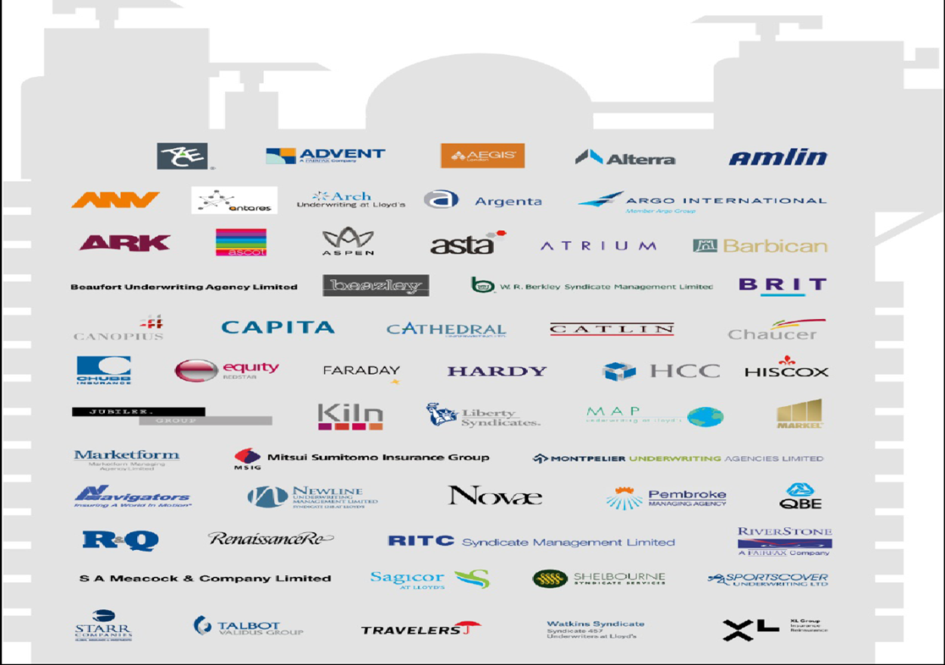
The Lloyd’s market

Slide 5

Who are Navigators?
  Navigators Mission Statement
    We are a global specialty insurer focused on targeted high-margin niches for which the quality of our intellectual capital, both in underwriting and claims, provide a meaningful competitive advantage. We specialize in insuring complex risks that require proven technical expertise, utilizing reinsurance to protect our conservative balance sheet. We always emphasize underwriting profit over market share and conduct our business with integrity, professionalism and pride.
  Recognized Leader in Specialty Insurance
      Recognized one of “100 Most Trustworthy Companies” by Forbes.com
      Ranked as fourth leading U.S. Marine insurer by National Underwriter
      96th Largest U.S. Insurance Group
      Ranked as fifth in net premium growth
  Global specialty insurance platform
      Navigators Syndicate 1221 at Lloyd’s provides global access to desired markets
      Approximately 35% of Navigators premiums are generated through Syndicate 1221.

Slide 6
Successful Execution of a Growth and Diversification Strategy
2001 D&O
  Chicago Office
2004 Excess Casualty
  Antwerp Office
2005 Acquired 100% Control of
  Lloyd’s Syndicate 1221
2006 Primary Casualty
  Inland Marine
2007 Orange County Office
  Miami Office (Latin America)
2008 LLOYD’S CHINA
  Stockholm Office
  Environmental
  New Jersey Office
2009 International D&O
  Architect & Engineering
  Philadelphia Office
  Pittsburgh Office
  Charlotte Office
  Copenhagen Office
    2010 LLOYD’S BRAZIL
      Los Angeles Office
    2011 Navigators Re
    2012 Commercial Surety
    Navigators Re Professional Liability

Slide 7
ing results to date
Lloyd’s Results
£m | Dec 2010 | Dec 2011 | Dec 2012
Gross written premiums | 22,592 | 23,477 | 25,500
Combined ratio | 93.3% | 106.8% | 91.1%
Investment return¹ | 1,258 | 955 | 1,311
Result before tax | 2,195 | (516) | 2,771
Return on capital (pre-tax) | 12.1% | (2.8%) | 14.1%
Source: Lloyd’s pro forma basis, 1) Return on syndicates’ assets, members’ funds at Lloyd’s and central assets

Slide 8
    2011 Natural Catastrophe Events
Size of losses to Lloyd’s
    US$ 2.2bn - Thailand Floods
    US$ 1.95bn - Japan earthquake and tsunami
    US$ 1.2bn - New Zealand earthquake
    US$ 650m - Australia floods
Notes:
RW/Notes:
In summary, 2011 was undoubtedly a difficult year for industry with the unprecedented level of natural catastrophes
Key points:
- we can manage all claims
- we remain well capitalised
- market showing discipline
However, we are content with performance in 2011, given high level of cats.
Remain concerned about ratings environment - circumstances should have driven rates higher.
General economic uncertainty putting pressure on businesses to keep costs down and, has driven surplus capital into market.
So industry facing a very difficult outlook in 2012 with rates not responding as they should. High levels of economic uncertainty remain, investment returns are substantially lower.
Sustainable pricing is key in these conditions.
- US$ 2.2bn – Thai Floods
- US$ 1.95bn - Japan earthquake and tsunami
- US$ 1.2bn - New Zealand earthquake
- US$ 650m - Australia flooding

Slide 9
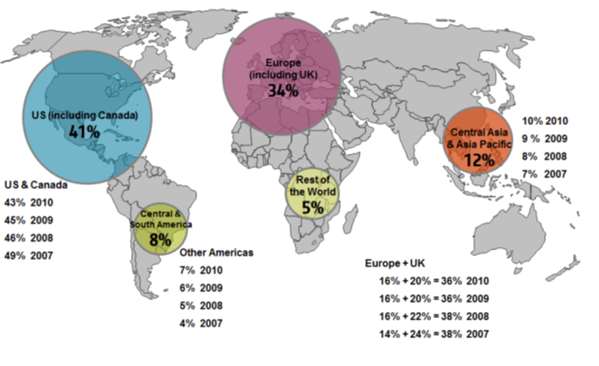
Ll9oyd’s
Lloyd’s Gross Written Premiums (2011)
Lloyd’s is the fifth largest reinsurer in the world
Source: Lloyd’s Annual Report 2011

Slide 10
Latin America
Direct Insurance versus Reinsurance - 2011
Class of Business breakdown - 2011
 | USD (million)
Lloyd's Direct Insurance | 65
Lloyd's Reinsurance | 1,372
Lloyd's Total | 1,437
Lloyd’s 10 | USD (million) | %
Property (D&F) | 606.26 | 42.19
Marine | 231.31 | 16.10
Energy | 205.44 | 14.30
Property Treaty | 148.59 | 10.34
Aviation | 144.35 | 10.05
Casualty | 72.30 | 5.03
Accident & Health | 26.04 | 1.81
Casualty Treaty | 2.16 | 0.15
Overseas Motor | 0.38 | 0.03
Source: Lloyd’s Compare Countries data 2011

Slide 11
Reinsurance Influences
Capital surplus – reinsurers and insurers
Supply and demand gap
Reserve releases / profitability of insurers
Low Interest rates / weak investment returns
Low GDP growth in mature economies / premium impact
Hurricane Sandy / Costa Concordia impact / CAT issues

Slide 12
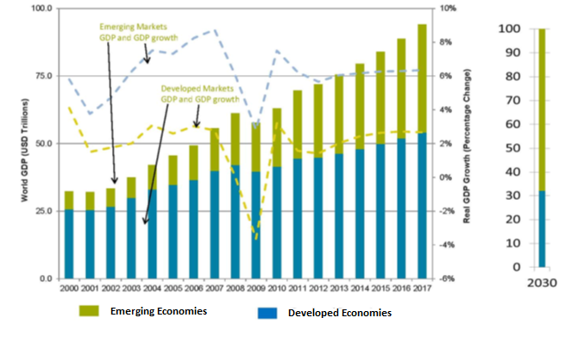
Change in global GDP

Slide 13
Size of Economies

Slide 14
Smaller economic zones are growing faster

Slide 15
Premium Growth in the world
Growth in direct insurance premiums written in major non-life insurance markets and regions
          2011 2012 2013 2014
Developed markets 1.1% 2.0% 2.7% 3.6%
Emerging markets 8.7% 7.8% 7.2% 7.4%
World average 2.3% 3.0% 3.5% 4.3%
Real growth in non-life reinsurance premiums
          2011 2012 2013 2014
Developed markets 5.9% 2.1% 3.7% 4.9%
Emerging markets 15.5% 7.7% 8.5% 7.8%
World average 8.0% 3.4% 4.9% 5.7%
Source: Swiss Re Economic Research & Consulting

Slide 16
Insurance penetration as a % of GDP

Slide 17
Insurance penetration as a % of GDP across Latin America

Slide 18
2012 Events
Superstorm Sandy
Loss is estimated at $20 billion
Modest impact on shareholder funds. Approx. 4%-5%
Less impact on reinsurers than initially anticipated
Some classes were particularly impacted by water damage, e.g. specie,
  power plants
Costa Concordia
$800 million loss
Removal of wreck costs far exceed previous losses
“International Group” Reinsurance programme -
  rate and retention increase

Slide 19
Current Alternatives to Traditional Reinsurance
Traditional reinsurance provides an alternative form of capital
to insurers.
“Syndicated underwriting” / Coinsurance
“Direct” insurers providing capacity
“Reinsurers” bypassing cedents
Sidecars / Special Purpose Syndicate
Insurance-Linked Securities / Cat Bonds
Retentions by cedents / Structure of Reinsurance
Programmes

Slide 20
Trends
Convergence between insurance and reinsurance
Reinsurance profitability in low interest rates world
Expense and efficiency gains
Need to earn a return on equity that exceeds cost of
  capital
Growth and insurance penetration and need for reinsurance support varies around the world
Increased sophistication of models to support business decisions:
        Capital (SII)
        Pricing
        Nat Cat
Impact of alternatives to traditional reinsurance (ILS)

Slide 21
Conclusions

