Slide 1
ICP 17: Capital Adequacy
Conor Donaldson
IAIS Head of Implementation
Santo Domingo, Dominican Republic, 10 April

Slide 2
ICPs, Elements, and Hierarchy
Proportionality Principle
ICP 17

Slide 3
ICPs: Elements & Hierarchy
Insurance
Core
Principle
The “Principle Statement”: the essential elements that must be present in the supervisory regime
Should be adhered to by all insurance supervisors
Basis from which standards are developed
Standard
High-level requirements that are fundamental to the implementation of the ICP
Written as obligations of the supervisor
Linked to specific ICP
Guidance
Supports the core principle and standards and provides additional interpretation or detailed guidance on how to comply with or implement the standard
Does not set out new requirements
Often provides examples of possible ways of implementing the requirements in the standard/principle statement

Slide 4
26 Insurance Core Principles
Supervisory Objectives and the Supervisor
ICP 1- Supervisory Objectives
ICP2 – The Supervisor
ICP 3 – Info. Exchange and Confidentiality
Insurer Licensing, Suitability and Control
Insurer Governance and Internal Control
Supervisory Process, Preventive and Corrective Measures, and Winding- up
Market Conduct and Financial Integrity
Group Supervision, Cross Border Cooperation and Crisis Management
ICP 4 – Licensing
ICP 5 – Suitability of Persons
ICP 6 - Control
ICP 7 – Corporate Governance
ICP 8 – Risk Management and Internal Controls
ICP 9 - Supervisory Review and Reporting
ICP 10 - Preventative and Corrective Measures
ICP 11 - Enforcement
ICP 12 - Winding-up and Exit
Solvency Regime
ICP 13 – Reinsurance
ICP 14 – Valuation
ICP 15 – Investment
ICP 16 - ERM for Solvency Purposes
ICP17 - Capital Adequacy
ICP 18 – Intermediaries
ICP19 – Conduct of Business
ICP20 – Public Disclosure
ICP21 Countering Fraud
ICP 22 - AML – CFT
ICP 23 - Group Wide Supervision
ICP 24 - Macro prudential Surveillance
ICP 25 - Supervisory Cooperation and Coordination
ICP 26 – Cross Border Crisis Management
Thematic Organisation of ICPs

Slide 5
ICPs: Proportionality Principle
Understand the objective of the supervisory measure
Not go beyond what is necessary to achieve the objectives
Tailored to the nature, scale and complexity of individual insurers and of the insurers’ business/risks (and potential risks)

Slide 6
ICP 17: Principle
Capital adequacy requirements
To absorb insurer’s significant unexpected losses
To provide for degrees of supervisory intervention

Slide 7
ICP 17: crucial standards
Regulatory capital requirements
Total balance sheet approach
Different degrees of intervention
All relevant and material categories of risk addressed
The use of internal models
Capital resources
Criteria for assessing the quality and suitability of capital resources

Slide 8
Total balance sheet approach
Determination of an insurer’s capital for solvency purposes should be based upon all assets and liabilities, as measured in the regulatory balance sheet of the insurer, and the way they interact (i.e., determination of capital takes account of both asset-side and liability-side risks).
TBSA
Assets
Liabilities
Regulatory capital requirements
Capital resources

Slide 9
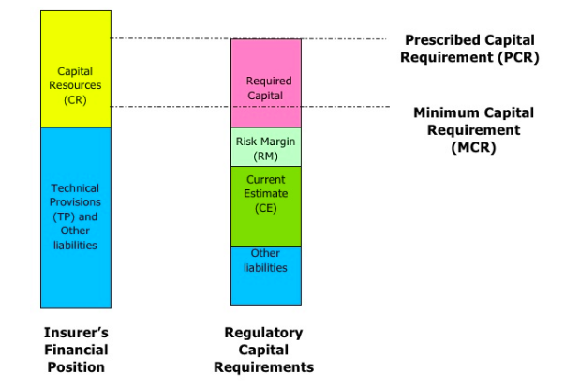
Solvency control levels and regulatory capital requirements

Slide 10
Different degrees of intervention
Compliance with PCR
Breach of PCR
Breach of MCR
No supervisory intervention
Supervisory intervention
Restore capital resources or reduce the level of risk
Stronger supervisory actions
Stopping the insurer’s activities, withdrawal of the insurer’s license, requiring insurer to close new business and run-off portfolio

Slide 11
All relevant and material categories of risk addressed
Dependencies and interrelations between risks
Allowance for risk mitigation
Transparency in recognition of risks in regulatory requirements
Treatment of risks difficult to qualtify

Slide 12
Internal models
Full or partial internal model
Prior supervisory approval
Documentation
Use test
  IM fully embedded into the insurer’s risk strategy and operational process
  Board and Senior Management have overall control of and responsibility for the construction and use of IM for risk management purposes

Slide 13
Conclusions
Significant interdependencies between ICPs
Important to consider market setup, preconditions, and supervisory objectives in establishing requirements
  DO NO MORE THAN NECESSARY TO ACHIEVE THE OBJECTIVE
ICP 17 establishes high level requirements for capital adequacy, but also need to think about
  Reinsurance
  Valuation
  Investment
  Enterprise Risk Management

Slide 14
Contact information
Conor Donaldson
Head of Implementation
International Association of Insurance Supervisors
Centralbahnplatz 2 c/o BIS
tel: +41 61 280 8602
mobile: +41 76 350 8602
Skype: conordonaldson
e-mail: conor.donaldson@bis.org

