Slide 1
SESSION 6–
ICP 17: Capital Adequacy
Eric A. Cioppa
NAIC President-Elect
Superintendent, Maine Bureau of Insurance
April 10, 2018
ASSAL

Slide 2
U.S. Solvency Framework
Regulatory Reporting, Disclosure and Transparency
  Heavy emphasis on reporting and disclosure
  Used in the continual assessment of risk
  Standardized reporting allows comparability
  Drive offsite and onsite monitoring
  More information requested when needed
  Used with internal company information
Off-Site Monitoring and Analysis
  Assess on an on-going basis the financial condition of the insurer (quarterly)
    Identify/assess current and prospective risks
    Automated financial analysis tools
    Use any information to help understand the company and its actions (SEC filings, market conduct reports, rate and policy form filings, consumer complaints, rating agency reports, media)
    Used to determine need for, and scope of, targeted exams
    Continual loop between analysis and exam
On-Site Risk-Focused Examinations
  Full scope exam performed at least once every 5 years
  Focus on the ability of company controls and processes to limit current and prospective solvency risk
  Include a review of corporate governance and ERM processes
  Develop detailed findings and recommendations to communicate to company and to assist in ongoing analysis process
  If issues exist, more frequent full scope or targeted exams occur

Slide 3
U.S. Solvency Framework
Reserves, Capital Adequacy and Solvency
  Requirements in place for insurers to utilize credentialed actuaries to issue
  an opinion on the company’s reported reserves
  Deficient reserves /rapid growth/underpricing=50% of insolvencies (P&C and health)
  PBR effective 1/1/17 for about 20 companies, another 150 expected 1/1/20, could change this
  Historically life reserves overly conservative
  XXX/AXXX created reserves 3 to 4 times cash flows/GAAP reserves
  Resulted in the creation of captives, however, less of an issue that elimination of the products, which is occurring in other countries where requirements are too stringent
  Risk-Based Capital (RBC) requires capital based upon the specific risks of the insurer
  (asset, underwriting, reserving) as opposed to fixed dollar amounts (which still exist as
  minimum start-up capital)
RBC Ratio | Action Level | Description
>301% 201% - 300% | No Action Required Trend Test Level | N/A Act as if CAL triggered
151% - 200% | Company Action Level (CAL) | Company submits an RBC Action Plan
101% - 150% | Regulatory Action Level | Commissioner may order specific corrective actions
71% - 100% | Authorized Control Level | May place insurer under regulatory control
≤70% | Mandatory Control Level | Must place insurer under regulatory control

Slide 4
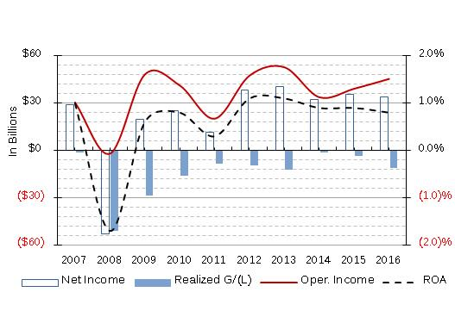
Life Industry Net Income,
Realized Capital G(L), Operating Income, ROA

Slide 5
Capital & Surplus, ROE

Slide 6
Life RBC
AGGREGATED Life RBC DATA
 |  | YR2016
# OF COMPANIES FILED RBC |  | 718
AUTHORIZED CONTROL LEVEL RBC (AFTER DIVERSIFICATION) |  | 53,371,992,970
Total C0 (Asset risk-affiliates) |  | 19,961,695,520
Total C1CS (Asset risk-common stock) |  | 26,649,848,001
Total C1O (Asset risk-Other) |  | 42,489,721,515
Total C2 (Insurance risk) |  | 24,540,625,751
Total C3a (Interest rate risk) |  | 15,229,088,812
Total C3c (Market risk) (C3b not listed as immaterial for health credit risk) |  | 2,208,998,999
Total C4a (Business risk) |  | 7,747,940,544
Total C4b (Business risk Admin Expenses) |  | 649,189,658

Slide 7
U.S. Solvency Framework
Regulatory Control of Significant, Broad-based Risk-related Transactions/Activities
  Certain significant broad-based transactions require separate treatment
    Licensing Requirements – Gateway to business
    Investment Limitations – Risk to company’s assets
    Change in Control - Can impact strategy & direction
    Extraordinary Dividends – Release of capital
    Transactions with Affiliates – Subject to abuse
    Reinsurance – Often material and subject to abuse
Preventive and Corrective Measures, Including Enforcement
  In addition to authority granted through RBC, U.S. supervisors have broad authority to require corrective action when a hazardous condition is identified
  Corrective examples include:
    Requiring the insurer to file interim financial reports
    Reducing, suspending or restricting the volume of business being accepted or renewed by the insurer
    Limiting or withdrawing the insurer from certain investments or investment practices
Exiting the Market and Receivership
  Receivership law examples include:
    Mergers, acquisitions, reinsurance
    Arrangements, non-renewal of part or all of the insurer’s book of business
    Allowing the insurer to be placed in run-off mode under its own management
    Priority of claims and guaranty funds

Slide 8
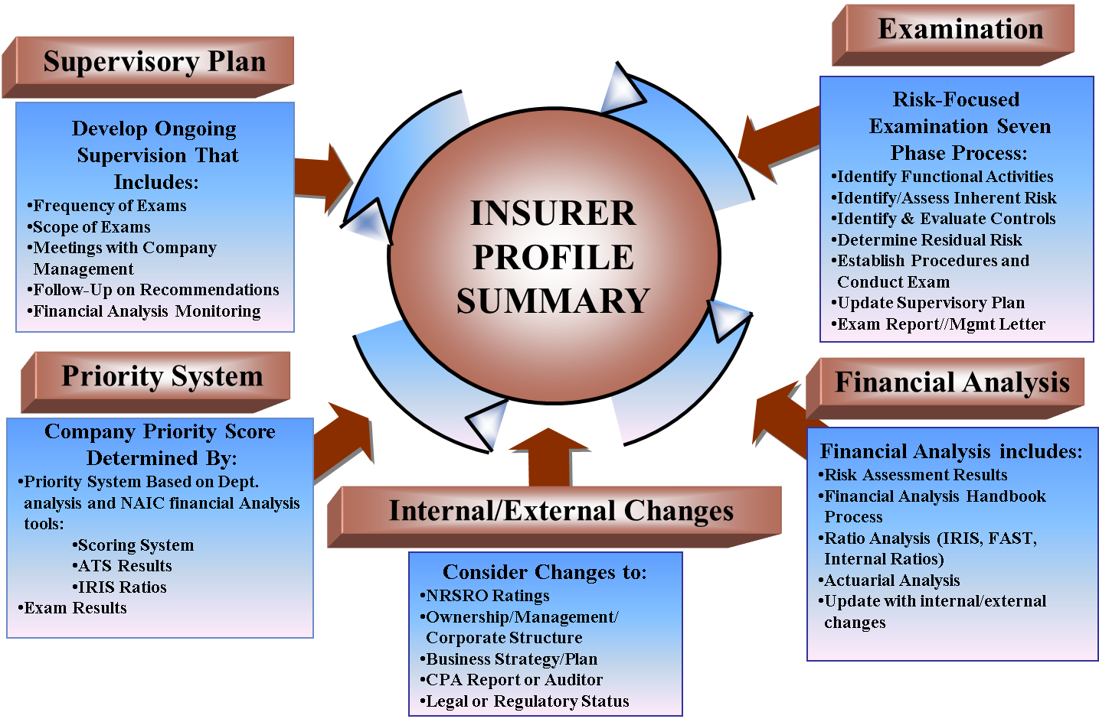
Risk-Focused Surveillance

Slide 9
Solvency Monitoring Activities
All U.S. Insurers
~ 4,600 entities
Subject to:
AS & Supplemental Filings
RBC Reporting/Requirements
FAST Review
Level 1 Analysis
IPS & Supervisory Plan
Insurers Exceeding Premium Thresholds
~ 2,000 entities
Subject to:
ORSA Reporting & Analysis
Enhanced Audit Requirements
Nationally Significant Insurers
~ 1,400 entities
Subject to:
Additional review, analysis and consideration through FAWG process
Insurers Undergoing Examinations
~ 1,150 entities
Subject to:
Review & Assessment of CG/ERM
Review of Critical Risks
Reporting Findings
Troubled/Potentially Troubled Insurers
~ 200 - 400 entities
Subject to:
Detailed FAWG Review
Discovery Meetings
Presentations and Reporting
Insurers Seeking Approval for Transactions/Events
~ 2,300 entities
Subject to:
Regulatory Review of Licensing, Acquisitions, Dividends, Affiliate Agreements, Reinsurance Contracts, Product/Rate Filings
Accreditation Review of Solvency Monitoring
~ 120 entities
Subject to:
Review of exam/analysis and licensing work by a team of independent experts
Peer Review of Solvency Monitoring
~ 30 entities
Subject to:
Review of analysis/exam work by teams of peers

Slide 10
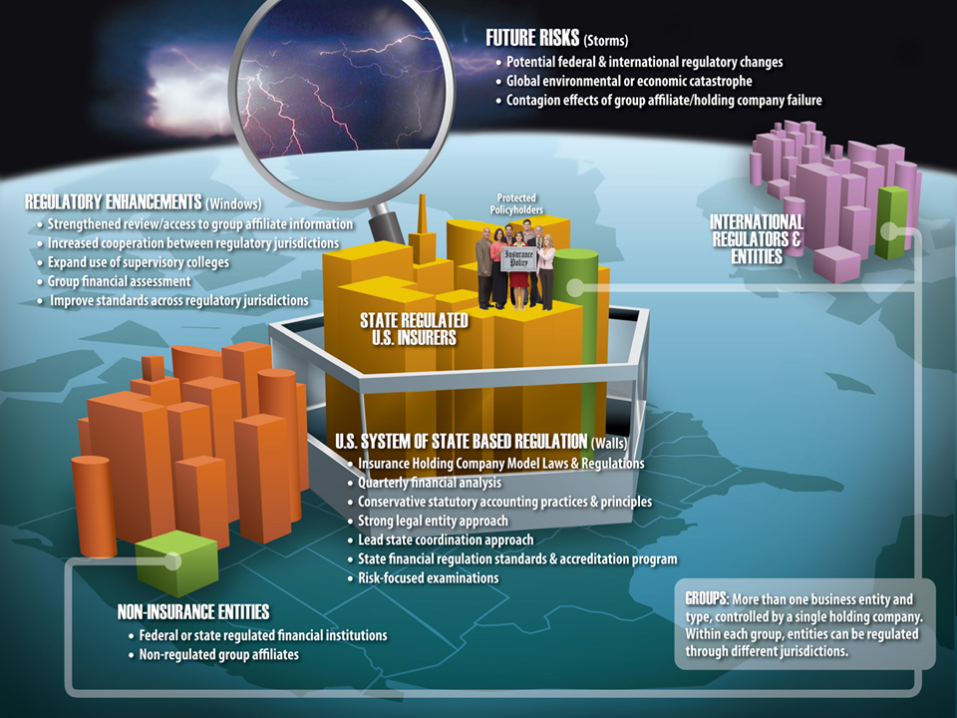
Group Supervision

Slide 11
Group Capital Calculation
In late 2015, the NAIC began exploring potential approaches to a Group Capital Calculation (GCC) rooted in the national system of state-based insurance and in 2016, formed the Group Capital Calculation (E) Working Group.
RBC – Basis for the calculation will use a risk-based capital aggregation methodology.
    An inventory method will be used that provides for a carrying value and capital requirement amount for each entity in the group.
Additional regulatory tool - The GCC is not intended to be an ICS or group capital requirement, but is a tool for regulators and may help inform such discussions and developments.
Goals and objectives of the GCC:
  Valuable analytical tool to complement the US’ current holding company analysis.
  Assists the group supervisor in monitoring the overall financial flexibility and strength of the group as a whole.
  Quantitative measure to be used by regulators in conjunction with group-specific risks and stresses identified in ORSA and Form F filings that may not be captured in legal entity RBC filings.
Scope of the GCC – Initially will include all legal entities within the group. Once calculation is developed, the Working Group may consider if it is not appropriate for certain groups and entities within the group.
GCC Timeline:
    Tentative timeline has been established, but no strict deadlines at this point
      The timeline includes two iterations of field testing in order to evaluate and fine-tune the calculation
    The tentative timeline anticipates the GCC being implemented during 2019 or 2020, after referral to the appropriate NAIC groups for incorporation into the NAIC toolkit

Slide 12
ORSA
The NAIC Risk Management and Own Risk and Solvency Assessment Model Act (RMORSA) went into effect January 1, 2015.
Two primary goals
  Foster effective level of ERM for all insurers
  Provide group-level perspective on risk and capital
Principle-based requirements
Implementation
  ORSA Model has been adopted by nearly all U.S. jurisdictions and nationwide adoption is expected by the end of 2017
  U.S. is requesting the group-ORSAs filed with foreign group-wide supervisors to gain deeper understanding.
2017 ORSA Findings
  More than 300 reports expected in total (approximately 200 at group level, 100 legal-entity only), excluding international premium data
  ORSA provides new and valuable information for U.S. regulators
  ORSA forces insurers to be more disciplined around risk management

Slide 13
Any Questions?

