Slide 1
Regulating for innovation: Encouraging responsible digital innovation
Regional Seminar on Training for Insurance Supervisors of Latin America ASSAL-IAIS
Stefanie Zinsmeyer, 22 October 2018

Slide 2
Digital technologies are changing the way financial services are delivered.
2

Slide 3
Digital innovations impact all parts of product cycle
Product development
Sales
Premium collection
Servicing and Risk management
Claims processing
Behavioural data from sensors used in risk assessment and pricing
Chatbots for personalised and efficient sales
Flexible payments and coverage updates via SMS
Nudges and rewards for less risky behaviour
Aerial images for accurate claims
Voice and facial analytics for detecting fraud
© 2017 Cenfri | Regulating for innovation
3

Slide 4
…and challenge the very foundation of insurance
What is insurance?
What can I regulate?
Who is an intermediary?
P2P models without a licensed risk carrier
Models operating outside national jurisdiction
Use of cryptocurrency
New players that don’t fit in traditional broker or agent categories
Robo advice and black box algorithms
© 2017 Cenfri | Regulating for innovation
4

Slide 5
… increasingly data is collected and shared among partners
internal
external
Product
dev
Sales
Premium collection
Servicing &
Underwriting
Claims
Mobile money data
Smartphone data
Social media data
Sensor (IoT) data
Government (open) data
Credit history
Image (meta)data
Transactional (financial)
Customer interviews
Information provided on sign-up
Complaints and call centre data
Psychometric data
Survey data
Biometric identifiers
Call detail records (CDR) and airtime
Satellite/aerial imagery
Credit bureau data
Geographic Information Systems (GIS)
Data types
Source: Hunter et al. (forthcoming)
5

Slide 6
For supervisors, digitalisation presents a “moving target in a moving environment”
6

Slide 7
Supervisory issues
1. New tools
SupTech solutions
Supervisors need to become data driven.
Interdisciplinary
supervisory teams
2. Supervisory capacity and skills
Different skills-set needed.
3. Supervisory cooperation
Cross-supervisory, cross-jurisdictional cooperation
Increasing interconnectedness
Innovations do not stop at borders.
Source: Consultation Draft IAIS Issues Paper on the Increasing use of digital technology in insurance and its potential impact on consumer outcomes, July 2018

Slide 8
Supervisory issues II
4. Regulatory arbitrage
Flexible regulation
Speed of technological innovations & new players and cross-border nature.
Cyber-security & Data-protection
5. Information Security
Storage, protection and third party use of customer data.
Source: Consultation Draft IAIS Issues Paper on the Increasing use of digital technology in insurance and its potential impact on consumer outcomes, July 2018 and Author’s own

Slide 9
Key consumer data risks affecting the insurance industry
Drivers
Failure of controls
Error
Data breaches
Obstructed consent
Unauthorized collection, storage and use
Negative consumer outcomes
Loss of privacy & financial loss
Lack of safety and security
Financial exclusion
Lack of value
Manipulation
Source: Based on IAIS (2016), IAIS (2018a), IAIS (2018b), Institute of Actuaries of Australia (2016), McKee et al. (2015), The Smart Campaign (2016), The World Bank Group (2017), BaFin (2018) and stakeholder interviews (2018)
9

Slide 10
In emerging markets digital technologies can help to provide access and to advance financial inclusion
10

Slide 11
Supervisors have an important role in supporting stable market growth
Support sustainability of the market
Ensure that providers can meet financial commitments
Ensure that customers are treated fairly (especially important for first time consumers)
Help build market trust and confidence
Help grow the insurance market
Develop proportionate and flexible regulations
Take steps to encourages providers to enter the market

Slide 12
…. whilst protecting consumers
Digitally enabled inclusive insurance products are often the first experience of insurance and will have a big impact on future growth of the market

Slide 13
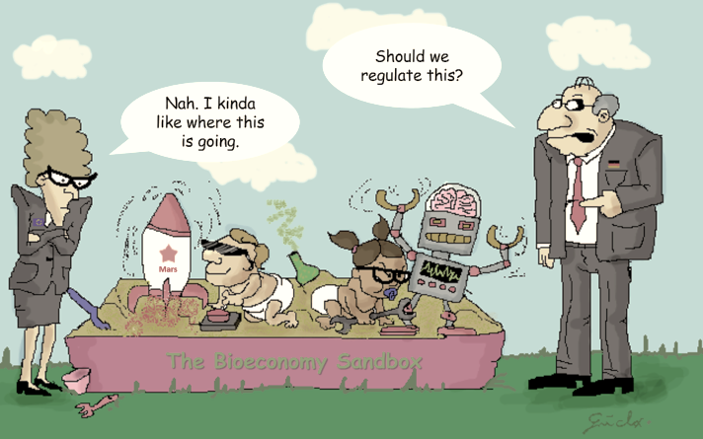
Regulatory sandbox is only one option
13
https://bioeconomy-conversation.com/2018/02/19/the-bioeconomy-sandbox/

Slide 14
Critical considerations
Coordination
Innovations often cut across authorities
Capacity
Required for monitoring, advice, understanding risks
Recruit and train for skills appropriate to the changing nature of the sector!
Objective
Tools implemented need to address the actual challenges faced by innovators in the market.
Consult with market players to understand primary challenges faced
© 2017 Cenfri | Regulating for innovation
14

Slide 15
14th Consultative Forum
… more at:
“InsurTech: rising to the regulatory challenge”
24 October 2018
Buenos Aires, Argentina
Hosted by
14

Slide 16
Thank you! Follow us on Twitter @a2ii_org, @StZinsmeyer, Youtube and LinkedIn

