Slide 1
Case Study - Causes of Insolvency
ASSAL Conference
Nov. 20, 2014
David Altmaier
Florida Office of Insurance Regulation

Slide 2
7 Typical Causes of Insolvencies
Deficient Reserves
Rapid Growth/Inadequate Pricing
Fraud
Investment Problems
Problems with Affiliates
Catastrophic Losses (Property)
Reinsurance Problems
50%+
Notes:
There are many cause of insurer insolvencies, but this slide lists the top 7 causes of historical insurance company failures in the U.S., based on data tracked and reviewed by AM Best. Deficient Reserves is the leading cause of insolvency followed by inadequate pricing and rapid growth. These causes account for over half of all historical insurer insolvencies in the U.S. The other 5 causes of insurer insolvencies represent between 3 and 10% of historical insurance company failures.

Slide 3

General Considerations
Common Insolvency Risk Indicators:
Unstable operating results
Material changes in writing
Changes in ownership/management
Audit concerns
Actuarial concerns
Increase in consumer complaints
Notes:
This slide provides a list of the more common general measures for monitoring the day-to-day operations of an insurer. When problems are identified in any one of these areas, it can be a sign of potential trouble that may require greater investigation. Let’s look at a few examples.

Slide 4

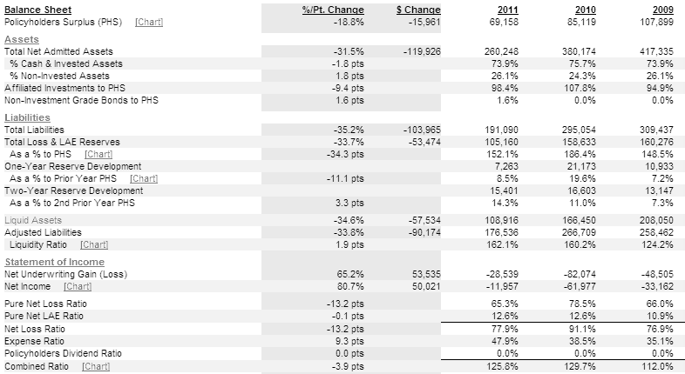
Unstable Operations
Notes:
Here is a good example of unstable operations. The insurer experienced adverse loss reserve development, unprofitable operations, poor liquidity, and declining capitalization, among other issues.
These signs all point in the wrong direction. An analyst would want to uncover the root cause of this insurer’s troubles.

Slide 5
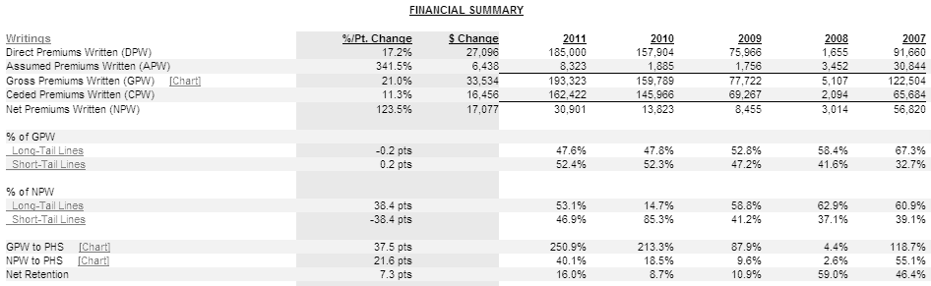
Material Changes in Writing
Notes:
In this example you see a steady rise in DPW while APW have declined leading to overall growth in GPW of about 58% over the past five years. In this example it is important to understand what is going on with the direct and assumed premiums, why have they made changes in how they produce business. Looking further we see that cessions have risen more than 147% over the past five years so we also need to understand what changes have taken place with regard to their reinsurance. Below the premium written section you see the resulting fluctuations in all the related ratios.

Slide 6

Changes in Ownership/Mgmt
Notes:
Here you see an insurer that has replaced a significant amount of its officers and directors. The pound signs indicate change and are a tip to investigate the reasons for the shift in management. Frequently, this type of information can be found in the Notes to Financial Statements. On occasion these changes in management can be the result of a merger or consolidation which may lead you down a different path of analysis.

Slide 7
Audit Concerns
Also in our opinion, the Company did not maintain, in all material respects, effective internal control over financial reporting as of December 31, 2008, based on criteria established in Internal Control - Integrated Framework issued by the Committee of Sponsoring Organizations of the Treadway Commission (COSO) because a material weakness in internal control over financial reporting related to the accounting and disclosure of insurance policy benefits, amortization expense, the liabilities for insurance products and the value of policies inforce at the Effective Date existed as of that date. A material weakness is a deficiency, or a combination of deficiencies, in internal control over financial reporting, such that there is a reasonable possibility that a material misstatement of the annual or interim financial statements will not be prevented or detected on a timely basis. The material weakness referred to above is described in Management's Report on Internal Control Over Financial Reporting appearing under Item 9A. We considered this material weakness in determining the nature, timing, and extent of audit tests applied in our audit of the 2008 consolidated financial statements, and our opinion regarding the effectiveness of the Company's internal control over financial reporting does not affect our opinion on those consolidated financial statements. The Company's management is responsible for these financial statements, for maintaining effective internal control over financial reporting and for its assessment of the effectiveness of internal control over financial reporting included in management's report referred to above.
/s/ PricewaterhouseCoopers LLP
Notes:
This slide shows you a qualified audit opinion that the insurer did not maintain an appropriate level of internal control, indicating a material weakness in accounting and reporting of insurance policy benefits, amortization expense, the liabilities for its insurance products and the value of its policies in force.
Lets move on to concerns by the actuary.

Slide 8
Actuarial Opinion Concerns
OPINION
In my opinion, based on the foregoing procedures, the Company's December 31, 2002 statutory-basis loss and loss adjustment expense reserves identified herein:
Do not make a reasonable provision in the aggregate for all unpaid losses and loss adjustment expenses, gross and net as to reinsurance ceded, under the terms of the Company's contracts and agreements.
Are not consistent with reserves computed in accordance with standards and principles established by the Actuarial Standards Board.
Do not meet the relevant requirements of the insurance laws.
Notes:
This example outlines an insurer that reported loss reserves that do not make for a reasonable provision. Over the past 20 years I have only seen a couple actuarial opinions with a statement like the one in this slide.

Slide 9
Consumer Complaints
By Year
Year | Number of Complaints | Percent of Change
2011 | 973 | 23.79%
2010 | 786 | 26.57%
2009 | 621 | 41.78%
2008 | 438 | 33.94%
2007 | 327 | 26.74%
2006 | 258
Notes:
This slide shows you an increase in consumer complaints that stemmed from, claims paying issues such as denial of claims, denial of coverage, policy premium changes, or Non-renewal of policy.

Slide 10
1. Deficient Reserves
Reserving Risk – Actual losses or other contractual payments reflected in reported reserves or other liabilities will be greater than estimated
  Focus on reserve estimates and actuarial processes supporting estimates
  Largest risk area impacting most insurers
Notes:
Now that we’ve covered some of the warning signs that companies in potential trouble may demonstrate, I’d like to talk a little more about each of the most common causes of company failure in the U.S. On an earlier slide, I indicated that deficient reserves were the leading cause of insurer insolvencies. We will talk more about the causes of that in a moment, but lets start by simply talking about reserving risk.
We have our definition on this slide which is self explanatory. The risk is that losses will be larger than expected leading to deficient reserves. This reserving risk is basically driven by uncertainty. We note in the slide that the focus to address this risk is on the reserve estimates, since that is the mechanical process that leads to the uncertainty. This risk is of the utmost importance to U.S. regulators as there is a great deal of room for assumptions, methodologies and estimates to impact the reserves calculated by the insurer and certified by its appointed actuary in the U.S. reserving requirements, particularly for P&C insurers.
We will however talk in the next couple of slides about those things that directly correlate to deficient reserves. But first, lets expand a bit more on our earlier discussion about general lines of business.

Slide 11
1. Deficient Reserves
Reserving risks vary significantly based on industry type:
Life/Annuity Reserves | P&C/Health Reserves
Largely based on policies in force | Largely based on historical claim results
Long-term in nature | Typically shorter-term in nature
Significantly impacted by interest rate changes | Significantly impacted by catastrophic events or changes in frequency/severity
Subject to significant risks related to asset/liability matching & liquidity | Subject to significant risks related to reinsurance coverage
Notes:
This chart addresses factors that play into our previous comments about life/annuity and P&C/health reserves. Until pending reserve changes for life products in the U.S. are implemented (known as principle-based reserving), the current reserving process generally results in fairly conservative reserves from the standpoint that the payments are generally not larger than anticipated compared to estimated reserve liabilities.
We should be clear though that life products are not without risk in the U.S. system. The biggest risks tend to result from the potential change in interest rates or other economic factors such as equity returns or from the potential that the liabilities are more easily called upon if the product is more like an investment product.
Although this risk exists, its not one that has occurred very frequently. Technically, the issue isn’t really an issue of reserves, but rather the potential that the product causes assets to be drawn sooner.
For non-life products, health products tend to be less risky because the risk is much more known. This may be attributable to the very short-term nature and how the products can and are re-priced every year. However, at one time in history there were longer-term products on traditional group accident and health. And it lead to underpricing and reserving issues which is easily explained from the standpoint that medical inflation which can be an extremely difficult risk to estimate.
That risk still affects other health products today and likely will for the foreseeable future, but historically that uncertainty has been smaller than within property casualty. Most of that can be attributed to the lower frequency but much larger severity factor that occurs with these lines.

Slide 12
1. Deficient Reserves
Causes of Deficient Loss Reserves:
  Lack of sufficient expertise
  Lack of sufficient historical data/trends
  Unchallenged reserve methodologies
  Known misstatement
  Consideration of exposure to catastrophe
  Consideration of line of business
Notes:
Lets talk now about the common causes of deficient loss reserves. As we indicated, U.S. reserves are based on estimates.
As we have previously suggested, reserves for many types of losses or claims are difficult to estimate because the policy benefits are not fixed, may be subject to negotiation, or may be subject to determination by the courts. Estimation of reserves is also difficult because the claims may not be settled or closed until an unknown future date and the ultimate cost of the claims may be subject to future events. Because of the complexities involved in the reserve estimation process, a high degree of expertise and informed judgment are required to establish adequate reserves. Most insurers rely on actuaries or individuals with actuarial training to assist in estimating reserves.
Many cases of inadequate reserving are associated with improper, inadequate or incomplete data. Analytical techniques cannot overcome such a basic shortcoming as data deficiencies. A new insurance company or an insurance company writing new lines of business often will not have sufficient loss development data to reasonably estimate its loss reserves. The use of data for similar types of business may not always be an appropriate basis for determining reserves because the business of the specific company may differ from the industry average.
Loss reserving is a dynamic process. Adequate reserving requires the use of appropriate projection methods for estimating reserves and it requires procedures to regularly verify the validity of earlier estimates by comparison to actual experience. Reliance on historical trends without considering adjustments to reflect current circumstances may very likely lead to incorrect conclusions.
When circumstances that were reflected in the historical database are not expected to recur in the future, the appropriateness of a historical-based methodology should be challenged. Also, changes in circumstances may be frequent enough that previous methodologies are rendered inappropriate. Accordingly, the appropriateness of a methodology should be challenged in each analysis of loss reserving methodology. Failing to do so could result in under-reserving and risk of insolvency.
In some cases, under-reserving may be the result of a deliberate misstatement of reserves to achieve some financial reporting objective. For example, an insurer who knowingly reported reserves on the low end of the scale that writes business in an area prone to catastrophe’s (such as hurricanes or wild fires) may face solvency concerns.

Slide 13



1. Deficient Reserves
Insurer Insolvencies
  Paula Insurance Company
  Atlantic Mutual Insurance Company
  Majestic Insurance Company
Notes:
Lets look at a couple of examples
Paula Insurance Company, a workers’ comp writer became insolvent due to deficient loss reserves. The Company reported deficient reserves totaling $37 million for accident years 97 to 99 on its California workers’ comp line of business. The deficient reserves pushed the company into RBC Mandatory Control Level which led to state supervision and eventual liquidation.
Another example is 173-year old Atlantic Mutual Insurance Company, which survived paying claims on the Titanic. The Company was put into liquidation in April 2011 due to declining surplus caused by severe loss-reserve development in its commercial lines business, primarily workers’ compensation and general liability.
And my last example, Majestic Insurance Company, did not go into liquidation, however, was placed in conservation in April 2011. At the end of 2010, Majestic reported capital and surplus of approximately $58 million. However, a reserve deficiency of more than $46 million was recorded. “After increasing reserves to appropriate levels, the company's surplus dropped to $11.5 million, an amount that is too low to permit the company to continue operations outside the protection of a formal conservation”. As part of the conservation, Majestic’s insurance liabilities and certain assets were transferred to AmTrust North America, Inc.

Slide 14
1. Deficient Reserves
U.S. Reserve Analysis Tools
  Financial Statement Pages
  IRIS Ratios
  Scoring System
  Financial Profile Report
  Loss Reserve Projections
  Bright Line Indicator
Notes:
What can be done by regulators to prevent concerns that exist because of poorly established reserves?
What most experienced regulators say is that unless you try and put a zero failure system in place where you require so much capital that its impossible to fail, potential insurer reserve deficiencies are a fact and potential issue. If one did try and put a zero failure system in place, its likely that you would essentially scare away any incoming capital to the industry because insurers couldn’t provide the return that investors demand on such capital. It would also raise the cost of insurance significantly making insurance unaffordable to many. Therefore, it’s a balancing act and we simply have to recognize that it’s a high risk area for many insurers.
But, its not as if nothing can be done to address the risk. Because it’s a potential high risk area for so many insurers, regulators can and should monitor various issues to try and catch the issue as soon as possible in order to minimize the impact on policyholder. That process of monitoring is what we are going to spend a fair amount of time on. There are a number of different tools that I am going to walk you through.
First the insurer’s financial Statement Pages, IRIS Ratios, Scoring Ratios, the financial profile report, Loss Reserve projections and the Bright Line indicator report are all tools that can be utilized for monitoring insures reserves.
Of course these are all simply methods of monitoring issues. I believe most analysts and examiners recognize that these are the means for monitoring, and ultimately any action taken on reserves is frequently the result of an examination of the reserves. When we are discussing these tools, please recognize this fact, but also recognize that the tools can be helpful in allowing state’s to monitor the risk.
Let’s take a look at each of these tools in more depth.

Slide 15
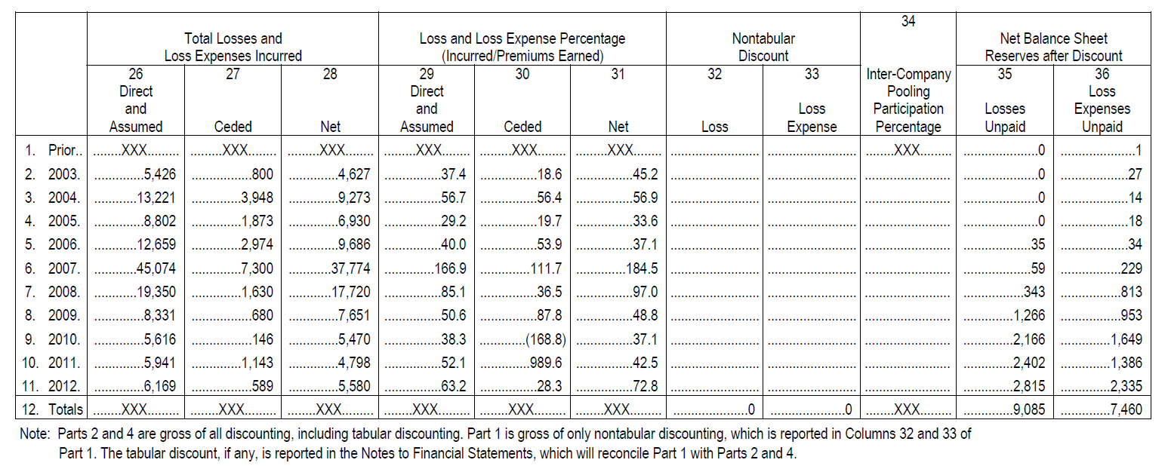
1. Deficient Reserves
Financial Statement Pages
Schedule P – Part 1
Notes:
On this slide you see an example of financial statement page data that is collected in the U.S. to allow us to analyze reserves held by a P&C insurer.
Schedule P Part 1 Tier 3 summarizes the data reported in tier 1 and 2 and provides the incurred amounts.
Part 1 of the Schedule P can be utilized by regulators:
-To review the loss and LAE ratios to determine any fluctuations between loss years
-and to find any large variances between an insurer’s loss and LAE ratios and the industry loss and LAE ratios.
For example, the Company in the slide reported a large fluctuation in loss and loss expense ratio for years 2007 and 2008. One could review Schedule P part 1 by line of business to determine which line(s) are responsible for the elevated loss and LAE.
So thinking back to our opening comments about reserves, we emphasized the estimation process. The point here is that a large fluctuation from one period to the next is obviously a sign that something within either the pricing or the estimation process has caused a large spike.
The analyst can try and narrow it down to a line of business, but many times it will need to be narrowed down to specific causes by discussing the results with the company. Its highly possible that the analyst may ask the examiner to perform such work. Therefore its important for the examiner to be able to understand the potential implications for that examination work and the potential solvency impact.
(11260)

Slide 16
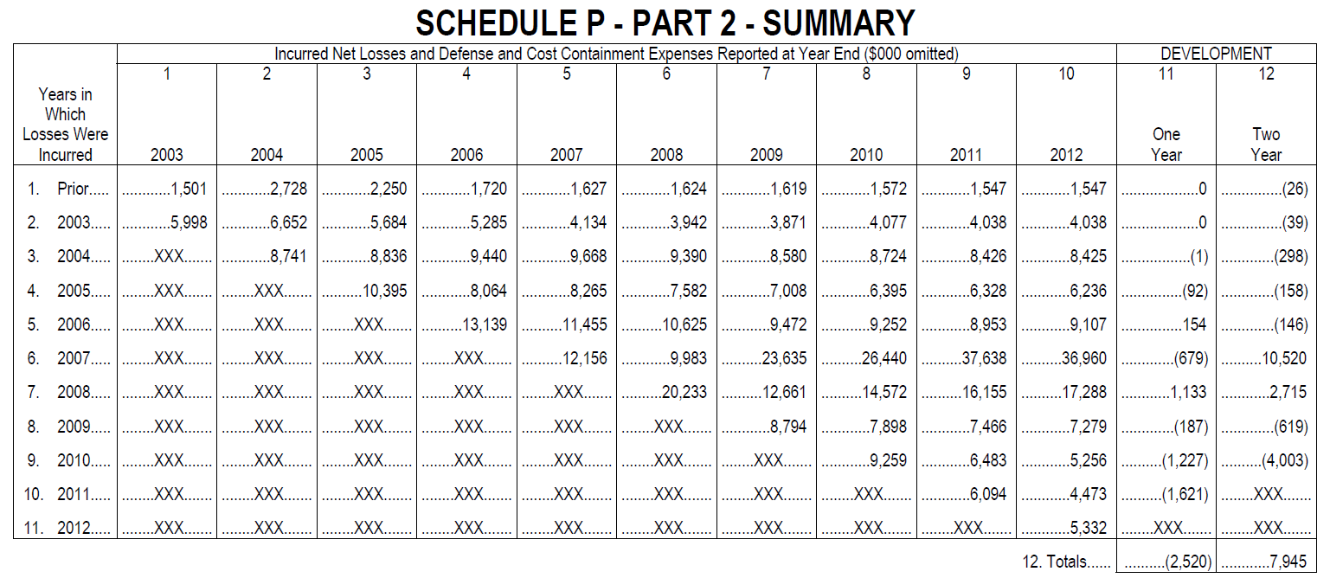
1. Deficient Reserves
Financial Statement Pages
Notes:
Schedule P Part 2 provides a history of incurred losses and defense & cost containment expenses.
This section of the Schedule P can be used by regulators to determine an insurer’s one-and two-year reserve development.
As an example, you can see that this Company is reporting adverse two-year development on accident years 2007 and 2008. This is the same insurer that was shown in the Schedule P Part 1 example. So the reserve development is consistent with the fluctuations discovered in the Part 1.
A regulator would want to review the Schedule P Part 2 by line of business to determine which line(s) the development has occurred. Clearly, what we saw on the previous slide has a real impact, as this schedule shows the amount of deficient reserves on these particular years. Its possible the analyst may want the examiner to focus on these particular years once the get a better sense of the cause of development from the insurer.
Recognize however that the potential reasons that an insurer may report adverse development includes things such as:
Strengthening
Commutation of ceded reinsurance
Changes in discounting
Increased writings
(11260)

Slide 17
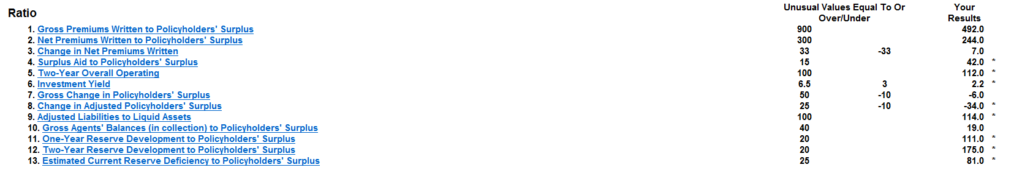
1. Deficient Reserves
IRIS Ratios
Notes:
One of the tools that utilizes the data provided within Schedule P is the IRIS ratios. There is an IRIS ratio worksheet available on I-Site that reports the results of all the IRIS ratios and the usual ranges. If an insurer is reporting a unusual value the result will have an asterisk next to it.
Above is an example of the IRIS ratio worksheet, this insurer reported unusual values for all 3 reserve ratios. In conjunction with the review of these three ratios, it would also be beneficial to review the Financial Statement pages and the Profile to see what additional information can be discovered about the Company’s reserves.

Slide 18
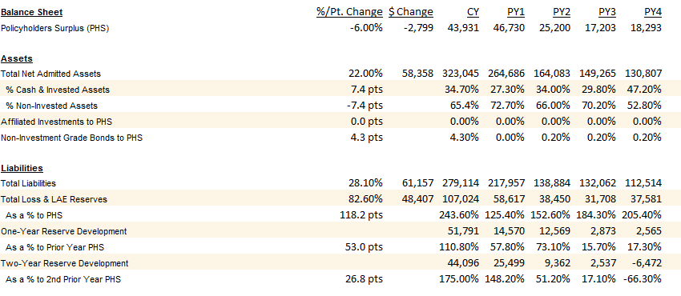
1. Deficient Reserves
Financial Profile Report
Notes:
Highlighted on this slide is the liabilities section of the financial profile report. This report allows U.S. regulators to identify material fluctuations, identify trends and compare data to industry benchmarks.
From this information the company shown has total loss and LAE reserves as a percentage of prior year surplus that is slightly below the industry benchmark at 243.6% . As you can see that the Company reported an 82.6% increase in total loss and LAE reserves from prior year end. Lastly, the company is reporting a trend of one- and two-year adverse reserve development. A quick glance at this report shows there are concerns regarding the insurer’s reserves.
Likely this would lead me to the financial statement, actuarial opinion, MD&A, and other resources to investigate these rather troubling issues.

Slide 19
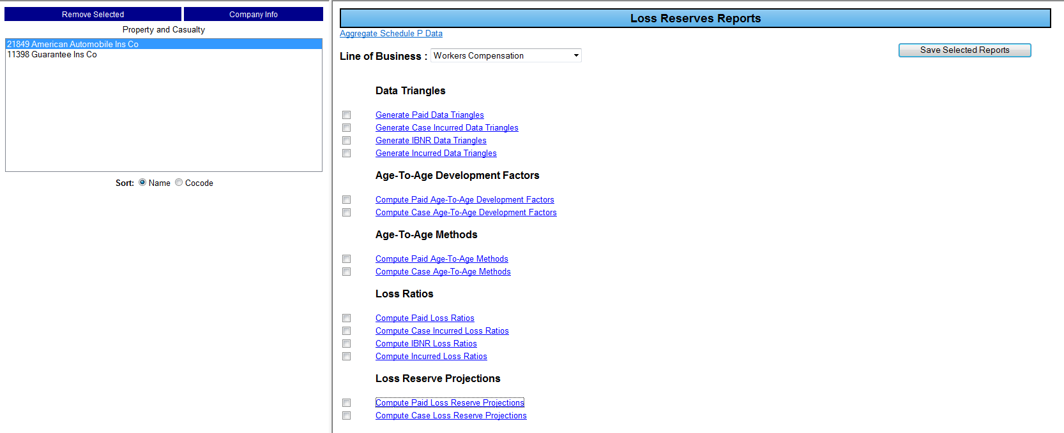
1. Deficient Reserves
Loss Reserve Projections
Notes:
The P/C Loss Reserve projection tools on I-Site gives a regulator the ability to project reserves. The tool projects reserve adequacy or deficiency based on historical experience without considering changes in product design, pricing, claims payment practices, etc. So this is a great tool for when you believe there may be a higher amount of reserving risk.
Note however, if a company has experienced a recent merger or a large block of business has been acquired, the tool should not be used.
And, if unusual results are obtained as a result of the loss reserve analysis performed, the regulator should consider having an actuary review the analysis performed. Again, as much as anything we are simply trying to use different tools to isolate our resources to the area where they are most needed. And if nothing else, the tools provide greater certainty that utilization of an actuary is appropriate.

Slide 20
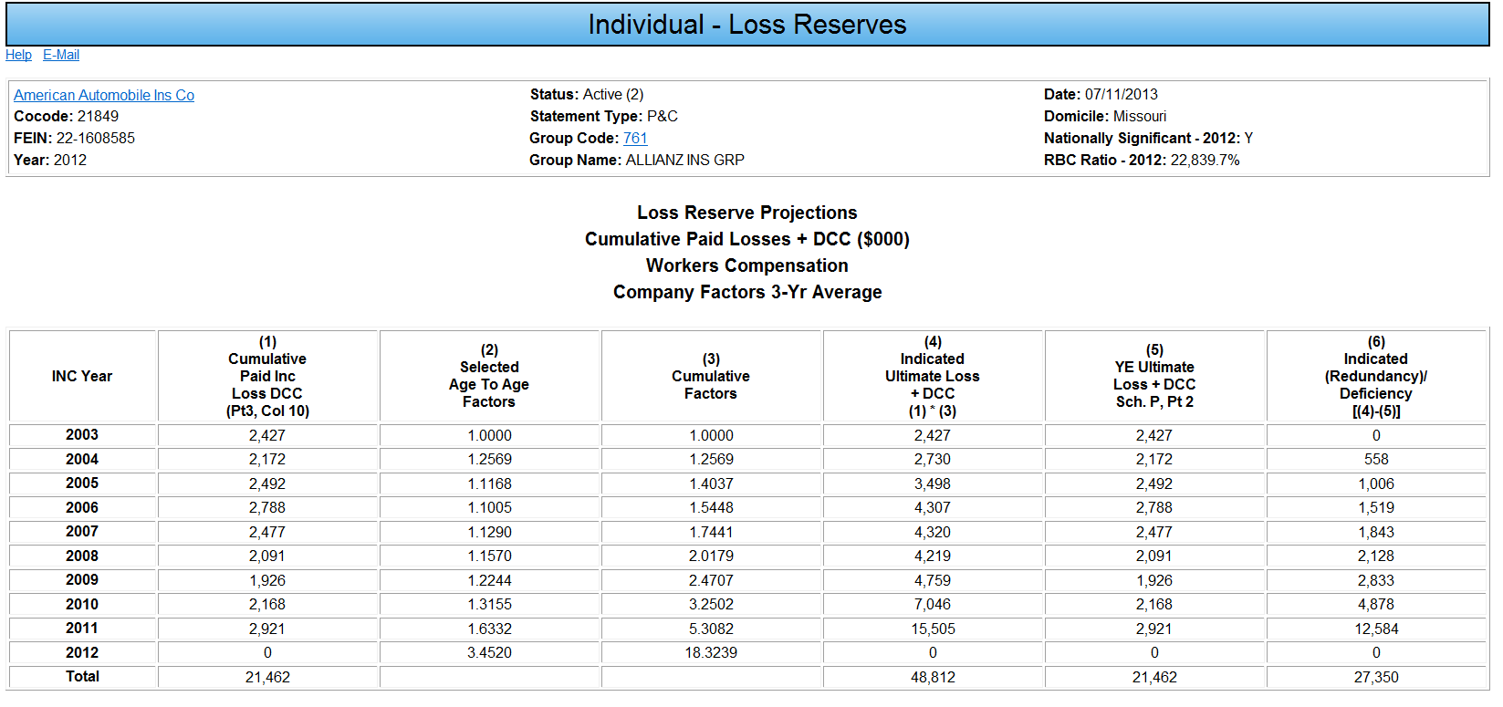
1. Deficient Reserves
Loss Reserve Projections
Notes:
Here is a projection that has been ran for workers comp, using the 3 year average, based on cumulative paid losses.
What are the results of the loss reserve projection?
We see that this insurer’s workers comp loss reserves are deficient by $27.4 million.
Again, this is just an estimate but it might give the analyst a little better idea of issues before involving the actuary.

Slide 21
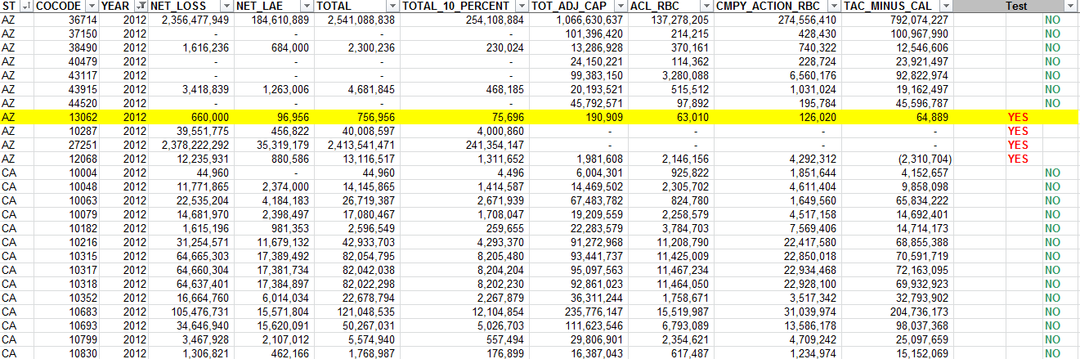
1. Deficient Reserves
Bright Line Indicator Report
  Identifies companies subject to regulatory action (RBC) if reserves were 10% higher.
  Published annually for regulator review
Notes:
The report results take 10% of an insurer’s net loss and LAE reserves and compares it to the difference between the Total Adjusted Capital (TAC) and Company Action Level Capital (CAL) . If 10% of the reserves is greater then the difference between TAC and CAL then the Company would return a yes response in the test column of report. A yes response would indicate that if reserves were 10% higher, the Company would be subject to additional regulatory requirements to address a low surplus level.
The Bright Line Indicator report is published on the NAIC’s State Net page on an annual basis. Obviously this is a very rough tool put obviously its purpose is to help evaluate if the reserve risk is higher. What I think the tool does is takes the concept of leverage and potential solvency impact and combined them together to highlight companies that just given some basic figures, are subject to great risk. Obviously its focusing on those companies that are nearing regulatory action level, so generally the issues on these companies are already known, but it’s a simply effective tool.

Slide 22
1. Deficient Reserves
How to address during analysis/ examination processes:
  Understand industry and risk factors
  Review historical development and perform loss reserve analysis
  Evaluate company processes and controls
  Test the accuracy and completeness of reserve data
  Involve an actuarial expert in the review process
Notes:
All of the tools provide a means for regulators to identify concerns relating to under reserving. However, once a concern has been identified, regulators need to step in and perform additional work to determine whether reserves are truly understated and should be adjusted for regulatory purposes. This slide lists a number of steps that could be performed during off-site analysis or on-site examination activities to determine whether reserves are truly understated and an adjustment is necessary to truly reflect the insurer’s solvency position. Much of this work typically focuses on a review of the company’s internal processes for calculating and recording loss reserve estimates as well as the involvement of a regulatory actuary in reviewing the reserve estimates. If questions regarding a company’s methodology or estimates arise, U.S. regulators will often ask a regulatory or third-party actuary to perform an independent reserve calculation to estimate the company’s required reserves. If the regulatory actuary determines that the carried reserves are understated, U.S. regulators can require the company to adjust their reported financial results to a level deemed appropriate to the regulator.

Slide 23

1. Deficient Reserves

Slide 24
2. Rapid Growth & Pricing
Pricing & Underwriting Risk – Pricing and underwriting practices are inadequate to provide for risks assumed
Rapid Growth Risk - Surplus is not sufficient to support resulting increased level of exposure from new business
Notes:
The second most common cause of historical company failure in the U.S. is rapid growth, especially when it is coupled with inadequate pricing. These two risks often go hand and hand as companies are often growing rapidly due to offering rates that are more attractive than their competitors. When it turns out that these rates are inadequate to cover the risks assumed under the policies, companies often become financially troubled and may become insolvent if they can’t turn around their fortunes and increase rates quickly enough. Definitions for pricing & underwriting risk and rapid growth risk are included on this slide for your review.

Slide 25
2. Rapid Growth & Pricing
How does pricing work?
Rate Composition
  Contingency Load
    Cost of capital, cost of risk transfer, uncertainty
  Expense Load
    Start-up, underwriting, admin, loss adjustment, marketing costs
  Annual Expected Losses
    Expected loss frequency and severity
Notes:
Since pricing is such a crucial element in an insurer being successful, let’s cover how an insurer determines premium rates.
Pricing insurance products is a very complex process, insurance premiums cannot be priced by supply and demand like most products because the premium policyholders pay for insurance is intended to help protect against the cost of unforeseen events happening. Three factors assist insurers in setting premium rates, they are: Contingency Load, Expense Load and Annual Expected Loss.
The contingency load is the amount charged to compensate the insurer for bearing risk. When reviewing the contingency load insurers focus on the cost of equity capital, the cost of risk transfer, frictional costs and the uncertainty load.
The cost of equity capital compensates the insurer’s owners for placing their capital at risk.
The costs of risk transfer includes reinsurance premiums as well as premiums paid for alternative risk transfer instruments.
Frictional costs include regulations and taxes imposed on the insurer as well as agency costs.
The uncertainty load is a margin to compensate the insurer for limited information or uncertainty associated with writing a specific insurance line. For those lines covering large, infrequent events, and even more frequent events in countries where the quality of data is poor, the uncertainty load can be a significant component of the premium.
The expense load compensates the insurer for the non-loss expenses of providing insurance. When reviewing the expense load insurers consider the following costs:
Start-Up Costs
Underwriting Costs
Administrative Costs
Loss Adjustment Costs
Marketing and delivery costs
All of these expenses should be recovered through the expense load charged in the premium.
And the final component of rate setting is the annual expected loss or pure premium, which is the average loss per year when averaged over a long period. The annual expected loss depends on two factors: the expected loss frequency and the expected loss severity.

Slide 26
2. Rapid Growth & Pricing
How does pricing work?
Rate Setting Methods/Sources
  Insurer History/Experience
  State of Economy
  Advisory Organizations
  Competitor Pricing
    Market share
    Inexperience
Notes:
Now that we know the factors that are considered in setting rates, let’s look the methods or sources of data they use to quantify those factors:
The main source of data an insurer uses to set rates is historical insurer data. Insurers use their loss experience as a guide to estimate the amount they can be expected to pay for future claims.
In addition to historical data, an insurer must take into account the state of the economy and economic trends when setting rates. The amount paid for a claim in the past will not equate to a future claim exactly so an insurer must adjust prices based on current economic or expected economic conditions.
If an insurer does not have historical data to rely on they may use outsourced data such as the data the ISO provides. The Insurance Services Office (ISO) is a provider of data, underwriting, risk management and legal/regulatory services. ISO has developed databases of information about large volume of individual insurance policies.
Competitor pricing has also been used in the past. We see this in instances where an insurer is attempting to gain market share by pricing products lower then competition and in instances when an insurer lacks experience in a line/territory so they price the product the same as an insurer that has been successful in that line of business or territory.

Slide 27
2. Rapid Growth & Pricing
How does underwriting work?
Direct Premiums Written
  Company Agent System
  Independent Agent Production
  Managing General Agent (MGA)
  Internet Sales
  Direct Marketing
Notes:
Insurers produce writings in two different ways, direct or assumed. The reason I want to bring up business production in this unit is to discuss the growth and pricing concerns specific types of business production present.
When an insurer writes premiums on a direct basis they can use internal resources such as company agents to underwrite the business or often times insurers will use independent agents or MGAs. Managing general agents produce business for an insurer and provide services such as underwriting, premium collection, claims adjustment, claims payout, and reinsurance negotiation.
MGAs have been used by insurers to increase the volume of business written without having to expand internal staffing and to facilitate entry into new lines of business or geographical locations. However, the more authority delegated to MGAs, the greater the opportunity for abuse.
If the insurer relinquishes too much control, management may not be able to effectively guide and monitor operations. MGAs may have priorities or needs that conflict with those of the insurer. For example, there is an inherent conflict for MGAs writing quality business and being compensated by commissions based on the volume of business written. When MGAs are compensated based on their volume of business written, there is an incentive to write as much business as possible. These types of conflicts have played a major role in the failure of several insurers.
So our focus is on MGAs because they provide an example of a risk that must be considered
However, there are other ways to produce business such as, internet sales and direct mail marketing.

Slide 28
2. Rapid Growth & Pricing
How does underwriting work?
Underwriter reviews application to determine acceptance?
  Consider hazards and exposures
    Health status, casualty exposures, etc.
  Consider risk limits
    By product, geographical location, etc.
  Ability to adjust price to match hazards/ exposures
    Competition, rate regulation, etc.
Notes:
After the insurer develops and markets an insurance policy, its underwriters have to review applications to determine whether they’re acceptable or not. In so doing, the underwriter considers the various hazards and losses that the applicant would be exposed too under the policy. This includes elements like the applicants health status (for life insurance) or the casualty risks a property is exposed to (for homeowners insurance).
In addition, the underwriter typically considers any risk limits the insurer has set, either by product, geographical location or other means in determining whether the insurer has the ability to assume additional exposure in that area. Finally, if the applicant is subject to an increased level of hazards or exposures, the underwriter typically has the ability to adjust the price of the policy to match the exposures. However, that ability is often limited due to the nature of competition, rate regulation and other limits.
The underwriting process is often very challenging and can lead to significant risks if it is not handled and controlled correctly. If the insurer underwrites policies for risks that it did not price for or exceeds limits that it had planned on, the eventual results to the insurer’s financial performance can be devastating.

Slide 29
2. Rapid Growth & Pricing
Causes of Rapid Growth & Pricing Issues:
  Underpricing due to complexities of Rate Setting
    Anticipating loss frequency & severity
  Expansion into new markets and locations
    Lack of expertise & experience
  Insufficient capital
    Capital can’t support increased writings
  Economic cycle
    Hard vs. Soft Market
Notes:
Now that we’ve covered how pricing and underwriting works at a basic level, I’d like to cover some of the primary causes of rapid growth and pricing risk. Often times, we tend to see underpricing of certain products due to the complexities associated with rate setting. It is difficult to predict loss frequency and severity, particularly for new and emerging products, so that can make it easy to underprice the product.
In addition, expansion into new markets and locations can result in challenges as the insurer may lack the necessary expertise and experience to underwrite and price the business in the new location. Different geographic areas are subject to various exposures and in some cases laws and regulations. If the company is not familiar with these exposures and rules, it can be easy for them to make mistakes in this area.
Another common cause of problems is the lack of sufficient capital to support the level of premiums written. A certain amount of capital is required to provide a level of security in case results don’t meet expectations or a catastrophic loss occurs. In situations where a company releases a product or moves into a line of business that is growing rapidly, it can be difficult for the company to maintain sufficient capital to support the increased writings.
Finally, another significant challenge to insurers in pricing and underwriting business is the economic cycle or market factors that impact underwriting and pricing decisions. Often, the market dictates the level of competition for a particular product or line of business and can influence the price and availability of coverage. In a hard market, there is a lack of competition and insurers can typically increase prices as demand exceeds supply. However, a soft market can put a lot of pressure on insurers as competition can drive prices down forcing companies to decide whether to lose market share or lower their rates, sometimes excessively. It is important for regulators to understand these factors to assist in identifying and addressing rapid growth and pricings risks at an insurer.

Slide 30
2. Rapid Growth & Pricing
Analysis Tools & Ratios
P/C
Financial Summary
Premiums Summarized
Premiums - Direct, Assumed, Gross, Ceded and Net Basis
Writings Long-tail and short-tail
Writings to Surplus
Writing Section
Premiums and Direct Loss Ratio By LOB and State
Exhibit of Business/ Profitability
GPW/NPW
Industry Averages
Life
Financial Summary
Premiums by LOB and State
Mix of Business Section
Premiums by LOB
Premiums - Direct, Assumed, Gross, Ceded and Net Basis
Direct Premium Written by State
3 years history of premiums written in all states
Health
Financial Summary
Premiums By LOB and State
Membership by LOB – CY vs PY
Membership Section
5 years history of membership by LOB
Notes:
Now that we have cover several aspects of pricing and growth risks, I’d like to cover some of the financial tools available to U.S. regulators that assist with the monitoring of these risks.
The financial profile report is a useful tool for monitoring insurers as it provides a 5-year trend. This allows an analyst to identify fluctuations in the insurer’s financial data.
When reviewing the profile for significant fluctuations an analyst should focus on both premium volume and mix of business. A material change premiums written in total or in a line of business class or geographic region may indicate a change in business plan.
Further, material premium increases in specific lines of business or geographic regions may be associated with the insurer entering into new lines of business or territories a red flag to the analyst. There are several places in the profile that an analyst can get this data such as the financial summary, the writings sections, Life insurer mix of business sections, or P/C exhibit of business/profitability section.
The P/C financial summary, in addition to premiums written, provides an analyst the percentage of long vs. short tail business. This will give the analyst insight on the risk involved with the writings.

Slide 31
2. Rapid Growth & Pricing
Analysis Tools & Ratios
P/C
Financial Summary
Scoring/IRIS
Combined Ratio
GPW/PHS, NPW/PHS
Statement of Income
Combined Ratio
Commissions & Brokerage Ratios
Life
Financial Summary
Scoring/IRIS
Benefit, Comm & Exp Ratios
Net Prem & Dep/C&S
Liabilities
A&H Loss Ratio
Line of Business
Gross Comm/Gross Prem
Admin&Exp/Gross Premium
Health
Financial Summary
Scoring
Revenues & Expenses
Summarized and by LOB:
Medical Loss Ratio
Admin Exp Ratio
Combined Ratio
Profit Margin Ratio
Notes:
The profile also provides key financial ratios for the insurer. Ratio analysis is necessary tool to gauge an insurer’s financial strength and to identify any areas of concern. This slide lists the ratios relevant to pricing and growth risks. It is helpful to view these ratios in the profile and compare them to industry benchmarks.
One of the main risks we associate with rapid growth is that the insurer will not have sufficient capital to support the increase in writings. The P/C GPW/PHS & NPW/PHS and Life Net Prem & Dep/C&S measure the extent to which an insurer utilizes its underwriting capacity. High ratio results may indicate that an insurer is excessively leveraged. The degree of leverage should also consider the mix of business.
All of these ratios and tools can be useful in identifying risks and trends that warrant further investigation and discussion with the company.

Slide 32
2. Rapid Growth & Pricing
Long Term Care Insurance
Lack of historical data
Fluctuating nature of business
Underpriced and under reserved older blocks of business
Uncertainty surrounding rate increases and reserve adjustments
Insolvent Insurer Example
National States Insurance Company
Liquidated in 2010
Causes of Trouble:
  Under priced products
  Inability to pay future long-tern care insurance claims
Notes:
Let’s discuss a few situations where U.S. insurers got into trouble due to rapid growth and pricing issues.
Long-term care coverage includes such benefits as skilled or intermediate nursing care, home health care, adult day care and custodial care. Long-term care entered the market in the 1970s and since then has become a source of financial strain for a number of insurers.
What makes long-term care challenging to write is the ever-changing nature of the health care industry. Also, lack of historical data on claim costs and utilization caused some insurers to fail with accurately pricing the product or establishing adequate reserves when the product entered the market. As claim costs and utilization have far exceeded original expectations, insurers have reported large underwriting losses requiring substantial reserve adjustments, premium rate increases and capital and surplus contributions.
In 2002, state insurance departments addressed the long-term care issues by strengthening regulatory requirements. With the implementation of these new standards, premium rates increased substantially, reducing the risk of inadequate pricing for newer LTC products. As historical data becomes available, insurers continue to re-evaluate and modify LTC products and make adjustments to pricing and reserving, however much of the early LTC business remains in run-off and continues to cause a strain on insurers.
There is still some uncertainty as to whether the rate increases and reserve adjustments made to date will be sufficient and that the need for future rate increases is inevitable. Although many insurers have been successful in their efforts to increase rates as a means to offset underwriting losses, there is a limit to how much rates can increase before healthy people drop coverage, leaving only the most risky policies in force.
For example, National States Insurance Company was licensed in 37 states when it ran into financial issues with its long-term care policies. The Company underpriced its products and as a result was unable to pay future long-term care insurance claims. The Insurer was placed in rehabilitation in April 2010 with the DOI focus on processing existing claims and to find another insurance company to assume the policies of National States. In November 2010 the insurer entered liquidation and in February 2012 an assumption agreement with Family Life Insurance Company that transferred all of National States in-force business to Family Life closed.

Slide 33
2. Rapid Growth & Pricing
Group Health Concerns
Competitive Market
Incremental cost bidding
Use of estimating in new markets
Significant changes in enrollment/volume
Premiums set by Government
Insolvent Insurer Example
Employers Life Ins. Corp
2005 Liquidation
Causes of Trouble:
  Direct Premium, Benefit Payment & Commissions increases
  Surplus decline
  RBC fell into mandatory control level
Notes:
Group Health is another line of business in which insurers experience issues with growth and pricing products properly. One of the largest factors leading to inadequate pricing practices in this market is due to the competitive nature of the market. A Health insurer’s desire for greater market share can lead to considerable underpricing due to bidding business at insufficient rates.
In many cases, a health insurer may establish inadequate reserves due to the need to use estimates when entering a new market which can lead to additional risk. Therefore, if the product is underpriced, it is possible the reserves may be understated.
Another sign of a trouble is when a health insurer cannot manage fluctuations in enrollment caused by rapid growth or exits from the market. Material changes in enrollment, premium, and utilization could have a material impact on a health insurer’s financial condition. Significant and rapid increases in enrollment should trigger reserve increases, which can strain operations.
Conversely, larger decreases in enrollment may indicate that the health insurer has exited lines of business or market regions, and drops in premium revenue are likely. This can have a huge impact on some staff and group models that have a higher percentage of fixed costs due to the ownership of clinic and hospital facilities.
Here is an example of the impact of growth. At year end 2004, Employers Life Insurance Corp’s direct premiums increased by 56.9% from the prior year end, mostly due to increases in group health business. Benefit payments and commissions also increased 93% and 30.8% respectively as a result of the increased premiums. The premium growth also resulted in a 64.8% decline in surplus and caused the RBC ratio to fall to 45.5%, which is well in the mandatory control level. The Insurer was placed into Supervision and in February 2005 agreed to cease writing medical and group term life and to stop providing coverage effective September 2005. The Insurer was put into liquidation in July of 2005.

Slide 34
2. Rapid Growth & Pricing
Medical Malpractice/
Workers’ Comp Concerns
Soft Market Conditions
Use of estimates
Volatile nature of business
Insolvent Insurer Example
PHICO Insurance Company
2002 Liquidation
Causes of Trouble:
  Soft Market
  Declining Rates
  Increased Premium Volume
Notes:
Over the years, we have seen inadequate pricing within the medical professional liability and workers’ comp lines. Pricing these lines of business is difficult as we have already discussed due to the long-tail nature. This long-tail aspect of the business makes it difficult for insurers to estimate future losses in order to set an accurate premium price.
During recent soft markets, we have also seen many insurers engage in competitive pricing on these risky lines. This has led to several insurers becoming troubled and even the insolvent. Let’s take a look at one of those insurers:
PHICO Insurance Company is an example of a med professional liability/workers’ comp writer that became troubled in 2001. The economy was experiencing soft market conditions and the Insurer began decreasing its rates while increasing premium volume in order to compensate for the market conditions. The excessive growth and underpriced business led to rehabilitation in 2001 and eventually insolvency in 2002.

Slide 35
2. Rapid Growth & Pricing
How to address during analysis/ examination processes:
  Understand market conditions
  Review risk indicators and discuss with company
    Combined ratios, premiums to surplus, etc.
  Evaluate company processes and controls
    Sufficient expertise, actuarial involvement in rate setting, etc.
  Test a sample of new policies
    Compliance with UW standards and rate guidelines
Notes:
There are a number of ways that rapid growth and pricing risks can be addressed during analysis and examination processes. However, in all circumstances, regulators should seek to first understand the market conditions that are impacting the company. Financial analysis should take steps to investigate issues by inquiring of company regarding changes and areas of concern. This can be done through written communication or in-person meetings with the company to discuss changes in underwriting and increasing loss ratios. If the changes are significant, the analyst can request an updated business plan and modify ongoing analysis accordingly to address the emerging risks.
During an onsite examination, regulators can focus in on company processes and controls to ensure that the company has sufficient expertise for all products and lines of business and that rates are determined using valid methods including actuarial involvement. To verify that new policies are being underwritten and priced in accordance with company standards and industry best practices, examiners could select a sample of new policies underwritten during the last year for testing.
Other more significant actions that could be taken to address risks include involving an independent actuary in a review of the company’s rates or taking steps to limit the amount of business the company can write to a certain percentage of surplus.

Slide 36
2. Rapid Growth & Pricing

Slide 37
3. Fraud
Insurance industry is particularly vulnerable to fraud risks
  Access to large amounts of cash and liquid assets
  Liabilities that are difficult to estimate and may not come due for a long time
Fraud has been identified as the cause or contributing factor in many insolvencies
  Difficult to prove or convict, but often a factor
Notes:
With that in mind, why should we spend time discussing fraud in this course? Fraud is difficult to identify and even harder to prove, so why is it worth the time and effort of regulators to consider? Well, first of all, the business of insurance is particularly prone to fraud risks. Insurers typically collect premiums up front and invest those funds until a loss payment comes due. This provides fraudsters access to large amounts of cash and liquid assets that can be stolen or diverted with the chance that missing funds will not be noticed for a long time. In addition, the amount of subjectivity and estimates built into the reserving process provide a lot of room for misinformation and deception. Also, the long term nature of many insurance liabilities can again provide fraudsters with some time to get out or turn things around before any deficiencies are recognized.
These risks are inherent to the nature of insurance and can never be fully mitigated. That is why fraud has been identified as the primary cause or a contributing factor in a number of company failures. In addition, for as many times as fraud has been identified as a problem, there are likely many other cases where frauds occurred but went unrecognized. It is one thing to suspect that companies are intentionally understating reserves or misreporting results, but it is often difficult to prove. Therefore, regulators need to be aware of fraud in fulfilling their regulatory responsibilities.

Slide 38
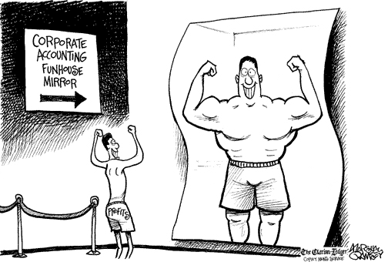
3. Fraud
Companies susceptible to fraud:
Fast-growth companies whose growth is slowing
Troubled companies trying to survive
Public companies fighting to meet expectations
Private companies with weak controls
Notes:
Many of the most significant frauds that result in company failures are the result of financial statement fraud, as opposed to asset misappropriation. Financial statement fraud is defined as the deliberate misstatement of numbers or information contained within a company’s financial statements. Or in other words, making your results or financial position look better than they really are.
There are a number of different situations that companies can find themselves in that make it more likely for financial statement fraud to occur. First of all, companies that have experienced rapid growth and have grown accustomed to expansion may feel more pressure to commit financial statement fraud when the growth starts to slow down. Perhaps the company’s ratings, stock price or bonuses are dependent on continued growth and the company feels pressure to continue to expand.
Another situation might be a troubled company that is doing everything it can to survive. It is often these companies that resort to taking desperate measures like completely overhauling their product offerings or misrepresenting their true results to buy themselves more time.
Another situation might be a public company fighting to meet earnings expectations. When company’s don’t meet expectations there can be a dramatic change in how that company is rated and the price that the company’s stock is traded at. Therefore, these companies may feel more pressure to manipulate earnings to meet expectations or set aside cookie-jar reserves for the future.
Finally, private companies are not exempt from pressure to commit financial statement fraud. Whether a private company is in need of funding, maintaining a rating or justifying its performance to stakeholders, there can be pressure to commit financial statement fraud. In addition, private companies may have fewer employees or internal controls in place to mitigate risks associated with financial statement fraud leading to more risk in this area.

Slide 39
3. Fraud
Fraud Theory
Pressure
Rationalization
Opportunity
Notes:
So, now that we have talked about organizations where financial statement fraud is more likely to occur and general regulatory controls in place to limit fraud activity, we’d like to discuss what motivates individuals to commit fraud. The fraud triangle is a widely recognized theory explaining what needs to be in place for individuals or groups to commit fraud. This fraud theory explains fraud as the interaction of three different influences – pressure, opportunity and rationalization. When these three influences are in place, fraud is much more likely to occur.
Pressure is what motivates the fraud to occur. An individual or an organization has some financial problems that cannot be easily resolved and result in pressure to take drastic steps to fix the problem. For example, an individual is facing personal financial difficulties or an organization is having trouble meeting its earning expectations.
Opportunity relates to a perpetrator’s perceived ability to commit a fraudulent act without being caught. The person sees some way in which he or she can abuse their power or authority to solve a financial problem without being caught. For example, a lack of segregated duties at a company allow an employee access to cash that has not yet been recorded.
Finally, rationalization is the ability to justify committing a fraudulent activity. The justification may be an intention to correct the action down the road, or tying the action to a perceived slight or injustice in how they have been treated. For example, individuals might justify theft on the basis that they are underpaid by their employer. As many articles and studies have determined, most all people can rationalize fraudulent behavior when placed in certain circumstances. Therefore, the most important areas for regulators to consider in assessing fraud risks at their companies are pressure and opportunity.

Slide 40
3. Fraud
Fraud Exposure
Management and Directors
Relationships with Others
Organization and Industry
Financial Results and Operating Characteristics
Notes:
In moving on from a discussion of fraud theory, which was presented in the form of a triangle, we’d like to cover ways that regulator’s can review and consider the various fraud exposures that companies face. These fraud exposure considerations are presented in terms of a rectangle. Each of the four parts of the rectangle represent areas of fraud exposure that regulators should consider in determining a company’s overall exposure to fraud risk. The categories consist of exposure due to the activities of a company’s management and directors, exposure due to a company’s relationships with others (including lenders, investors, affiliates, lawyers and regulators, exposure due to the organization of the company and industry factors and exposures due to the company’s financial results and operating characteristics. In reviewing and considering each corner of the fraud exposure rectangle, regulators can identify potential areas of heightened fraud risk to discuss with the company and investigate during onsite examinations.

Slide 41
3. Fraud
Prominent Fraud Cases
  Equitable Life Insurance (UK)
    The company used money from guaranteed annuity rate policyholders to subsidize variable annuity rate policyholders
    No executives/directors were convicted
  HIH Insurance (AZ)
    The company understated reserves, overstated goodwill, reinsurance recoveries and DTAs
    Executives/directors were convicted of stock market manipulation, disseminating false information, etc.
Notes:
Now that we’ve covered various areas where companies are exposed to fraud risks we’d like to take a quick look at a couple of the largest international insurance company failures that were linked to fraudulent activities.
At its peak in the year 2000, Equitable Life Insurance of the United Kingdom had 1.5 million policyholders with funds worth £26 billion under management, but it had allowed large unhedged liabilities to accumulate in respect to guaranteed fixed returns to investors without making provision for adverse market changes. When Equitable attempted to reduce the value of guaranteed annuities by comingling the policies with its variable rate annuities, policyholders filed suit and eventually won a judgment. However, at this point the company had become insolvent and was taken over by regulators to manage its runoff. Although various reports and studies indicated that the company had acted fraudulently in conducting its business activities, no executives or directors of Equitable were convicted of crimes associated with its collapse.
Another example is HIH. HIH was the second largest insurance company in Australia before its collapse in 2001. The company had grown quickly through a number of acquisitions and by expanding into new markets. However, the company was experiencing significant adverse loss development that began to reduce its surplus. Due to decreasing surplus levels, the board appointed a provisional liquidator to take control of HIH and its controlled entities in 2001. The provisional liquidator attributed the HIH company failures to rapid expansion, unsupervised delegation of authority, extensive and complex reinsurance arrangements, under pricing, reserve problems, false reports, reckless management, incompetence, fraud, greed, and self–dealing. The demise of HIH was the largest corporate failure in Australia's history. HIH liquidators eventually estimated that the company collapsed with losses totaling up to $5.3 billion. As a result of the company’s failure, the CEO and a director were convicted of various crimes including market manipulation, disseminating false information and intentionally acting dishonestly.
These companies provide examples of how fraudulent activities can cause or be a contributing factor in the failure of large insurers. They also provide an example of how fraud is difficult to prove and obtain convictions on.

Slide 42
3. Fraud
How to address during analysis/ examination processes:
  Look for unusual changes in financial results
    Understand operations to be able to identify unusual results
  Ask questions and follow-up on unusual items
    Employ professional skepticism
  Adapt planned examination procedures as necessary to mitigate fraud risk.
    Enhanced testing in certain areas – journal entry review, reserving, cash receipts/disbursements
Notes:
As insurance companies are particularly susceptible to fraud risks and the risks can manifest themselves in different ways, regulators need to be constantly aware of these types of risks in conducting solvency monitoring activities. Regulators should look for unusual changes in financial results and gain a sufficient understanding of the insurer’s operations to be able to identify unusual results that warrant additional review and scrutiny. When particular concerns are identified, the regulator should be obligated to ask questions and follow-up on unusual items, without stopping until the concern is adequately addressed in the regulators mind. To do so, regulators must maintain a skeptical attitude and not just accept a simple response from the company if it doesn’t appear to make sense.
In addition, if fraud risks are identified during the course of an onsite examination, planned procedures should be modified as necessary to address and mitigate the risks identified. For example, exam teams may elect to perform enhanced testing in certain areas such as reviewing certain types of risky journal entries, testing cash receipts and disbursements in greater detail and subjecting the review of loss reserves to greater scrutiny. In all circumstances, the regulator should maintain a healthy level of professional skepticism by requiring the insurer to provide an adequate explanation for unusual items and results.

Slide 43
3. Fraud

Slide 44
4. Investment Problems
Problems in investment activities typically stem from one of three areas:
  Credit Risk – Amounts collected or collectible are less than those contractually due.
  Market Risk – Movement in market rates or prices that adversely affect the reported and/or market value of investments.
  Liquidity Risk – Inability to meet contractual obligations as they become due because of an inability to liquidate assets or obtain funding without incurring unacceptable losses.
Notes:
The 4th most common cause of insurance company failures in the U.S. is problems with investment activities. As you all know, there are variations in the average portfolios of life insurers, property casualty insurers and health insurers. This is because each of these types of insurers have unique goals in terms of what they are trying to achieve with the investment portfolio. Now, we could spend a great deal of time talking about the different investment philosophies of insurers. And clearly, as you begin to examine insurers, and have a discussion with them about their goals, and more specifically the specific investment types that they use to achieve such goals, you would see a wide range of practices. But what you are generally going to see is that insurers investment mix is typically driven most by its products, or what exists on the right side of the balance sheet. You will also see, to a lessor extent, is the use of conservative versus aggressive strategies when you look at individual companies. However, this really gets at the unique goals that each company has coupled with the wide range of different investments used to achieve those goals, and some strategies will be seen as more conservative while others will be seen as more aggressive.
Of course the risk we are generally the most concerned about in reviewing investments is credit risk because it has the ability to reduce the hard earned surplus that has been built up over the years by the insurer. Obviously credit risk can have a material impact on the ability of the insurer to meet the obligations assumed by a product since its possible to lose an entire investment holding in a credit loss. Of course in the worst economic environments, firms can be pressured by the economy and can go out of business more easily, leading to major credit losses that can lead to insolvency. One thing to keep in mind is that history shows that net investment yields are often highest on equity securities even after considering their higher potential for material losses per unit. This is what incentivizes companies to invest in equity markets, even though the downside risks may be greater.
Insurers are also clearly exposed to market risk, particularly in equity securities, but because most insurers hold their securities for long periods, they generally invest through market cycles, which can limit the risks they face in this area. That being said, insurers can experience material unrealized losses on investments that can lead to capital issues, and insurers can be forced to cut their losses earlier than they like. And of course, changes in economic conditions can lead to market risk for any particular segment of the market, so insurers need to be diversified to avoid significant risks in this area.
However, liquidity risk can also have a significant impact on an insurer based on its investment holdings. In fact, as we discussed related to P&C and health portfolios, one of the major drivers of their investment holdings is the need for ample liquidity due to the short term nature and unpredictability of their cash demands. And because of this, most P&C and health insurers typically have a lower amount of liquidity risk, at least in terms of the make-up of their portfolio. So ironically, it’s the life insurers, who usually have very stable cash inflows and outflows, that are generally subject to greater liquidity risk. Generally speaking, there is a direct relationship between credit risk and liquidity risk. This is because when large credit events occur within the economy, there is a rush to quality, and because of that, products that have lower credit risk are generally very tradable in all market conditions.

Slide 45
4. Investment Problems
General U.S. Regulatory Controls
  Investment restrictions/limitations
  Conservative accounting requirements
  Increased capital requirements for risky investments
  Detailed reporting and disclosure
Notes:
In U.S. insurance regulation, there are a number of regulatory requirements that have been put in place to limit the amount of risk in an insurer’s investment portfolio. These are requirements that frankly are a means to help control some of the risks we have already mentioned. State insurance laws required insurers to maintain diversified portfolios, at a general level. State laws differ in terms of how they do that, between outlining specific limitations in investments and outlining principles for insurers to follow in developing their own standards. For example, the defined limits NAIC model investment law puts caps on certain types of investments as well as putting the 3% limit on any one issuer. The defined standards version essentially requires a very prudent approach to any assets used to support insurance liabilities and only allows more discretionary investments on the assets supporting the surplus of the insurer. We also have conservative impairment rules included in our statutory accounting requirements as well as other valuation requirements that require conservative accounting treatment. Another control that can limit the level of investment risk accepted by an insurer is the RBC process that produces a higher capital charge for riskier investments held by insurers. Finally, there are detailed reporting and disclosure requirements for all of the investment holdings of an insurer, which provide a great deal of information for regulatory analysis and review.

Slide 46
4. Investment Problems
Causes/signs of investment problems:
  Significant shifts in portfolio
  Concentrations in a particular issuer, security type or industry
  Concentrations in non-investment grade securities
  Failure to match duration of portfolio with liability payments
Notes:
This slide lists some of the most common causes or signs of investment problems at an insurer. These trends and concerns are tracked and monitored through use of a wide range of analysis tools and ratios built into the U.S. solvency monitoring system, similar to those we presented for reserving and pricing. Analysis tools help to point out significant shifts in an insurer’s portfolio that may indicate a shift in investment strategy or focus. In addition, various tools are used to identify concentrations in a particular issuer, security type or industry, including historical comparisons and benchmarking against peers. We’ll cover a case in a few minutes that highlights the importance of monitoring concerns in this area.
In addition to monitoring for concentrations in an issuer or industry, U.S. regulators maintain a number of tools and resources focused on identifying concentrations in non-investment grade securities or other high risk assets. These tools point out specific assets of concern that can be followed-up on through discussions with the insurer or testing during an onsite examination.
Finally, another common cause of investment problems emerges as a result of a failure to match the maturity of investments with liability cash flows to ensure proper duration matching. U.S. regulators have a number of ratios and tools designed to identify risks in this area and can request additional reporting when signs of a potential mismatch are identified.

Slide 47
4. Investment Problems
XYZ Case Study
Background Information – 12/31/07
  Assets of $1.6 Billion
  Capital and Surplus of $120 million
  A.M. Best Rating A
Notes:
This case is based on a real company failure that occurred as a result of investment problems encountered during the recent financial crisis. The company was a medium sized life company that wrote all the traditional life lines of business. The company had been in business for almost 100 years and had a pretty good track record of earnings and positive financial performance. As of December 31, 2007, the company held assets of $1.6 billion, total capital and surplus of $120 million and had an AM Best rating of A.

Slide 48


4. Investment Problems
XYZ Case Study
In the first quarter of 2008 the company purchased the following two securities:
  $25.5 million Freddie Mac Preferred Stock
  $24.2 million Fannie Mae Preferred Stock
Notes:
In the first quarter of 2008, the company made a decision to purchase preferred stock in both Freddie Mac and Fannie Mae. Both companies are Government Sponsored Enterprises (GSEs) whose debt and securities were not backed by the full faith and U.S. Government, but were highly rated. Many investors felt that as the entities were sponsored by the federal government that their securities carried an implicit guarantee of backing. As both of the stock purchases were within state investment limits, which stipulated that no more than 5% of assets or 25% of surplus could be invested in any one issue, the regulators did not raise any concerns regarding the investments.

Slide 49
4. Investment Problems
XYZ Case Study
Housing Crisis
  The market value on the securities begins to decline.
  The dividends were then suspended and the securities continued their decline.
  Freddie and Fannie were eventually both placed under government conservatorship.
Notes:
As the housing crisis began to increase in 2008, home values in the U.S declined sharply. Many homeowners found themselves “underwater” in in their mortgages. Unemployment shot up and many people found themselves out of work. Many people began losing their homes through foreclosure. It was subsequently discovered that many people were given loans based on faulty information or were extended loans that did not match their income level. As more and more mortgages went into default, the losses mounted at both Freddie Mac and Fannie Mae. The market value on the preferred stock held by XYZ began to decline and eventually the dividends were suspended. At this point, the market value on the preferred stock really sunk and it was too late for the company to sell its holdings without taking a huge loss. Freddie and Fannie were eventually both placed under government conservatorship and XYZ continued to hope that the government would bail out stockholders.

Slide 50
4. Investment Problems
XYZ Case Study Outcome
Freddie and Fannie paid off their debt, but the preferred stock became worthless
XYZ lost it’s entire investment
On February 12, 2009, regulators seized control of XYZ
  The difference in yield between the debt and preferred stock was 20 basis points
Notes:
In the end, the federal government backed Freddie and Fannie enough to ensure that their debt was paid off to bondholders, but the preferred stock became worthless. To make a bad situation, worse company had some other assets tied to the housing market, including mortgage-backed securities, the overall investment losses eroded the company’s surplus and forced the department to seize control of the company.
In looking back on the purchase of these securities, even though the company was abiding by the state investment laws, the preferred stocks for these two issues were concentrated in the housing market. Each individual stock represented about 20% of the company’s surplus, which was within the state investment laws limiting investments in individual securities at 25% or surplus. However, if you combined these two securities, they represented about 40% of the company’s surplus. In comparing the difference in yield between debt issued by Freddie and Fannie and the preferred stock that XYZ purchased, the net result was that the company lost its entire investment in these two entities in an attempt to gain an additional 20 basis points in yield.
Hopefully this case study illustrates the importance of reviewing investment portfolio’s for concentrations in certain sectors of the market. In addition, this case should make it clear that although state investment limitations provide some basic level of security and protection to a company’s portfolio, they are not intended to function as a safe harbor and should not be seen as such by regulators.

Slide 51
4. Investment Problems
How to address during analysis/ examination processes:
  Understand and evaluate investment strategy and policies
    Do policies outline standards regarding quality, diversification and maturities of invested assets?
  Determine whether insurer is adhering to its internal policies and regulatory limits
  Evaluate the results of stress testing on potential areas of concentration
Notes:
If investment concerns or problems are identified during analysis or examination processes, regulators can take a number of different steps to address the issues identified to ensure that risks have been appropriately mitigated.
The XYZ case study was provided to show an example of how specific investment problems can result in a company failure. In performing follow-up procedures from an analysis perspective in responding to potential issues, the regulator is seeking to gain a more detailed understanding of a particular concern in order to reach conclusions regarding the insurers ongoing solvency assessment and whether additional regulatory action may be necessary to address adverse findings. As it pertains to a company’s investment policy and strategy, the regulator should seek to understand the policies in place and whether they address the quality, diversification and maturities of investment assets at a sufficient level of detail. As you can tell, typically before reviewing such information, the regulator would need to understand other aspects of the insurer, including the types of business written and the liquidity/cash flow needs. And then as indicated, the regulator may want to consider asking the insurer if they are aware of market conditions that could threaten the portfolio.
In addition to understanding the insurer’s investment strategy and policies, it is important to verify that those policies are being enforced, which can be determined in the course of an onsite examination. In addition, regulators may choose to test the valuation of individual securities that are complex in nature or result in a significant exposure to the insurer. This type of testing can provide the regulator with some assurance regarding the credit quality of assets held by the insurer.
Finally, as regulators consider investment risk, its always critical to consider how assets may become stressed in light of changing market conditions. This can be difficult since regulators may not be as in tune to the market as insurers, but stress testing and scenario analysis may be worthy of consideration if particular concerns or concentrations are identified. Often, the regulator may be able to focus on the insurers processes to identify and stress its own portfolio through risk management practices, which may provide valuable information regarding credit and market risks.

Slide 52
4. Investment Problems
If controls don’t exist or aren’t operating effectively:
  Perform independent tests to address/assess investment risk exposure.
  Consider involving an investment specialist in reviewing portfolio, performing stress tests, etc.
  Communicate control weaknesses/prospective risk concerns to company
Notes:
In situations where the company’s processes and controls in relation to investing activities seem to be unreliable, regulators may need to independently test the valuation of certain securities, subject a portfolio to stress testing or perform other tests to get an understanding of the susceptibility of the company’s portfolio to credit, market and liquidity risks. After detail testing is performed, final conclusions regarding the company’s investments and ongoing risk profile can be developed and control weaknesses or prospective risk concerns can be drafted for communication to the company through a management letter. For example, the company could be asked to review its investment policy and consider developing more specificity around portfolio diversification requirements if this is a concern of regulators.

Slide 53
4. Investment Problems

Slide 54
5. Problems with Affiliates
Related Party Risk – The risk that transactions with affiliated entities may not reflect economic realities or may not be fair and reasonable to the reporting entity and its policyholders.
Notes:
Problems with affiliate transactions has been identified as the 5th most common cause of historical insurance company insolvencies in the U.S. Related party risk can be defined as the risk that transactions with affiliated entities may not reflect economic realities or may not be fair and reasonable to the reporting entity and its policyholders. As related party transactions can be utilized to mask true financial results, they should always be reviewed with an appropriate level of professional skepticism. In other words, we have to learn to challenge company results and responses that don’t make sense or aren’t valid.

Slide 55
5. Problems with Affiliates
Affiliate:
  An entity that is within the holding company system that, directly or indirectly, through one or more intermediaries, controls, is controlled by, or is under common control with the reporting entity.
Related Parties:
  Entities that have common interests as a result of ownership, control, affiliated or by contract.
Notes:
In U.S. insurance regulation, we’ve developed definitions for affiliates and related parties that we use to restrict certain transactions and subject agreements to regulatory review and approval.
Statutory accounting principles define an affiliate as an entity that is within the holding company system that, directly or indirectly, through one or more intermediaries, controls, is controlled by, or is under common control with the reporting entity.
In addition, statutory accounting principles define related parties as entities that have common interests as a result of ownership, control, affiliated or by contract.

Slide 56
5. Problems with Affiliates
Common areas of abuse:
  Service agreements
  Reinsurance contracts
  Tax sharing agreements
  Mergers and acquisitions
  Dividend payments
  Investment management
Notes:
There are several different types of affiliated agreements and transactions with related parties that have been found to be subject to abuse by insurers. These agreements and transactions include:
Service agreements
Reinsurance contracts
Tax sharing agreements
Mergers and acquisitions
Dividend payments
Investment management
With regard to affiliated agreements, the main concerns relate to the type of service being performed and the reasonableness of the cost. This is a common area of abuse when the parent company’s overall desire is to withdraw funds from the insurer and would not be permitted to via a shareholder dividend. Therefore, there needs to be an understanding of why the parties were motivated to enter into such affiliated agreements and the overall benefit to the insurer.
Typically, a cost prohibitive agreement can be seen through an inflated expense ratio which should be monitored closely when affiliated agreements are in place. An additional consideration would be to look past an offsetting expense reductions such as surplus aid that may mask the true expense paid on an affiliated contract.

Slide 57
5. Problems with Affiliates
U.S. Regulatory Controls:
  Holding company authority
    All intercompany transactions/agreements subject to regulatory review and approval
    Extraordinary dividends subject to approval
    Mergers and acquisitions subject to approval
  Conservative accounting treatment
    Transactions reviewed for economic status
    Non-economic transactions subject to lower of cost or fair value accounting
    Transactions for the purpose of avoiding statutory accounting principles are voided
Notes:
To lower the level of risk associated with affiliate/related-party transactions, U.S. regulators have implemented a number of regulatory requirements and standards that insurers must comply with. These standards include authority granted by the Holding Company Act that grants the regulator broad powers to review and approve/disapprove related party agreements and transactions including the release of extraordinary dividends and the completion of mergers and acquisitions. In addition, statutory accounting principles include conservative protections in relation to affiliate transactions that require these transactions to be reviewed for their economic status. If it is determined that a particular transaction or agreement is not at arms length or is otherwise non-economic in nature, such an agreement must be accounted for at the lower of cost or fair value to ensure that the true nature of the transaction is not masked. In addition, if the purpose of the transaction is to otherwise avoid statutory accounting principles or insurance regulation, the transaction or agreement must be voided.
These regulatory processes provide a powerful means for U.S. regulators to protect policyholders against manipulative affiliated transactions and help to ensure fairness and consistency in financial reporting.

Slide 58
5. Problems with Affiliates
ABC Company
  Company Concerns:
    Poorly executed affiliated transactions
    Improper affiliated transaction
  Cause of Trouble:
    Significant fringe benefits were being paid to company officials who were also shareholders
    Management agreement that allowed funds to be diverted to owners
Notes:
However, even with strong regulatory processes in place, problems can emerge when companies engage in significant affiliated transactions. Lets take a look at a troubled company example.
This particular company was a relatively small privately owned stock property/casualty insurance company. During an examination, there were certain concerns discovered that were threatening the financial stability of the Company.
One of those concerns was the fact that significant fringe benefits were being paid to a few company officials who were also shareholders. These benefits appear to have been far in excess of what reasonably could be justified for the company’s size.
In addition, it was noted that the Company had entered into a management agreement with an affiliated company, whereby the affiliate would provide the Company with investment management guidance for a stipulated fee. However, the agreement appeared to be more form than substance, because the people actually performing the investment work were employees of the Company. It appeared that the management agreement was merely a conduit to allow funds to be diverted to the owners. The management agreement apparently was entered into in violation of the holding company statue because the Company was not able to pay dividends directly to owners due to certain statutory restrictions.

Slide 59
5. Problems with Affiliates
ABC Company (cont.)
  Corrective Actions:
    The insurance department entered an order that restricted the Company’s transactions with affiliates and required compliance with the holding company statute
    The agreement with the Company’s affiliates was voided and funds paid to the Company’s management under that agreement during the preceding year were ordered to be returned
    Certain officers were required to resign their positions
Notes:
A corrective plan was developed under which the insurance department entered an order that restricted the Company’s transactions with affiliates and required compliance with the holding company statue. The agreement with the Company’s affiliates was voided and funds paid to the Company’s management under the agreement during the preceding year were ordered to be returned. Certain of the officers were required to resign their positions.

Slide 60
5. Problems with Affiliates
How to address during analysis/ examination processes:
  Review financial condition of insurer and affiliate(s)
  Evaluate insurer transactions and determine motivation for transaction
  Understand the insurer’s corporate structure
  Determine whether investments in affiliates are significant and valued properly
  Test cost allocations for appropriateness
Notes:
So, given the risk associated with affiliated transactions, what can be done during the solvency monitoring processes to address risks in this area? First of all, regulators should always be familiar with the financial condition of the insurer and its significant affiliates. In the U.S., we are paying greater attention to risks emerging from affiliates by increasing reporting requirements in this area (Form F, ORSA, etc.) and completing enhanced HC analysis on an annual basis.
In addition, regulators can closely evaluate related party transactions and gain an understanding for the purpose of the transaction. If the purpose is not clear, this may be a sign of increased risk. As part of gaining an understanding of the purpose of the transaction, the regulator needs to understand the corporate structure of the insurer and its affiliates and how that structure may present different risks to the organization. For example, if the holding company is subject to a significant amount of debt, there may be more incentive to move money out of the insurance company to service that debt.
In all cases, regulators should review and test investments in affiliates and cost allocations in service agreements to ensure that amounts are appropriate and equitable. This work should be performed during the initial approval of the transaction/agreement and on an ongoing basis to ensure that the transactions remain fair and equitable throughout their lifetime. It may be difficult to determine whether certain agreements are fair, but regulators can always look to similar arrangements between non-affiliated entities to compare terms. In so doing, regulators will be able to gain comfort in the fairness of affiliate transactions and limit the risk that economic results will be masked by manipulative intercompany agreements.

Slide 61
5. Problems with Affiliates

Slide 62
6. Catastrophic Losses
Catastrophic Insolvency Risk:
  The risk that natural or man-made catastrophe losses can lead to the insolvency of an insurer when claims exceed the insurer’s financial resources.
    An event is designated a catastrophe by the U.S. insurance industry when claims total $25M or more and a significant number of policyholders and insurers are impacted.
Notes:
Catastrophic events pose a significant threat to the financial solvency of P/C insurers due to the rapid and unexpected impact that can occur. No single cause of insolvency can affect an insurer’s financial strength more instantaneously than catastrophes.
Increased frequency and severity of catastrophic events and concentrated population growth in recent years has brought catastrophe risks to the fore front and challenged insurers and reinsures to improve their catastrophic risk management systems and controls and to provide stronger capitalization to support the risk.
The risk referenced in this unit is the risk that a natural or man-made catastrophe losses can lead to the insolvency of an insurer when claims exceed the insurer’s financial resources.
An event is designated as catastrophe per industry standards when direct losses exceed $25M or more and a material amount of policyholders and insurers are impacted.

Slide 63
6. Catastrophic Losses
Top 10 most costly U.S. disasters:
Rank | Date | Event | Est. insured losses (2012 dollars)
1 | Aug. 2005 | Hurricane Katrina | $47B
2 | Sept. 2011 | 911 Attack | $23B
3 | Aug. 1992 | Hurricane Andrew | $23B
4 | Oct. 2012 | Super Storm Sandy | $18B
5 | Jan. 1994 | Northridge, CA earthquake | $18B
6 | Sept. 2008 | Hurricane Ike | $13B
7 | Oct. 2005 | Hurricane Wilma | $12B
8 | Aug. 2004 | Hurricane Charley | $9B
9 | Sept. 2004 | Hurricane Ivan | $9B
10 | Apr. 2011 | Midwest Storms | $7B
Notes:
This slide shows the most costly nature and man-made catastrophes as you can see from the dollar values these events can have a significant impact on an insurer. As you can see by the magnitude of estimated insured losses, these types of events have the potential to wipe out the surplus of an individual insurer or reinsurer if they are overly exposed to a particular catastrophe.

Slide 64
6. Catastrophe Losses
Company Controls
  Capital
    Appropriate level of capital
    Access to additional capital
  Risk appetite
    Risk tolerances/limits
  Risk controls
    Price of business written
    Diversification
    Reinsurance
Notes:
It was noted in the introduction of this unit that catastrophic events can pose a significant threat to the financial solvency of P/C insurers due to the rapid and unexpected impact. Therefore one of the most critical aspects of analysis for this risk is to ensure there is an appropriate level of capital and a sufficient support structure to manage catastrophic risk.
Insurers assess the level of risk through models and predict losses which may eventually impact the capital position. It is through this assessment that insurers determine the level of capital needed at not only the insurer level, but also the group level.
In the event that the level of capital is not sufficient, a good quality capital support structure is critical. Parental capital support via a agreement or support via a measure such as, RBC where a parent will provide support if RBC goes below 300% are important to understand in the monitoring process.
If this type of support is not particularly evident in your analysis then access to capital must be determined. If the insurer is public it may issue stock to raise funds or seek a venture capital firm to invest in it. However, if it is a mutual it may only be able to assess its policyholders if it is an assessable mutual, if not, it may not have any way to raise capital. Thus, the ability of the insurer to raise additional capital as needed may be an important consideration, depending upon the company’s exposure to cat risks and the amount of capital it has on hand.
In addition to maintaining adequate capital resources, insurers need to manage catastrophe risk by developing an understanding of the likelihood of various levels of potential losses and guard against those probabilities. In so doing, there are several factors an insurer must consider when developing a risk management plan.
First, an insurer must identify it’s cat risk appetite, which is how much loss over a given time period can the insurer absorb without an adverse effect to it’s capital. Identifying the risk appetite gives the insurer a basis for setting suitable cat limits.
Measuring the level of cat exposure an insurer has is also a key factor in managing catastrophic risks. Most insurers measure exposure using probable maximum loss (PML) levels. An insurer can use it’s PML measures to determine how much business it can write in a specific line of business or geographic location without exceeding it’s cat limit identified when defining it’s risk appetite.
An insurer must also have effective risk controls to manage catastrophic risk. First, an insurer must ensure that it factors it’s catastrophic risk in the premium price. An insurer must also perform ongoing analysis of it’s risk profile to ensure that the premium prices remain relevant. It may be necessary to adjust premiums prices if the risk exposure changes.
Additionally, an insurer must recognize the need to limit risk. This can be done in several different ways. For example, an insurer’s risk portfolio must be appropriately diversified in both lines of business written and in geographic location. Looking at the group as a whole, the legal entities must be diversified as well or the entire group could experience issues if for example the business is pooled, such as with the Tower Group.
The most common way in which an insurer manages it’s catastrophic risk is by utilizing reinsurance. Using reinsurance allows insurer’s to control exposure to catastrophic risks and protect it’s capital base. It is important that an insurer obtain an appropriate level of reinsurance that is consistent with it’s risk profile. Obtaining reinsurance contracts with quality reinsurer’s is equally important. Having reinsurance in place is only effective in managing catastrophic risks if the ceding insurer can easily collect reinsurance losses paid.

Slide 65
6. Catastrophic Losses
Causes/signs of catastrophic risks:
  Slim capital/surplus margin
  Concentration in geographic areas
    Coastal exposure, earthquake exposure, hail/tornado exposure, etc.
  Lack of defined risk appetite
    Defined underwriting limits
  Level of reinsurance coverage inadequate
    Types of coverage, retention levels, limits, etc.
Notes:
While we’ve covered some of the basic controls and processes that insurers should have in place to guard against catastrophic risks, it’s important to note that not all insurers will have adequate processes in place in light of the risks they’ve exposed themselves to. This is often due to the complexities associated with cat risk modeling and the cost of various risk management controls such as reinsurance coverage. Therefore, this slide lists some causes or signs of potential exposure to catastrophic risks.
Slim capital/surplus margin
Concentration in geographic areas
Coastal exposure, earthquake exposure, hail/tornado exposure, etc.
Lack of defined risk appetite
Defined underwriting limits
Level of reinsurance coverage inadequate
Types of coverage, retention levels, limits, etc.

Slide 66
6. Catastrophic Losses
U.S. Analysis Tools:
  Financial Statement
    Schedule T
    Underwriting and Investment Exhibit
    Property and Casualty Notes and Interrogatories
  Management’s Discussion & Analysis
  Audit Report
  Actuarial Opinion
  Financial Profile Report
Notes:
U.S. insurance regulators have a number of tools available for use in determining an insurer’s exposure to catastrophic risks.
Risks may be evident through the review of the financial statement or disclosed within the MD&A, audit report or actuarial opinion. However, one of the most critical aspects of monitoring any risk is understanding the overall picture by knowing the overall risk within the insurer and their financial condition and support. Financial statement information is reported by U.S. insurers regarding the amount of business written, geographic concentrations, reinsurance coverage and other critical information. In addition, the company is required to discuss its exposure to cat risks through the MD&A and such exposure may also be covered in the external audit report and/or the actuarial opinion. The reported financial data can be analyzed through the financial profile report where regulators have the most current data and five year trend of data as well as ratios to help understand overall solvency and risk exposures.

Slide 67
6. Catastrophic Losses
How to address during analysis/ examination processes:
  Understand and evaluate company’s risk appetite and limits
    Test enforcement of limits
  Review and evaluate results of cat modeling/ stress testing
  Understand and evaluate company’s reinsurance strategy
    Test implementation of strategy
Notes:
If significant exposure to catastrophic losses is identified, there are a number of procedures that can be performed to investigate concerns in more detail. For example, the regulator can take additional steps to understand and evaluate the company’s risk appetite and limits and to determine whether those limits are being enforced. For example, if the company has limited the amount of business it will underwrite in a particular geographic area, these controls can be tested during an onsite examination.
In addition, regulators can review the company’s use of catastrophe modeling and stress testing to gain an understanding of the impact of various event scenarios. This stress testing can be performed using complex third party models based on the company’s policy data or through a more simplified process.
Finally, the company’s reinsurance strategy and treaties in place to cover exposure to cat risk can be reviewed for appropriateness. Often, the results of cat modeling and stress testing can incorporate the reinsurance coverage in place to show the projected impact on the insurer in the event of a catastrophe. In all circumstances, the regulator should understand that controls for cat risk are not an exact science and are subject to variability. However, simple regulatory controls may help to limit cat risk exposure by establishing basic premium to surplus limits for the company to follow or other similar measures to limit a company’s exposure and protect policyholders.

Slide 68
6. Catastrophic Losses

Slide 69
7. Reinsurance Problems
Reinsurance - The assumption by an insurer of all or part of a risk originally undertaken by another insurer.
  Can be used for capacity, stabilization, cat protection or to increase financial strength
Reinsurance Risk - The risk that the reinsurance agreement will not spread or transfer the risk of loss or that the obligations of an agreement will not be fulfilled.
Notes:
Our final category for discussion today, and the 7th most common cause of company failure in the U.S. is problems with a reinsurance contract. Reinsurance is defined as the assumption by an insurer of all or part of a risk originally undertaken by another insurer. Understanding the reasons for an insurer’s particular reinsurance program may provide a basis for determining if existing or proposed reinsurance pose a threat of current or possible solvency concern.
The four principal reasons for an insurer to enter a reinsurance agreement include capacity, stabilization, catastrophic protection, and increased financial strength.
First, lets look at capacity, reinsurance increases an insurer’s capacity to write greater amounts of premium.
Second, Stabilization. Reinsurance can serve to stabilize an insurer’s overall underwriting results by allowing an insurer to pass along losses to reinsurers. Reinsurance also stabilizes underwriting risks by reducing possible impact of any one line of business or geographic area on overall results.
Third, catastrophe Protection. Reinsurance protects insurers against large aggregate losses, such as Hurricane Katrina. While individual losses may be small, an insurer may not be able to absorb the accumulation of multiple losses due to a single event or occurrence.
And, lastly increased financial strength. Reinsurance provides a form of financing for insurance companies. When reinsuring policies, an insurer transfers a portion of its unearned premiums to the reinsurer and receives a ceding commission from the insurer. As a result, the ceding company’s surplus rises by an amount equal to the ceding commission. This function of reinsurance is referred to as surplus aid.
However, whenever reinsurance is utilized there is a risk that the agreement will not adequately transfer risk or that the obligations of the agreement will not be fulfilled. Therefore, regulators must be aware of the risks associated with the use of reinsurance and understand what steps the insurer has taken to reduce or mitigate those risks.

Slide 70
7. Reinsurance Problems
Common areas of concern:
  Transfer of risk
    Can mask financial results
  Uncollectible Reinsurance Recoverable
    Amounts in dispute
  Solvency of reinsurer
    Concentrations in coverage
  Reinsurance contracts written for surplus aid/relief
    Subject to cancellation, costs can be prohibitive
Notes:
Under the general heading of reinsurance problems, U.S. regulators have identified a number of specific issues and concerns. These key concerns include:
Transfer of risk - An essential element of a true reinsurance contract is the shifting of risk from the ceding insurer to the assuming reinsurer. Per stat accounting rules, indemnification of the ceding entity against loss related to insurance risk requires the reinsurer to assume significant insurance risk under the reinsured portions of the underlying insurance agreements and that it is reasonably possible that the reinsurer may realize a significant loss from the transaction. The transfer of insurance risk requires some element of timing risk and underwriting risk. Unless the contract contains this essential element of risk transfer, the ceding insurer is not allowed to account for the agreement as a reinsurance recoverable and take credit against loss reserves. Therefore, if a reinsurance contract does not transfer insurance risk, the insurer is required to account for the transaction as financing. Determining whether a contract involves true transfer of risk requires a complete understanding of the contract. All contractual features that limit the amount of insurance risk to the reinsurer or delay the timely reimbursement of claims by the reinsurer require interpretation, many times by legal staff.
Uncollectible Reinsurance Recoverable - Another recurring problem has been uncollectible reinsurance recoverables. Balances due from reinsurers may become uncollectible due to reinsurer insolvency, or in a dispute over contract terms. It is for these reasons that appropriate collateral is required to be posted for unauthorized reinsurance in the U.S. It is also important to consider whether appropriate reinsurance diversification is in place. When a major catastrophe arises, lack of diversification can result in recoverable issues.
Solvency of reinsurer – In certain cases, an insurer has failed to properly assess the capabilities and responsibility of the reinsurer. In these cases, the reinsurer was found to be unable to honor its obligations. As a result, the insurer will be stuck with the bill and potentially additional expense related to legal avenues to attempt to seek recovery. It is crucial that the insurer evaluate the financial condition and responsibility of its reinsurers to ensure the collectability of reinsurance recoverables. When significant reinsurance placements are made, the same type of analysis should be completed on the reinsurer as is done on the ceding insurer. All aspects of capitalization, profitability, liquidity, and leverage should be reviewed to ensure financial soundness.
Reinsurance contracts written for surplus aid/relief – Often times, insurers that are struggling with capacity issues may turn to reinsurance as a means to provide surplus relief. Ceding business to a reinsurer allows the insurer to receive a ceding commission and reduce its net premiums to a level more appropriate to the surplus that it has accumulated. However, some reinsurance contracts may be too heavily focused on providing temporary surplus relief to the ceding company, which can be quite expensive and, in the long run, can further aggravate a weakened financial condition. The use of these arrangements may indicate an underlying problem in the adequacy of the ceding company’s surplus. Often, surplus relief can reduce expenses and favorably impact net income and surplus. However, if the reinsurance contract that is producing the surplus aid is cancelled, so goes the aid and expenses rise and surplus falls. For insurers that possess low capitalization this can be detrimental.

Slide 71
7. Reinsurance Problems
Casualty Reciprocal Exchange
  Insurer became troubled due to significant declines in capital, poor operating results and adverse reserve development.
  Attempted to remedy financial strain by securing reinsurance through three contracts
  Missouri Department of Insurance discovered that reinsurance did not transfer risk
  August 2004 insurer was placed in liquidation
Notes:
As we just discussed the importance that transfer of risk plays in reinsurance, let me provide you an example of a transfer of risk issue.
Casualty Reciprocal Exchange wrote mainly workers’ compensation and auto liability insurance. The insurer became troubled due to significant declines in capital and surplus, poor operating results and adverse reserve development. These issues, were in part, due to a interaffiliate pool the insurer had in place with Equity Mutual Insurance Company.
The insurer attempted to place most of their business with a reinsurer through 3 reinsurance contracts, this was one of their last attempts to remedy a pending insolvency. Following review of the contracts by the MO DOI, the reinsurance contracts did not transfer risk, shortly thereafter the insurer became insolvent.
It is important to note, that the reinsurance contracts were a potential remedy and not the cause insolvency, but this potential corrective measure was appropriately reviewed which proved to be extremely crucial. The company was ultimately liquidated in August 2004.

Slide 72
7. Reinsurance Problems
Life & Health Insurance Co
  Insurer business consisted of long-term-care insurance, home health-care products, and life insurance.
  Dispute with Employers Reinsurance Corp regarding two terminated reinsurance agreements
  In February 2003 an arbitration panel found in favor of insurer, however, the final award did not cover the insurer’s losses
  Insurer became insolvent July 2004
Notes:
Life and Heath Insurance Company of America was a long-term-care and home health-care products company.
The Company was in dispute with Employers Reinsurance Corporation regarding the obligations of the parties on the termination of two reinsurance agreements covering LTC business.
The resolution of the dispute was pursued through arbitration.
In February 2003, the arbitration panel found in favor of the Company
However, the final award did not cover the Company’s losses, which reduced the Company’s surplus below the required statutory minimum
The insurer became insolvent in July 2004

Slide 73
7. Reinsurance Problems
NLC Mutual Insurance Company
  November 2006 Company discovered it had fallen victim to reinsurance fraud from intermediary the Company had used for 10 years.
  Company was led to believe it had purchased excess workers’ comp reinsurance protection from 2003-2006.
  Intermediary produced falsified reinsurance agreements that were illegitimate.
Notes:
Let’s take a look at another example of an insurer that experienced issues due to a reinsurance arrangement. This time, the problems relate to both reinsurance issues and fraud.
In November 2006, NLC Mutual Insurance Company discovered it had fallen victim to reinsurance fraud from an intermediary that that Company had used for 10 years. NLC-MIC originally dealt with the intermediary as part of a large brokerage, and because of the past relationship, the individual was given a measure of trust when he approached the firm a few years later offering to place their coverage. Through the brokerage the intermediary created in his own name, the intermediary made legitimate placements for NLC for a number of years, and then the fraud began. The Company was led to believe that it had purchased excess workers’ comp reinsurance protection during the years 2003 through 2006. However, the intermediary did not place the business and produced falsified reinsurance agreements that were illegitimate. In total, the intermediary ran off with more than $10 million in premiums from NLC without completing a reinsurance contract. Eventually, the fraud was uncovered by a state insurance department fraud examiner who discovered that the reinsurance contracts were not legitimate. The intermediary was eventually charged in the case and sentenced to six years in prison. Ultimately, most of the diverted funds were recovered and NLC was able to recover and continue in operation.

Slide 74
7. Reinsurance Problems
How to address during analysis/ examination processes:
  Review significant contracts for existence and test for risk transfer
  Identify and discuss concentrations of coverage
  Review and discuss financial condition of significant reinsurers
  Test the collectibility of significant recoverables
  Test the reasonableness of loss reserve credits
Notes:
So, given the fact that problems with reinsurance contracts can result in solvency concerns, regulators may need to address these risks through analysis and examination processes. A required element of each full-scope exam in the U.S. is to review significant reinsurance contracts to test for appropriate risk transfer. In complex reinsurance contracts, this may require the involvement of a reinsurance expert, lawyer or actuary to test the cash flows associated with the reinsurance agreement.
In addition, analysts and examiners can identify, assess and discuss the impact of concentrations of reinsurance coverage with the insurer. In situations where the insurer is too heavily concentrated with one reinsurer, the regulator may recommend diversification and/or require corrective action if the risk is considered severe.
For significant reinsurers utilized by the company, the analysts and examiners will often review and assess the financial condition of the reinsurer by reviewing financial statements, ratings, etc.
Significant reinsurance recoverables recorded by the insurer can be tested for collectibility through confirmation with the reinsurer, testing the underlying insurance claims for compliance with treaty provisions or reviewing subsequent collection by the insurer.
Finally, often the most significant benefit of a reinsurance treaty is the ability of the ceding insurer to take credit for reinsurance in loss reserve calculations. By netting out the amount of unpaid losses estimated to be covered by reinsurance, ceding companies can greatly reduce the amount of net reserves they are required to hold. However, since much of this process is subject to estimates and assumptions, it is important for regulators to review the reasonableness of loss reserve credits taken for reinsurance. Often, regulators will involve a department actuary in this review.
All of these steps serve to help regulators understand the risks associated with the insurer’s reinsurance program and reduce exposure to problems with individual reinsurers.

Slide 75
7. Reinsurance Problems

Slide 76
U.S. Corrective Actions
Significant Solvency concerns may require corrective action/enforcement through:
  RBC (capital requirements)
  Specific compliance requirements
  Hazardous Financial Condition
  Regulatory (moral) suasion
Determination of significance should be made by senior management
  Material adverse findings require reporting to senior management for review
Notes:
Today we’ve covered a number of different risk areas that have caused company failures and discussed how to identify and assess risks in these areas. In addition, we’ve talked about recommendations and follow-up that can be performed by analysts and examiners. However, it is important to note that certain solvency concerns may require more formal corrective action and enforcement through the use of regulatory authority. In our U.S. system, we’ve developed a range of regulatory authority in different areas that allows us to take corrective action when significant issues are identified. This authority includes actions associated with our Risk Based Capital requirements, specific compliance requirements that can be enforced (allowing transactions to be reversed), hazardous financial condition authority that allows the regulator to step in and require corrective action when a hazardous situation is identified, and the use of informal actions through regulatory suasion. All of these sources of action are commonly used in the U.S. and have helped us reduce the number of troubled companies and failures over the years.
However, we stress the importance of communicating significant findings and concerns identified through analysis and exam processes to senior management through our “material adverse finding” standards that require communication and timely action in the event of a significant concern. It is the responsibility of department senior management, not the staff analyst or examiner, to determine what steps should be taken to address any “material adverse findings”.

Slide 77
U.S. Corrective Actions
RBC – Calculation of minimum regulatory capital to support overall business operations based on the size and risk profile of an insurance company.
  Four formulas (Life, P&C, Health and Fraternal)
  Factor-based calculation to account for an insurer’s risk exposures.
  Reflects risks inherent in operating an insurance company.
Notes:
First of all, our system for capital requirements in the U.S. is known as Risk Based Capital or RBC. RBC requires companies to calculate the minimum regulatory capital necessary to support their business operations, which is based on the size and risk profile of the company. Four standardized, factor based formulas are maintained to account for an insurer’s risk exposures and calculate capital charges for each category of significant risk. In general, the formula is intended to reflect the risks inherent in operating an insurance company, which includes the three major categories of asset risk, underwriting risk, and other risks.

Slide 78
U.S. Corrective Actions
RBC Ratio = Actual Capital/RBC Calculation
RBC Ratio | Action Level
>200% | No Action Required
150% - 200% | Company Action Level
100% - 150% | Regulatory Action Level
70% - 100% | Authorized Control Level
<70% | Mandatory Control Level
Notes:
Under the system, if a company’s RBC ratio falls below a certain threshold, various actions are triggered. The chart on this slide shows the levels at which various actions are authorized and/or required. If a company’s RBC ratio is above 200, no action is authorized under RBC authority, unless a trend test indicates significant downward movement in RBC in successive years.

Slide 79
U.S. Corrective Actions
RBC Levels:
RBC Level | Description
Company Action Level | Company submits an RBC Action Plan
Regulatory Action Level | Commissioner may order specific corrective actions
Authorized Control Level | May place insurer under regulatory control
Mandatory Control Level | Must place insurer under regulatory control
Notes:
This slide further explains the various action levels and the steps allowed/required to be taken:
Company Action Level
Insurer submits an RBC Action Plan including:
Identify conditions that led to event.
Specify corrective actions to move out of an action level.
Include financial projections for the next 4 years.
Describe quality of insurer’s business and any problems with the business.
Plan should be submitted within 45 days of the action level event.
State has 60 days to approve plan or find it unsatisfactory.
Trend test can also trigger CAL for companies between 200-300 RBC.
Regulatory Action Level
Insurer submits an RBC Action Plan within 45 days.
Examination or Analysis.
Commissioner’s Order for Corrective Actions.
Rate changes, cease writing certain lines, etc.
Authorized Control Level
Place insurer under “Regulatory Control” – at the discretion of the commissioner
Mandatory Control Level
Place Insurer under “Regulatory Control” within 90 days unless
The insurer submits a plan that will eliminate the mandatory control level event within that 90 days.

Slide 80
U.S. Corrective Actions
Specific Compliance Requirements – Transactions can be reversed or not recognized if non-compliance is identified
  Licensing requirements
  Investment restrictions
  Credit for reinsurance
  Dividends and intercompany transactions
  Other
Notes:
In addition to RBC requirements, U.S. regulators have broad authority to review and disapprove or reverse transactions if regulatory concerns or non-compliance with regulatory requirements is identified. This includes the company licensing process, restrictions over the amount that can be invested in certain areas, requirements related to the ability to take credit for reinsurance, the ability to issue extraordinary dividends and entering into intercompany transactions.

Slide 81
U.S. Corrective Actions
Hazardous Financial Condition –Commissioner may deem an insurer to be operating in a hazardous condition based upon one or more factors including:
  Adverse reserve development;
  Significant losses;
  Management suitability concerns;
  Unsupported rapid growth; or
  Any other factor deemed significant.
Notes:
Another significant source of authority for U.S. regulators is the Hazardous condition authority, which allows the commissioner to determine that a company is operating in a hazardous condition based on a number of different factors, some of which are listed on this slide.

Slide 82
U.S. Corrective Actions
Hazardous Financial Condition
  Companies deemed to be operating in a hazardous condition may be ordered to:
    Reduce, suspend or limit business written;
    Reduce general expenses and/or commissions;
    Change rates;
    Add capital;
    Change investment holdings and practices;
    Correct governance deficiencies; and
    Provide a business plan.
Notes:
If a company is deemed to be operating in a hazardous financial condition, the insurance department has the authority to require a number of different corrective actions to address the issue or concern. For example, the department can limit the amount of new or renewal business written, require reductions to commissions, changes to rates, require capital contributions, etc. This authority is very broad and allows the regulator to take action to prevent a hazardous situation from turning into a company failure.

Slide 83
U.S. Corrective Actions
Regulatory (moral) suasion - A persuasion tactic used by an authority to influence and pressure, but not force, companies into adhering to policy.
  Closed door meetings with management and/or the board
  Increased requests for information and data
  Increased frequency and extent of examinations
Notes:
The type of action that is most commonly used in the U.S. system and is available to all regulators is that of regulatory or moral suasion. Under this type of action, the regulator uses persuasion and informal action to influence or put pressure on a company to take certain changes. For example, the regulator may conduct closed-door meetings with management or the board of directors in an attempt to encourage corrective action. In addition, the regulator could increase the scope of monitoring activities, such as information requests and examinations to encourage the company to take action. In most instances, this type of action is very effective and can result in dramatic improvements. However, it is important for regulators to have a wide range of actions available to address the issues identified at companies that are not as cooperative.

Slide 84
General Questions

