Slide 1
Macroprudential Surveillance and Insurance Supervision
Commissioner Susan Donegan
November 19, 2014
Regional Training Seminar for Insurance Supervisors of Latin America

Slide 2
Insurance Core Principle 24
The supervisor identifies, monitors and analyzes market and financial developments and other environmental factors that may impact insurers and insurance markets and uses this information in the supervision of individual insurers. Such tasks should, where appropriate, utilize information from, and insights gained by, other national authorities.
Notes:
While paying attention to volatility in the general economy and marketplace has always been a component of insurance regulation, the importance of these issues as they are distinct for microprudential supervision has become an increasing part of the discussion.
Microprudential supervision is the building of our policies and practices, as well as the recognition of potential vulnerabilities, from the ground up, focusing on the performance of our insurance entities. Macroprudential surveillance and the development of policies from there recognize that the general economy and the marketplace as a whole can have a material, and potentially very negative, impact on even the best managed company.
I also want to draw an importance distinction between macroprudential surveillance from a supervisory standpoint, from macroeconomic policies, which are clearly the purview of central banks and governments.
Insurance Core Principle 24 lays out the responsibilities of insurance supervisors when it comes to macroprudential policy and surveillance.

Slide 3
Macroprudential Policy and Surveillance Subcommittee
Published “Macroprudential Policy and Surveillance in Insurance” (July 2013)
Risk Categories Working Document
Macroprudential Knowledge Portal
Indicators and Tools
Key Insurance Risk Trends (KIRT) Survey
Global Insurance Markets Report (GIMAR)
Merger with Reinsurance and Other Forms of Risk Transfer Subcommittee
Notes:
The NAIC chairs the Macroprudential Policy and Surveillance Subcommittee of the International Association of Insurance Supervisors. This subcommitee, which will become a working group next year after a merger with the Reinsurance subcommitee, reports to the Financial Stability Committee of the IAIS.
In July of 2013, the subcommittee published a paper that describes the conceptual framework as it relates to insurance.
Since the paper was published, the subcommittee has forged ahead towards the development of indicators and tools that will assist insurance supervisors around the world. Two key steps are the development of the Risk Categories Working Document and the launching of the Knowledge Portal.
Related to the Risk Categories, the Macroprudential group also has recently taken responsibility for the Key Insurance Risks Survey, or KIRT, and the Global Insurance Markets Report, or GIMAR. Those will serve as valuable sources of information in the ongoing work.

Slide 4
Macroprudential Policy and Surveillance in Insurance
The primary objective of MPS is to limit or mitigate systemic risks with the goal of maintaining financial stability and minimizing the incidence and impact of disruptions in the provision of key financial products and services that can have adverse consequences for the real economy and broader implications for economic growth. Macroprudential surveillance is predicated on: (i) the assessment of system-wide vulnerabilities and the accurate identification of threats arising from the build-up and unwinding of financial imbalances; (ii) shared exposures to macro-financial shocks; and (iii) possible contagion or spillover effects from individual institutions and markets due to direct or indirect connectedness. The findings from surveillance efforts support macroprudential policy, which includes measures to counter increases in potential systemic risks using existing microprudential tools or instruments designed specifically to mitigate systemic risk.
Notes:
Going back to the conceptual framework for macroprudential surveillance, I’d like emphasize a couple specific paragraphs of the report that was published in 2013.
The focus of macroprudential surveillance and, hence, policies is on system-wide issues. While there are possible if not likely specific effects on individual institutions, the concern is how risks and shifts in the environment could negatively impact the industry as a whole or large sectors on the industry, either globally or regionally.

Slide 5
Macroprudential Policy and Surveillance in Insurance
In contrast to microprudential supervision, which is concerned with the viability of individual institutions, MPS takes a market-wide perspective (“portfolio risk”) with a view to maintaining financial stability. Its successful implementation depends on the quality of surveillance activities and analytical tools, strength of supervisory measures and institutions, and effectiveness of policy instruments (including the persuasiveness of recommendations).
Notes:
While there is unavoidable overlap, macroprudential surveillance is distinct from microprudential supervision. The latter focuses on the solvency of individual insurers; what are they doing or not doing within their company, that could create concerns about their ability to meet their obligations. What we have learned though is that even well-run companies can be very heavily impacted by market forces that may be beyond their ability to manage. The financial crisis was a good example. Other examples are those that are broad based across the entire market. These are “portfolio risks”. When we focus exclusively on the individual companies one at a time, it may be possible to overlook either short or long term trends, especially those that do not have an immediate impact on the typical solvency measures.

Slide 6
Macroprudential Policy and Surveillance in Insurance
Clear differences between insurance and banking demonstrate, however, that insurance supervisors must have a lead role at the macroprudential policy design table for insurance entities. The preceding statements appear to give the lead to central banks while relegating supervisors to a merely supporting role. There should be little, if any, disagreement that cooperation and a robust dialogue between central banks and supervisors would be beneficial. In their role, central banks develop and have access to a wealth of information about broad economic and market factors. Economic and broad market considerations are very important aspects of macroprudential surveillance by financial supervisors overall, including insurance supervisors, and can substantively inform the development of macroprudential policies. However, while there is a substantive overlap in certain areas, an approach that places central banks in a lead role with insurance supervisors providing simple technical support has the potential to lead to inappropriate results.
Notes:
It is also important to make a distinction between macroprudential surveillance for insurance and macroeconomic policy. There is no reason to duplicate the already very good work of central banks and international bodies like the IMF. That would be a waste of resources. The key is to focus on the added value. As insurance supervisors there are specific things we should be focusing on that are different from the broad economic issues. Alternatively, there is a specific slant or bias that we have in the way we look at the economic data as it may impact insurance products or insurance companies.

Slide 7
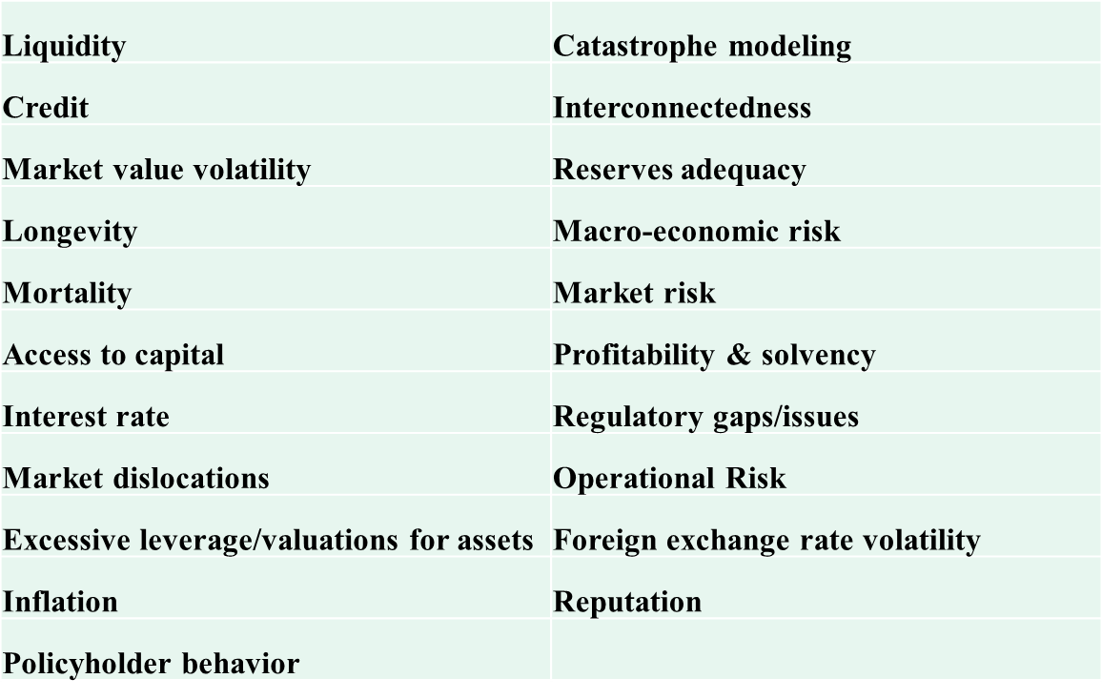
Risk Categories
Notes:
As I said, one of the products of the IAIS’s Macroprudential Subcommittee was the development of a working document that listed broad risk categories that could impact insurance. The working document listed twenty one risk categories that it considered important. Also included in the working document were brief descriptions of each risk category and examples of potential downside scenarios to illustrate the subcommittee’s intentions.
Although all of the risk categories on the list were considered important by the subcommittee, it did prioritize the risk categories into high, medium and low. The distinctions focused on near term deliverability as well as the potential for risks escalating quickly as opposed to having a longer development period.
The next steps of the subcommittee are to consider and make recommendations for indicators and tools for insurance supervisors to monitor these risks on a global, regional and national level, using common definitions and data points.
The idea of having common definitions and data points is an important aspect. Level setting so that insurance supervisors globally are speaking from the same book will improve the dialogue and enhance all of our ability to coorperate.

Slide 8
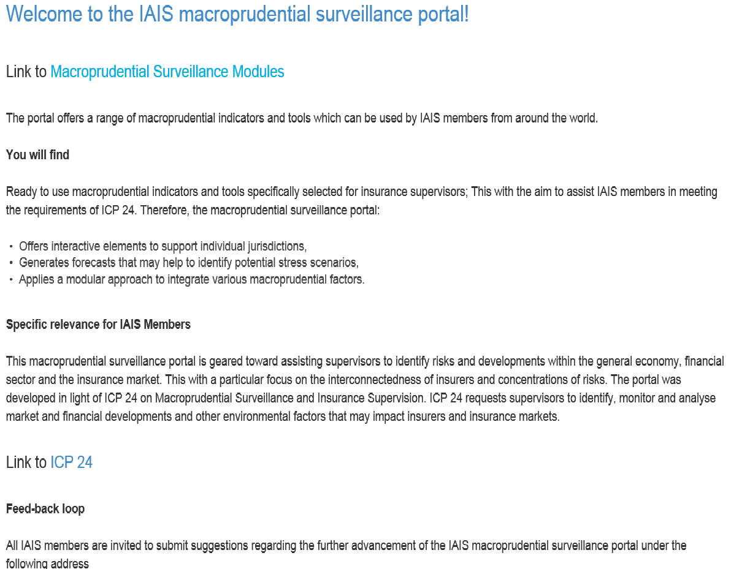
Macroprudential Knowledge Portal
Notes:
A second piece towards level setting that is just being launched at the end of this year is the Knowledge Portal. This is a page on the IAIS website that is for insurance supervisors only. It will be a way to share common information and be useful in building our understanding of macroprudential surveillance as well as the tools needed for policy development to deal with these issues.
To start out with there are four modules to the portal.

Slide 9
Notes:
The first module contains very basic data on the insurance industry generally. Some key statistics.

Slide 10
Notes:
The second module takes us to some more advanced data. This is information that is not so specific to the basic solvency profile of the industry or insurance market information. In its initial population, it takes us to broader market indicators.
As the indicators for the risk categories I previously talked about are developed, it is here that we will be sharing information.
The expectation is that the data here will be updated on a fairly regular basis, at least annually, hopefully quarterly. Maybe more often for those data points that are more volatile.

Slide 11
Notes:
The third module will vary in its content from time to time. At the outset, this will have some of the work of the US. Published items of the NAIC. Capital Markets Special Reports that provide some good information on the investment exposures of US insurers. But also some snapshot information for each the insurance sectors on size and growth in the US.

Slide 12
Notes:
The fourth and final module is a space for sharing what is the most current thinking on the topic of macroprudential policy and surveillance. Things like academic papers and more advanced research.

Slide 13
MACROPRUDENTIAL SURVEILLANCE AND THE NAIC

Slide 14
NAIC Tools and Support
Capital Markets Bureau
Financial Regulatory Services
Notes:
Within the US state regulatory system, there are a number of ways we focus on macroprudential issues.
While each individual state insurance department is responsible for this, there is support that we get from the NAIC. I would like to highlight two groups within the NAIC that provide support to state regulators.
The Capital Markets Bureau is based in the NAIC’s Capital Markets & Investment Analysis Office in New York. The Financial Regulatory Services Department is located in the NAIC’s Central Office in Kansas City.

Slide 15
Capital Markets Bureau
Putting information readily in the hands of insurance regulators
Capital Markets Daily Newsletter
Hot Spots
Capital Markets Conference Calls
Investment Portal
Special Reports
Notes:
The NAIC’s Capital Markets Bureau monitors developments and trends in the financial markets. It has a number of ways to pass along potential concerns to state insurance regulators, all with the idea of making information easily available.
The daily newsletter is for regulators only. It provides regulators with a brief summary of the top news headlines and the exposure within US insurance companies where appropriate.
Some issues are further highlighted in what we call a Hot Spot. These are things that are not a major problem for the US insurance industry, but still are things regulators should pay attention to.
The Bureau also holds conference calls on the quarterly basis, again for regulators only. This gives the staff an opportunity to highlight analysis of trends, but also gives regulators a chance to ask questions and get clarifications, both about topics that were discussed as well as about any other topic of interest that has to do with investments.
Regulators are also provided easy access to market data and different reports through a secure page on the NAIC’s website. This is very much like the IAIS’s Knowledge Portal I described earlier.
One of the regularly referenced tools for US insurance regulators are the Capital Markets Special Reports

Slide 16
Capital Markets Special Reports
Notes:
As market conditions vary, the NAIC’s Capital Markets Bureau focuses on issues that may have an impact on insurers investment portfolios and may require regulatory attention. In many instances, after analyzing the exposure within US insurance companies, they will report on their findings in Special Reports. While available to the general public, these are targeted specifically to the concerns of insurance regulators. Most recent, was a report on the growing market for Insurance Linked Securities and potential implications for Reinsures and the more traditional reinsurance market.
In the past, the Capital Markets Bureau has done pieces on derivatives exposure, investments in a variety of different asset types, different portfolio strategies such as involvement in securities lending and repurchase agreements. Many times the result of their analysis is that there is not significant reason for concern, and that is just as important as raising alarm bells over more serious issues.

Slide 17
GAO Report (2013)
“NAIC also expanded its Capital Markets Bureau activities during the crisis to help analyze information on the insurance industry’s investments, such as exposure to potential market volatility, said NAIC officials.
For example, one state said that the report on the effects of the European debt crisis on U.S. insurers was useful and another state said the reports on securities lending helped focus their dialogue with domiciled insurers about their risk management practices.”
Notes:
The U.S. General Accounting Office in 2013 completed a study and published a report analyzing Impacts of and Regulatory Response to the 2007-2009 Financial Crisis in the Insurance Markets. The report noted that the US insurance industry fared relatively well through the financial crisis and the system of state based insurance regulation in the United States proved to be effective.
The report also noted on several occasions the usefulness of the Capital Markets Special Reports in focusing attention on potentially problematic situations before they become problems. This is true not just on an industry wide basis, but also when US regulators are dealing with individual companies that they regulate. In the risk-focused examination process, it is important to spend time and resources on those areas that can have a negative impact on solvency.

Slide 18
Financial Regulatory Services
Supports state insurance departments in solvency monitoring efforts and initiatives
Macro-prudential efforts include:
Identification, research and communication of emerging issues through FAWG process
Semi-annual monitoring and reporting on industry financial results
Ad hoc queries of FDR database to identify emerging risks and trends
Notes:
One important regulator group that focuses on these broad issues at the NAIC is the Financial Analysis Working Group, or FAWG. The FAWG process involves a team of analysts that monitors company financial performance. These efforts often result in the identification of macro-prudential issues that are researched and communicated to state insurance departments. In addition, analysts from the NAIC’s Financial Regulatory Services monitor industry wide results for the property & casualty, life and health insurance segments in the U.S. and produce semi-annual reports on the state of each industry segment for distribution to state insurance departments. Finally, FRS staff routinely perform ad hoc queries of various company financial information maintained in the NAIC Financial Data Repository (FDR) database to identify emerging risks and trends. Risks identified through these queries are communicated to state insurance departments to support their ongoing monitoring efforts.

Slide 19
Framework Enhancements
Macro-prudential surveillance results in ongoing enhancements to the U.S. solvency monitoring framework
RBC, Accounting & Reporting, Exam Procedures, etc.
Specific recent examples include:
ORSA Requirements
Risk Focused Surveillance
Notes:
As macro-prudential issues are identified, the impact of these issues is considered in developing enhancements to the U.S. solvency monitoring framework. This includes modifications to risk-based capital charges, accounting and reporting requirements and suggested exam/analysis procedures. A couple of specific recent examples of enhancements to the U.S. solvency monitoring framework include the development of U.S. ORSA requirements and modifications to risk-focused surveillance practices.

Slide 20
U.S. ORSA Requirements
Risk Management and Own Risk & Solvency Assessment Model Act
Requires all insurers to maintain a risk management function
Large insurers must perform an ORSA and report results annually to regulators
Section 1 – Risk Management Framework
Section 2 – Assessment of Risk Exposures
Section 3 – Group Risk Capital and Prospective Solvency Assessment
Effective 1/1/2015
Notes:
ORSA requirements have been developed to be flexible enough to address macro-prudential issues that are relevant at that time. The NAIC’s ORSA requirements should allow regulators to get more access to information from insurers regarding how they manage their most significant solvency risks. They will help ensure that all U.S. insurers are required to maintain an effective risk management function. Those insurers that write more than $500 million in annual premium, or insurance groups that write more than $1 billion in annual premium, will be subject to ORSA reporting requirements. This reporting will provide regulators information on the most significant solvency risks that the insurer has identified, the insurer’s processes for identifying, monitoring and mitigating those risks and the insurer’s calculation of its economic capital requirements and prospective solvency position.
While much of this information will be company specific, regulators will be able to get an understanding of broader issues impacting the insurance industry by looking across the various ORSAs that are received. This information should allow regulators to customize their solvency monitoring of individual insurers, as well as identify broad issues that may need to be addressed at the industry-wide level.

Slide 21
U.S. ORSA Requirements
Guidance for regulatory use in reviewing and assessing ORSA under development
Plan to incorporate review and assessment into existing Financial Analysis and Financial Examination processes
Information provided in ORSA summary report should assist in streamlining risk-focused monitoring processes
Small insurers expected to implement risk management concepts
Notes:
Guidance for regulator use in reviewing and utilizing ORSA reporting is continuing to be developed and refined. However, the primary focus will be on assessing a group’s Enterprise Risk Management processes through the use of a maturity model. Groups demonstrating more mature processes will be rewarded with more efficient examinations and monitoring processes. Companies with less mature, robust frameworks will be subject to greater regulator scrutiny and review.
Smaller insurers not subject to ORSA reporting requirements will not be exempt from a review of their ERM capabilities, but such a review will be customized based on the nature and extent of the risks the company is exposed to.

Slide 22
Risk Focused Surveillance
Ongoing enhancements include:
Increased focus on holding company/group issues
Increased focus on emerging & prospective risks
Increased focus on risks known to cause company failures
Improved communication between functions (analysis & examination) and states
Notes:
Risk Focused Surveillance is the term we use to describe our company monitoring system in the U.S. Some of the most recent changes that have been made to risk-focused surveillance in light of macro-prudential surveillance are listed on this slide:
Risk-focused surveillance now requires additional financial analysis at the group level, and communication of that analysis to impacted states. States are also conducting and participating in more supervisory colleges. Finally, U.S. regulators are starting on a project to obtain direct authority over Holding Company groups and the ability to apply financial reporting and capital requirements at the group level.
There is an increased focus on emerging and prospective risks that will come through the review and consideration of ORSA information. However, even for companies that don’t provide ORSA reporting, the focus of our work is turning more to prospective risks that could threaten the future solvency of the company. This includes additional focus on development strategies, as opposed to simply historical performance.
In addition to considering new and emerging risks, we are honing our focus on risks known to have caused company failures.
Another enhancement we are working on within our framework is in improving communication across functions, to ensure that the most critical risks facing insurers are being effectively monitored through both off-site analysis and on-site examination. The efforts are to emphasize the use of a consistent language in communicating about ongoing risks and to suggest specific procedures for follow-up and additional testing.

Slide 23
Questions?
Notes:
While paying attention to economic and market conditions that could have an impact on the industry has always been an important aspect of insurance regulation, the still recent memories of the financial crisis has raised this to a new threshold. We recognize the fundamental reality that sound management at the individual company level can be overrun by external pressures, and that the insurance industry and insurance entities are more and more interconnected with other financial institutions. This makes them, unfortunately, vulnerable to macro issues.

