Slide 1
Corporate Governance of the Insurance companies
ASSAL 19 November 2014
Annick Teubner
Chair, IAIS Governance Working Group

Slide 2
Agenda
Introduction IAIS principles
Why Corporate Governance matters
Revision ICPs: topics 2014
Effective corporate governance
Supervisory review of effective corporate governance

Slide 3
IAIS Framework for Insurance Supervision
Supervisory action
Supervisory assessment & intervention
Regulatory requirements
Financial
Governance
Market conduct
Basic conditions for the effective functioning of insurance sector &supervision
Preconditions
3
Notes:
3

Slide 4
Insurance Core Principles (ICPs)
Purpose: “maintaining a fair, safe and stable insurance sector for the benefit and protection of the interests od policyholders, beneficiaries and claimants …contributing to the stability of the financial system.”
Provide a globally accepted framework for supervision of the insurance sector.
ICP Framework
Statements – highest level, prescribes essential elements to promote a financially sound insurance sector
Standards - set out key high level requirements that are fundamental to the implementation of the ICP statement
Guidance - provides detail on how to implement an ICP statement or standard.

Slide 5
Why Corporate Governance matters
General Motors
HBOS
HP
LIBOR
ENRON
BCCI
AHOLD
Worldcom
Parmalat
‘Capital opens the door – without it you can’t start the business. But to be successful you need governance and risk management’

Slide 6
CG foundation of insurers business
Structures to establish and implement
objectives, strategy and risk appetite and
controls
Roles, responsibilities and relationships
Board, business and control functions
Culture/incentives/behaviour
Integrated framework – interactive elements
Board
Business
CF

Slide 7
Relevant Insurance Core Principles
ICP 7: Corporate Governance
The supervisor requires insurers to establish and implement a corporate governance framework which provides for sound and prudent management and oversight of the insurer’s business and adequately recognises and protects the interests of policyholders.
ICP 5: Suitability of Persons
ICP 8: Risk Management and Internal Controls

Slide 8
Revision ICPs
Revision governance ICPs in 2015
SAPR;
revised Governance principles OECD
revised Governance principles BCBS
IMF Global Financial Stability Report
Hot topics:
Board responsibilities
Effectiveness - behavioural factors:
independence, time commitment, suitability, culture
Supervisory review

Slide 9
ICP 7 Responsibilities of the Board and senior management
7.1 Setting objectives and strategies of the insurer 7.2 Allocation of oversight and management responsibilities
7.5 Risk management & internal control systems & functions
7.6 Remuneration policy and practices
7.7 Reliable and transparent financial reporting
7.8 Transparency & communications
7.9 Duties of senior management

Slide 10
7.2 Allocation of responsibilities and oversight
BLUE = input ; GREEN = direction ; RED = oversight / control
Day-to-day management
(man body)
Strategy and Direction
(Sup body)
Independent Control
(Control Functions)
Oversight
(Sup Body)

Slide 11
Effectiveness of Governance framework
Behaviour
External Direction: legal framework
Culture
Values - practices
Internal direction:
strategy - incentives
Effective Corporate Governance

Slide 12
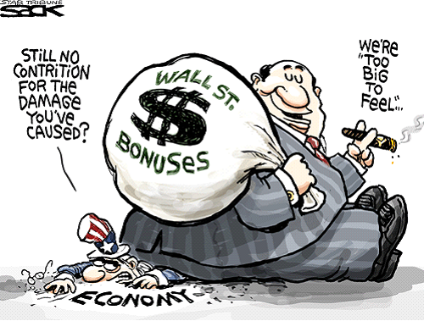
Remuneration
7.6 The Board shall have oversight of remuneration policies and practices (incentives for compensation and risk taking)

Slide 13
ICP 7 Board composition and structure
7.3 Structure and governance of the Board
ensure that there is an overall adequate level of knowledge, skills and expertise at the Board level
practices and procedures for efficient, objective and independent judgment and decision making
7.4 Duties of individual Board members
exercise independent judgment and objectivity in his/her decision making, taking due account of the interests of the insurer and policyholders

Slide 14
ICP 5 Suitability of Persons
“The supervisor requires Board Members, Senior Management, Key Persons in Control Functions and Significant Owners of an insurer to be and remain suitable to fulfil their respective roles”.
  Knowledge/experience (proper understanding of the business)
  Skills
  Attitude and behaviour
    Suitable background, education and professional expertise/ understand and respect the law / ethical behaviour / avoid conflicts of interest etc.

Slide 15
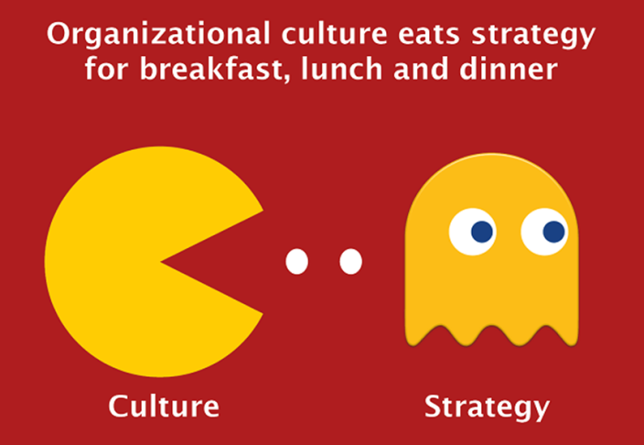
Corporate Culture
IMF Global Financial Stability Report
‘It is impossible to design an incentive structure that leads a bank manager to make the “right” decision every time... In cases in which incentive rules are insufficient, corporate culture will guide decisions and complement a bank’s ability to manage risk.
Corporate culture thus provides a set of unwritten, but widely accepted, rules that determine acceptable behavior— which in some corporate cultures may include disregarding written rules.’

Slide 16
Culture: indicators
FSB paper on risk culture - 4 indicators of a sound risk culture:
Tone from the top
Accountability
Effective communication and challenge
Incentives

Slide 17
Supervisory review
  Supervisory powers
  7.10 regarding the adequacy and effectiveness of corporate governance frameworks
  ICP 11 to impose corrective measures
Trends
Lack of robust, frequent and ongoing supervision
Need fot new supervisory approaches to assess effectiveness

Slide 18
Supervisory review effectiveness
No prescriptive approach / compliance exercise
Own assessment – dialogue with supervisor
Assessing effectiveness is assessing:
Behaviour of people
Business model & strategy
Compensation and personnel decisions
Supervisor needs new skills, instruments and approaches

Slide 19
Supervisory review suitability: DNB practice
Desk research
Check antecedents
Interview(s) with proposed candidate
Interviews references
Collective suitability: competences matrix
New approach: objections doubled

Slide 20
Suitability: DNB Competences Matrix
http://www.toezicht.dnb.nl/en/binaries/51-226115.doc
4 factors - D. Balanced and consistent decision-making
4 factors –
Knows how the internal decision-making process is organised
Knows when to ask for missing information to fulfil his/her task adequately
Is capable of and has experience with ensuring that sufficient alternatives are being weighed in a decision-making process
Knows how in a decision-making process the interests of all stakeholders are weighed and has experience with this
Has knowledge of and experience with recognizing and raising the issue of conflicts of interests in the decision-making process
Is capable of sufficiently assessing whether decisions have been taken in line with the company strategy
Knows how decision-making is laid down carefully and has experience with this

Slide 21
Evaluation of culture: DNB practice
IMF
the “tone from the top” is important in shaping risk taking - supervisors should evaluate risk culture and governance regularly.
DNB
qualitative assessment of bank conduct and culture as a complement to the more traditional prudential supervision
supervision focuses on leadership styles; the example that leaders set; accountability; shared values; openness to discussion; and the effects of groupthink.

Slide 22
Governance 2.0: effectiveness and pro-active supervision

Slide 23
Thank you for listening and for contributing.
Any questions?

Slide 24
Annex
IAIS Governance Working Group

Slide 25
IAIS Governance Working Group
The Governance Working Group (GWG) has been established to provide a framework to develop high level corporate governance principles and guidance applicable to the insurance industry and in insurance supervision.
To this end the GWG will:
Recommend and provide input to standard-setting work relating to corporate governance;
Contribute to the development of the Common Framework for the IAIGs;
Promote the effective and efficient application of governance-related supervisory and supporting material;
Cooperate with other IAIS committees and liaise with other relevant regional or international bodies.

Slide 26
Annex ICP 7 Standards

Slide 27
ICP 7 Overview of Standards
Setting objectives and strategies of the insurer (7.1)
Allocation of oversight and management responsibilities (7.2)
Structure and governance of the Board (Standard 7.3)
Duties of individual Board members (7.4)
Risk management & internal control systems & functions (7.5)
Remuneration policy and practices (7.6)
Reliable and transparent financial reporting (7.7)
Transparency & communications (7.8)
Duties of senior management (7.9)
  10th Standard : Supervisory Review (7.10)

Slide 28
ICP 7 Standards
7.1 Objectives and Strategies of the Insurer
The supervisor requires the insurer’s Board to set and oversee the implementation of the insurer’s business objectives and strategies for achieving those objectives, including its risk strategy and risk appetite, in line with the insurer’s long term interests and viability.

Slide 29
ICP 7 Standards
7.2 Appropriate Allocation of Oversight and Management Responsibilities
The supervisor requires the insurer’s Board to:
ensure that the roles and responsibilities allocated to the Board, Senior management and Key Persons in Control functions are clearly defined so as to promote an appropriate separation of the oversight function from the management responsibilities; and
provide adequate oversight of the Senior Management.

Slide 30
ICP 7 Standards
7.3 Structure and Governance of the Board
The supervisor requires the insurer’s Board to have, on an on-going basis:
an appropriate number and mix of individuals to ensure that there is an overall adequate level of knowledge, skills and expertise at the Board level commensurate with the governance structure and the nature, scale and complexity of the insurer’s business;
appropriate internal governance practices and procedures to support the work of the Board in a manner that promotes the efficient, objective and independent judgment and decision making by the Board; and
adequate powers and resources to be able to discharge its duties fully and effectively.

Slide 31
ICP 7 Standards
7.4 Duties of Individual Board Members
The supervisor requires the individual members of the Board to:
act in good faith, honestly and reasonably;
exercise due care and diligence;
act in the best interests of the insurer and policyholders, putting those interests of the insurer and policyholders ahead of his/her own interests;
exercise independent judgment and objectivity in his/her decision making, taking due account of the interests of the insurer and policyholders; and
not use his/her position to gain undue personal advantage or cause any detriment to the insurer.

Slide 32
ICP 7 Standards
7.5 Risk Management and Internal Control Systems and Functions
The supervisor requires the insurer’s Board to provide oversight in respect of the design and implementation of sound Risk management and internal control systems and functions.

Slide 33
ICP 7 Standards
7.6 Remuneration Policy and Practices
The supervisor requires the insurer’s Board to:
adopt and oversee the effective implementation of a remuneration policy, which does not induce excessive or inappropriate risk taking, is in line with the identified Risk appetite and long term interests of the insurer, and has proper regard to the interests of its stakeholders; and
ensure that such a remuneration policy, at a minimum, covers those individuals who are members of the Board, Senior Management, Key Persons in Control functions and other employees whose actions may have a material impact on the risk exposure of the insurer (major risk–taking staff).

Slide 34
ICP 7 Standards
7.7 Reliable and Transparent Financial Reporting
The supervisor requires the insurer’s Board to ensure there is a reliable financial reporting process for both public and supervisory purposes which is supported by clearly defined roles and responsibilities of the Board, Senior management and the external auditor.

Slide 35
ICP 7 Standards
7.8 Transparency and Communications
The supervisor requires the insurer’s Board to have systems and controls to ensure the promotion of appropriate, timely and effective communications with the supervisor and relevant stakeholders on the governance of the insurer.

Slide 36
ICP 7 Standards
7.9 Duties of the Senior Management
The supervisor requires the insurer’s Board to have appropriate policies and procedures to ensure that Senior Management:
carries out the day-to-day operations of the insurer effectively and in accordance with the insurer’s strategies, policies and procedures;
promotes a culture of sound risk management, compliance and fair treatment of customers;
provides the Board adequate and timely information to enable the Board to carry out its duties and functions including the monitoring and review of the performance and risk exposures of the insurer, and the performance of Senior Management; and
provides to the relevant stakeholders and the supervisor the information required to satisfy the legal and other obligations applicable to the insurer or Senior Management.

Slide 37
ICP 7 Standards
7.10 Supervisory Review
The supervisor has the power to require the insurer to demonstrate the adequacy and effectiveness of its Corporate governance framework.

