Slide 1
Seminar NAIC/ASSAL/SVS
Regulation & Supervision of Market Conduct
Market
Analysis
© 2014 National Association of Insurance Commissioners

Slide 2
overview
Introduction
Goals
Levels of Interest
Levels of Analysis
Baseline Analysis
Level 1 Analysis
Level 2 Analysis
After Analysis
Open Issues

Slide 3
introduction
Market Analysis is a structured and formalized system of collecting, organizing, and analyzing data and other information to enable regulators to identify general market disruptions and specific market conduct problems as soon as possible.

Slide 4
goals
Increase Effectiveness
Improve Efficiency
Encourage Uniformity
Enhance Collaboration

Slide 5
Levels of interest
Analysis of entire insurance market
Selection of outlier companies
Analysis of a specific company
More detailed analysis of a company to identify areas of interest

Slide 6
Levels of analysis
Baseline Analysis
Level 1 Analysis
Level 2 Analysis

Slide 7
Baseline analysis
A systematic process whereby basic parameters are used to evaluate the entire marketplace in order to identify those companies that require more detailed and thorough analysis.
Provides high level comparison based on complaint, financial, regulatory activity and demographic information.
Identifies companies that need further, more detailed analysis, called Level 1 and Level 2 Analysis.
Provides raw data from the NAIC systems and an automated score.
Relies on the Market Analysis Prioritization Tool (MAPT).

Slide 8
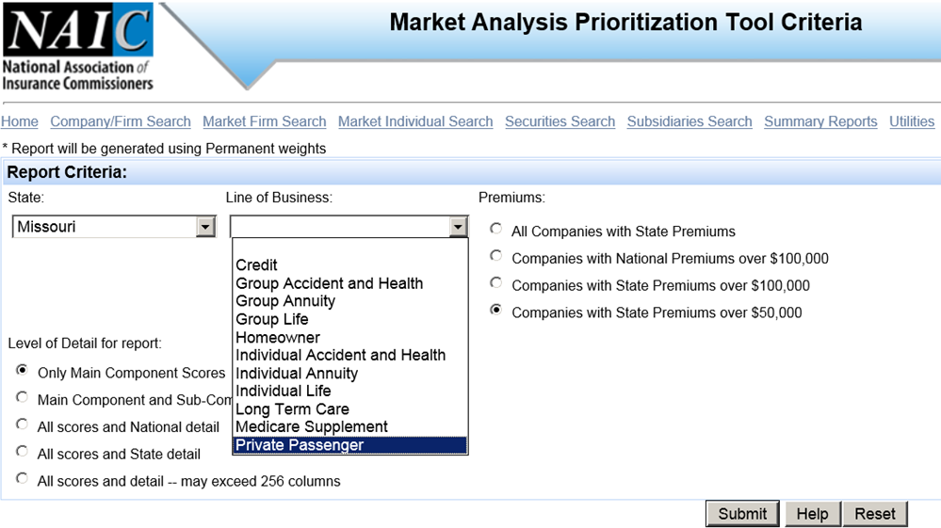
Baseline analysis

Slide 9
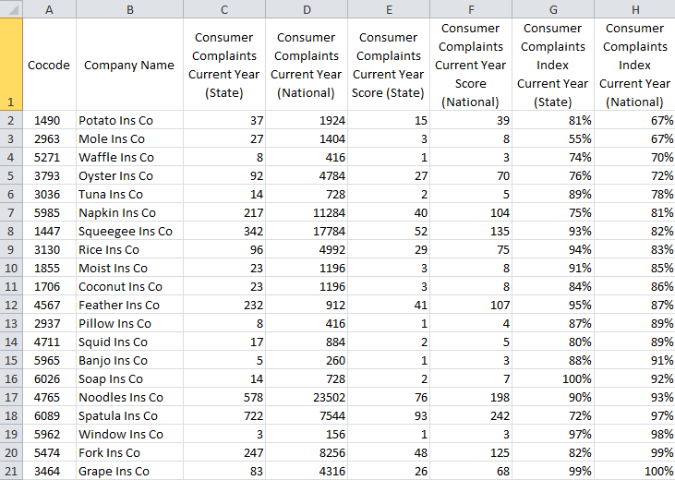
Baseline analysis

Slide 10
Baseline analysis
Consumer Complaints
IRIS Ratios
Regulatory Actions
Premium
Market Share
Loss Ratio
Claim Defense Cost
Expense Ratio
Examinations
Merger and Acquisition
Domiciliary Change
Licensed Jurisdictions
National Score
State Score
Overall Score

Slide 11
Level 1 analysis
A uniform, checklist-driven, process to evaluate a specific company in the insurance marketplace.
Identifies companies that appear to not have any further concerns or need additional, even more detailed analysis, called Level 2 Analysis.
Provides a detailed review of uniform information from NAIC Databases and ability to share information with other analysts and states.
Relies on the Market Analysis Review System (MARS).

Slide 12
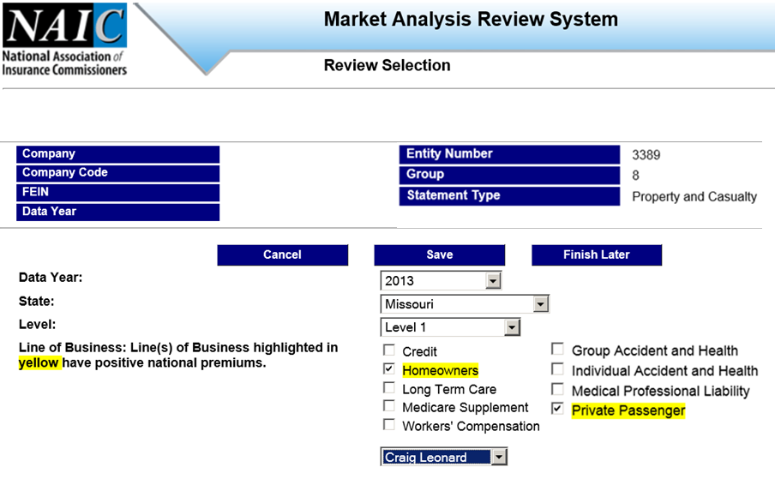
Level 1 analysis

Slide 13
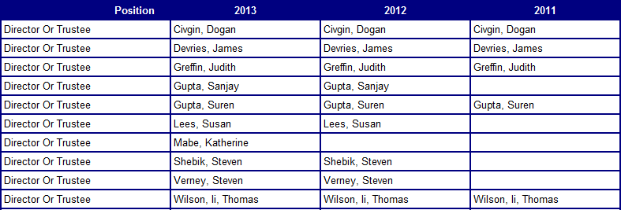
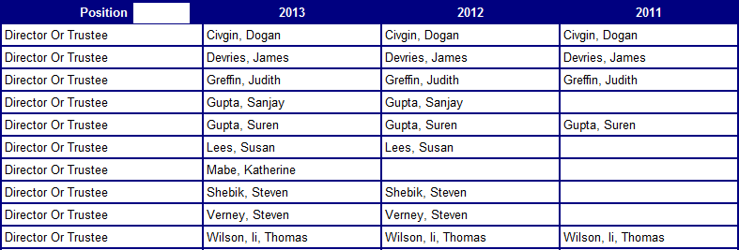
MARS Level 1 Operations and Management

Slide 14
Mars Level 1 Loss and Expense Ratios

Slide 15
Level 1 analysis
Company Operations/ Management
Financial Ratios
Regulatory Actions
Examinations
Premium Information
Market Share
Loss and Expense Information
Resisted and Unpaid Claims
Complaints
Market Conduct Annual Statement
Recommendation

Slide 16
Level 2 analysis
A uniform process to perform a detailed evaluation of a specific company in the insurance marketplace.
Is intended to be conducted without the need to contact the company for further information.
Provides a detailed review of information from the company at the Department of Insurance.
Relies on the Market Analysis Review System (MARS).

Slide 17
Mars Level 2 Core Areas

Slide 18
Level 2 analysis
Market Analysis
Consumer Complaints
Interdepartmental Communications
Continuum Activity
Examinations
Regulatory Actions

Slide 19
Level 2 analysis
Department Filings
Dispute Resolution Activity
Financial Analysis
Financial Rating Agencies
Geographic Analysis
Human Resource Department
Internet
Legal Information
NAIC Bulletin Boards
Other Governmental agencies
Producer Licensing
Special Activities Database
State Mandated Items
Trade Publications and other Media Sources
Voluntary Accreditation and Certification Programs

Slide 20
After analysis
Do nothing
Continuum Action
Examination

Slide 21
Open issues
Need to understand being an analysis is different than being an examiner.
Need to understand analysis does not immediately generate evidence of a violation.
Need for even more data.
Need to balance the regulator’s need for data with requirement of additional resources.
Need for a continued evolution of market analysis.

Slide 22
summary
Introduction
Goals
Levels of Interest
Levels of Analysis
Baseline Analysis
Level 1 Analysis
Level 2 Analysis
After Analysis
Open Issues

Slide 23
QUESTIONS/COMMENTS

