Slide 1
Insurance in the context of principles for sustainable insurance (PSI) of the UN environment program financial initiative, and climate change effects on the insurance industry
Mike Kreidler
Washington State Insurance Commissioner

Slide 2
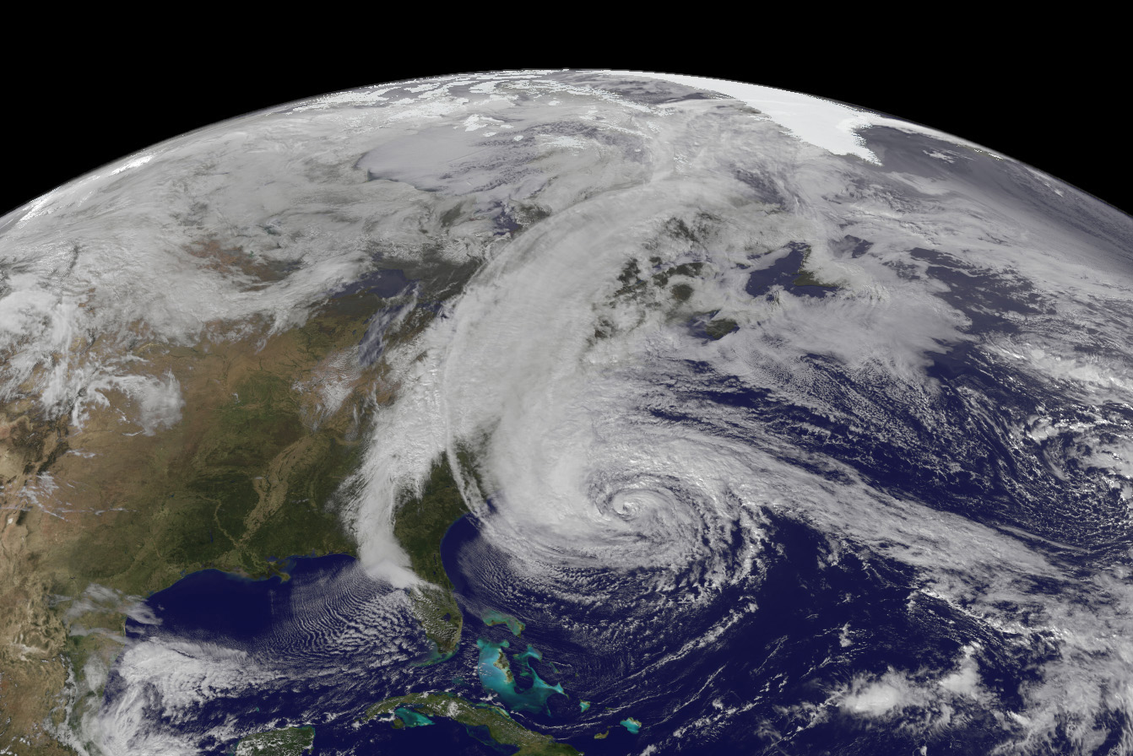
Superstorm sandy 2012
Notes:
Hurricane/Superstorm Sandy 2012.

Slide 3
Climate Change Risks to Insurers
Climate change has the potential to impact nearly every segment of the insurance industry, including:
Property, crops and livestock
Health and life
Business interruption
Directors & officers liability (D&O)
Pollution liability
Breakdown in backwards-looking cat models and actuarial assumptions
Invested assets

Slide 4
Key Insurance Regulatory Goals
Ensure availability and affordability of insurance
Conduct financial examinations
Encourage enterprise risk management principles
Own-Risk Solvency Assessment (ORSA)
Promote strong building codes and loss-mitigation efforts
Collect data
Disclosures and reporting requirements

Slide 5
For Insurers, Climate Change is an Emerging Risk to be Managed...
Insurers are....
Messengers
Integrators
Risk assessors
Risk managers
but...
Vulnerable
Flying partly blind
Selective
and....
Part of the solution

Slide 6
Insurers’ Investments
Risks to insurers’ investments:
Stranded assets
Economic volatility
Reputational risks
Clean and renewable technologies
Energy efficiency

Slide 7
Incentivize Innovation, Mitigation
Loss prevention
Strong building codes
Effective land-use planning
Policyholder education
New modeling techniques
Developing new products
Green building components
Usage-based auto insurance
Pricing incentives for policyholder mitigation

Slide 8
Risk-Assessment Tools
Own-Risk Solvency Assessment (ORSA)
Should reflect insurer’s specific risk assessment and appetite
Regulators set goals, but do not dictate how insurers reach them
Financial examinations
Recent additions to Financial Condition Examiners Handbook
Provide an examination framework for climate risks and their impact on how an insurer invests its assets and prices its products

Slide 9
Climate Risk Disclosure Survey
8 questions for insurers that assess insurer strategy and preparedness in the areas of investments, mitigation, financial solvency (risk management), emissions/carbon footprint and engaging consumers. Premium threshold is $100 million in direct written premium.
Five state regulators participated in the 2015 survey, led by California. Other state regulators gather information through financial examinations, but it’s not reported publicly.
If more states join the survey, more insurers will be prepared to publicly discuss their climate risks.

Slide 10
Climate Risk Disclosure Survey Results
Reporting year 2014 responses, compiled by the California Department of Insurance:
78% of companies indicated they have a plan to assess, reduce or mitigate emissions.
Only 38% of companies have a climate change policy with respect to risk and investment management.
73% of companies had a process for identifying climate change-related risks and assessing the degree that they could affect business, including financial implications.
77% of companies summarized their current or anticipated climate change risks.

Slide 11
Climate Risk Disclosure Survey Results
72% of companies had considered the impact of climate change on their investment portfolios. However, only 33% of companies had altered their investment strategy in response to these considerations.
63% of companies had taken steps to encourage policyholders to reduce the losses caused by climate change-influenced events.
67% of companies had taken steps to engage key constituencies on the topic of climate change.
75% of companies had taken actions to manage the risks climate change poses including, in general terms, the use of computer modeling.

Slide 12
Ceres Findings
P&C insurers:
Climate strategies driven by cost efficiencies and weather-related loss reductions
Property & casualty insurers were most engaged in mitigating the impact climate change can have on weather-related losses
Most common loss reduction strategies:
Limiting geographical and investment catastrophic exposure
Expanding exclusions
Defensive underwriting
Life insurers:
Climate risk mitigation strategies centered on investments

Slide 13
What More Can Insurance Regulators Do?
Adopt statutes and rules that require insurance companies to specifically address climate change risks related to investments
Conduct stress tests for insurers’ investment portfolios that focus on carbon-related investments
Establish investment categories that emphasize low-carbon/green investments
Rate insurers’ portfolios in fossil fuels as high-risk
Encourage/require insurers to adopt a prudent person investment standard (Washington state, 2012)

Slide 14
Setting the Stage for Climate Action
September 2013: The U.S. Environmental Protection Agency (EPA) proposed carbon standards for new power plants
November 2014: U.S. and China issued a bilateral announcement to jointly reduce emissions
September 2015: U.S. and China issued a Joint Presidential Statement of Climate Change, setting common goals for an agreement at COP21
December 2015: U.S. Commitment to Paris Accord largely based on lower carbon emissions from power plants

