Slide 1



Addressing the Principles for Sustainable Insurance (PSI)
ASSAL Annual Assembly – Rio de Janeiro, 20 April 2016
Martin Weymann, Senior Risk Officer, Swiss Re

Slide 2
Agenda
Swiss Re’s value proposition
The protection gap – challenges and opportunities
Swiss Re’s approach to corporate responsibility
Summary

Slide 3
Swiss Re’s value proposition

Slide 4
Global re/insurance is a catalyst for economic growth
 | What global re/insurers do | Benefit to society | Pre-requisites
Risk transfer function | Diversify risks on a global basis | Make insurance more broadly available and less expensive | Global mobility of premiums and capital
Capital market function | Invest premium income according to expected pay-out | Provide long-term capital to the economy on a continuous basis | Ability to invest in real economy (equity, corporate bonds, etc)
Information function | Price risks | Set incentives for risk adequate behaviour | Market- and risk-based pricing
Source: Swiss Re
Global re/insurers absorb shocks, support risk prevention and provide capital for the real economy

Slide 5
Swiss Re Group at a glance
Swiss Re is a leading and highly diversified global reinsurer, founded in
Zurich (Switzerland) in 1863 with more than 150 years of experience
The Group offers traditional reinsurance products and related services for property and casualty, as well as for life and health businesses
The Group also offers commercial insurance through Corporate Solutions and manages open and closed life insurance books through Life Capital
The financial strength¹ of Swiss Reinsurance Company Ltd is currently rated:
Standard & Poor’s: AA- (stable); Moody’s Aa3 (stable); A.M. Best: A+ (stable)
Swiss Re was named as the insurance sector leader in the 2015 Dow Jones Sustainability Indices
Armonk, New York
Key statistics (USD billions) FY 2011 FY 2012 FY2013 FY2014 FY 2015
Total revenues 28.0 33.6 36.9 37.3 35.7
Net income 2.6 4.2 4.4 3.5 4.6
Shareholders’ equity 29.6 34.0 33.0 35.9 32.4
¹ As at 23 February 2016
Notes:
5

Slide 6
Swiss Re is broadly diversified by geography and product line
Swiss Re Group net premium earned¹ 2015: USD 30.2bn
by region (in USD bn) … and by business segment
13.2
10.3
6.7
Americas
EMEA
Asia
44%
34%
22%
Swiss Re benefits from geographic and business mix diversification and has the ability to reallocate capital to achieve profitable growth
¹ Includes fee income from policyholders; does not reflect the exposure to HGMs through Principal Investments (PI)
Source: Swiss Re

Slide 7
The protection gap – challenges and opportunities

Slide 8
Gap between economic losses from nat cat disasters and insured losses has been increasing
USD bn
Economic development, population growth and a higher concentration of assets in exposed areas are increasing the economic cost of disasters
The protection gap for 2014 losses was USD 75bn
Urbanisation rate will continue to increase rapidly
Demand for natural catastrophe capacity is expected to increase on average by approx. 50% in mature markets and 100% in emerging markets by 2020 compared to 2012
Source: Swiss Re Economic Research & Consulting and Cat Perils, Sigma on natural catastrophes and man-made disasters

Slide 9
Different solutions are available to address the insurance gap
How to close the gap?
Economic
loss
Solution type
Description
Foregone revenues
Macro
Risk transfer solutions
for (sub)sovereigns to cover
their direct or indirect costs
Damaged public physical assets
gap
Clean up costs
Emergency relief
Pooling
Insurance schemes and pools
to increase insurance penetration; distribution and simplified products
Damaged uninsured
private assets
Insured
loss
Livelihood assistance,
rehabilitation of the poor
Micro
Simplified products distributed
via aggregators such as
MFIs, NGOs, and corporates
9

Slide 10
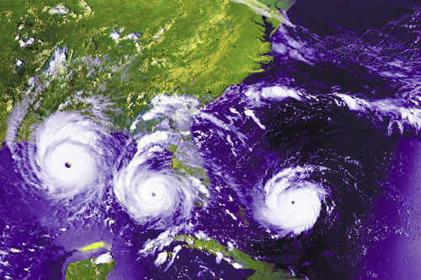
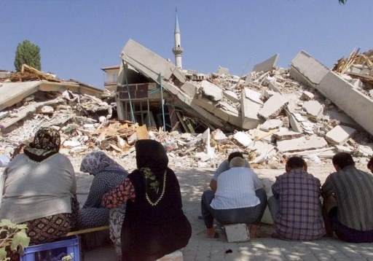
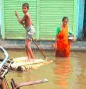
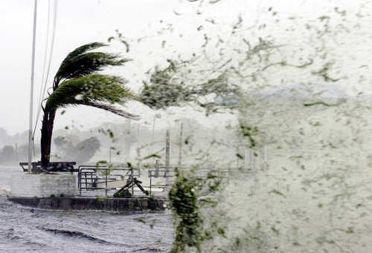

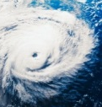
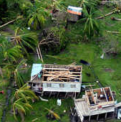


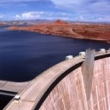
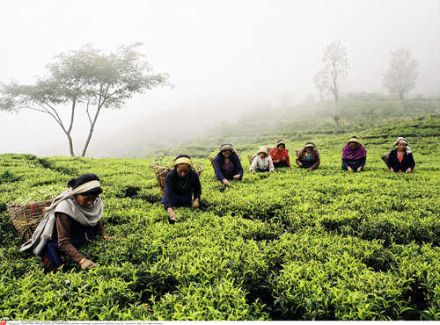
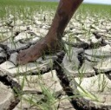
Swiss Re’s Global Partnerships unit addresses the protection gap by offering innovative risk transfer solutions
First dedicated public sector team in the reinsurance industry
Over 80 closed transactions since 2006
Insurance, reinsurance and capital markets instruments
Perils (disasters, weather, longevity, etc.)
Global footprint
Pioneer in emerging and industrialized markets
  Examples of recent Swiss Re transactions
Alabama
Hurricane risk
Turkey
Earthquake pool
Bangladesh
Meso flood
insurance
Caribbean
Hurricane and
earthquake risk
Beijing
Agricultural risk
Pacific Islands
Earthquake and tropical cyclone risk
Mexico
Earthquake/hurricane
and livestock risk
Uruguay
Energy production shortfalls
due to drought
India
Weather insurance
for farmers
Vietnam
Agriculture yield
cover
African Risk Capacity
Government drought insurance pool
(Mauritania, Senegal, Kenya, Niger Mozambique)

Slide 11
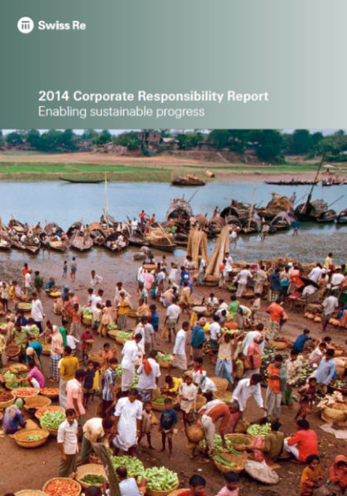
Swiss Re's approach to corporate responsibility

Slide 12

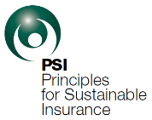



Swiss Re takes the long-term view and enables sustainable progress
Signatory of the UN Global Compact, UN Principles for Sustainable
Insurance (PSI) and UN Principles for Responsible Investments (PRI)
  Swiss Re's proprietary Sustainability Risk Framework
  implements an integrated approach to identify, assess and control the Group's risk exposure with respect to environmental, social and ethical issues
Swiss Re is an innovator in climate risk transfer solutions, as demonstrated by the launch of China's first low temperature weather index insurance programme for cotton in July 2015
UN Climate summit, 23 Sep 2014, NY: "By the year 2020, Swiss Re commits to having advised 50 sovereigns and sub-sovereigns on climate risk resilience, and to have offered them protection of USD 10bn against this risk"
  Swiss Re is included in the main ESG indices; named sector leader in 2015 Dow Jones Sustainability Indices, Swiss Re has led this ranking nine times since 2004
We generate value for shareholders and contribute to sustainable economies in the future

Slide 13
Our approach to corporate responsibility
Swiss Re's core values:
client centricity, agility, team spirit,
passion to perform, integrity
Sustainability is a guiding principle:
Taking the long-term view,
playing our part in enabling sustainable progress
Business solutions
Risk intelligence
Stakeholder dialogue
Our footprint
Active in society
Our employees

Slide 14
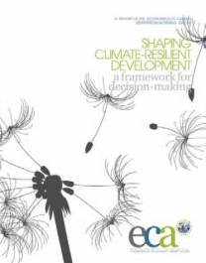
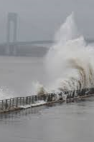

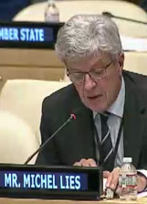
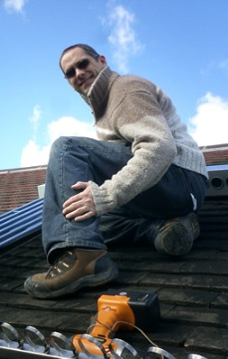
Climate change – a key risk for a reinsurer
Swiss Re's climate change strategy
Risk intelligence – assess the risk
Business solutions – seize opportunities
Advance (our) knowledge about climate change risk
Quantify climate change risk
e.g. Economics of Climate Adaptation
Integrate climate change risk into underwriting and risk management framework
Collaborate with leading institutions
→ New Climate Economy (NCE)
Develop appropriate solutions for adapting to and mitigating climate change
Traditional catastrophe insurance
Weather risk solutions
Renewable energy solutions
We promote risk transfer as a way of becoming more resilient
Stakeholder dialogue – Advocacy
Our footprint - lead by example
Raise awareness, disseminate knowledge to all stakeholders and advocate a long-term policy framework
Publications, platforms (e.g. WEF), Centre for Global Dialogue, speaking engagements
Top Topic Managing climate and natural disaster risk
Greenhouse neutral since October 2003
Reduced emissions per employee by 49.3% by 2014
CO_{You2} Programme since 2007, re-launched Jan 2014 (until 2020)

Slide 15


Recent developments (1)
Paris Agreement at COP21 2015
A new climate agreement was reached in Paris:
Some 185 nations adopted the goal to limit the rise in average global temperature to well below 2°C, with the ideal goal being 1.5°C.
The Intergovernmental Panel on Climate Change (IPCC) was commissioned to develop target emissions reduction pathways.
The agreement established a process to review national emission reduction efforts (present targets in 2020 for 2015, review every five years) and stimulate a “race to the bottom”.
To reach the goal, a reduction in carbon emissions by 40% to 70% are needed by 2050.
“CO2 could peak around 2020 if countries stick by targets” (Goldman Sachs).
“We see the deal as a boost to the low carbon economy, now a fast-growing $600 bn+ market” (Goldman Sachs)

Slide 16
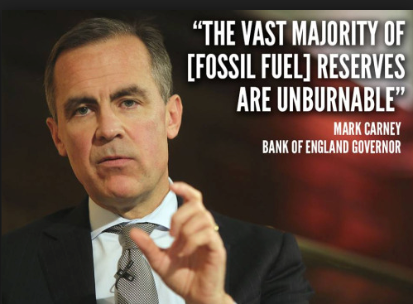
Recent developments (2): FSB highlighted climate related risks potentially affecting the financial stability
Risk highlighted by FSB:
The Financial Stability Board (FSB) was commissioned by the G20 to assess climate risks and their potential impact on the financial market.
As a result of these assessments, Mark Carney highlighted specific risks potentially affecting the stability of the financial system.
In addition, FSB established a climate risk disclosure task force (Swiss Re involved) to define standards relevant for mitigating stability risk factors.
Physical
More frequent and severe extreme weather events resulting in property damage affecting stock listed companies and their valuation.
Liabilities
Climate related lawsuits by parties having suffered losses against those stock listed companies they hold responsible.
Transition
Value depreciation of capital market traded assets due to climate-related regulation affecting owners of fossil reserves (e.g. oil companies), carbon based electricity providers (utilities) or large consumers of carbon energy (e.g. building material industry; steel industry) leading to “stranded assets”.

Slide 17
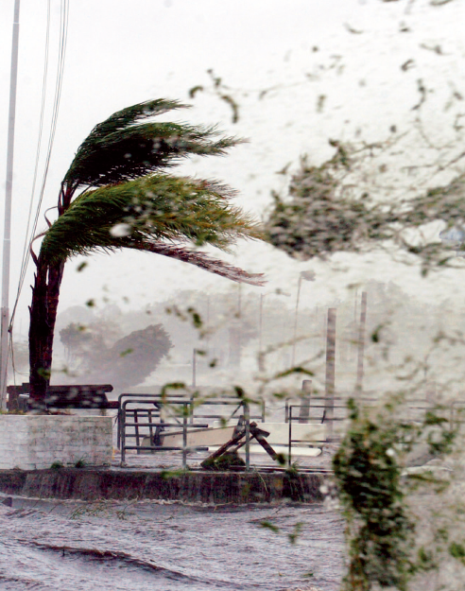
Creating business solutions for sustainability (I)
Business solutions
Risk
intelligence
Stakeholder
dialogue
Our footprint
Active in society
Our employees
Our re/insurance solutions help address key environmental and social challenges
Focus 1: Natural catastrophes and climate change
    Swiss Re offers clients innovative and effective protection against natural catastrophes
    Swiss Re provides financial protection for renewable energy projects
    Natural catastrophes constitute key risk in our P&C business (approx 1/5 of P&C premium is from nat cat in 2014)
    Understanding nat cat risk and impact of climate change is key to Swiss Re: own models, collaboration with universities, etc
    Swiss Re supports clients with strategic expertise and integral risk assessment of natural disasters, including Economics of Climate Adaptation (ECA) studies
    ECA is a framework for decision-making to enhance climate resilience and give national and local leaders the facts to understand the impact of climate on their economies
    Swiss Re is a leader in insurance-linked securities (ILS)
Notes:
17
Picture from "Closing the Financial Gap", © 2011 Swiss Re.
Information from CR Report 2013

Slide 18

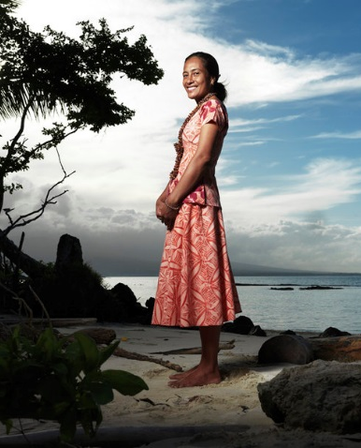
Creating business solutions for sustainability (II)
Business solutions
Risk
intelligence
Stakeholder
dialogue
Our footprint
Active in society
Our employees
Focus 2: Life & health insurance and funding longer lives
    L&H insurance products create stability for individuals and society (approx 1/3 of premium is from L&H in 2014)
    We invested in R&D to improve ability to predict mortality and longevity trends
    Protection gap: Swiss Re is working closely with local and global insurers to develop affordable solutions to help minimise the gap for everyone
Focus 3: Insurance cover in emerging markets
    Financial inclusion: Swiss Re offers innovative risk transfer solutions tailored to the needs of governments, farmers and small entrepreneurs
    Involved in a variety of projects and partnerships, including:
    Grow Africa Partnership: By the end of 2014, Grow Africa had brought weather insurance to 2 million smallholder farmers in 12 Sub-Saharan countries
    Kilimo Salama: Largest weather index insurance programme in Africa, insuring 185'000 farmers in Kenya, Tanzania and Rwanda
    MiCRO: The Microinsurance Catastrophe Risk Organisation financially protects micro-entrepreneurs in Haiti from hurricanes, earthquakes and excess rainfall
    Pacific Catastrophe Risk Insurance Pilot: Launched in 2013 and led by the World Bank, the initiative provides protection against earthquakes, tsunamis and tropical cyclones for 5 Pacific island nations
    China's first low temperature weather index insurance programme for cotton launched in July 2015
Notes:
18

Slide 19


Extending our risk intelligence
Business solutions
Risk
intelligence
Stakeholder
dialogue
Our footprint
Active in society
Our employees
Technical risk assessments
  Comprehensive approach in underwriting: e.g. proprietary nat cat models,
  Risk Engineering Services
Sustainability Risk Framework
  Identify, assess, and control the Group's risk exposure
  Eight policies on sensitive sectors and issues
Emerging Risk Management
  Systematic observation of notions associated with risks through SONAR framework
  Strategic risk initiatives: foster risk dialogue with various partners
Research Partnerships
  ProClim is an extensive network of scientists which monitors the latest climate change-related research worldwide and provides information to Swiss Re
  Integrative Risk Management Chair at ETH Zurich
  Quantify impacts on extreme weather events with the Swiss Federal
  Institute of Technology (ETH Zurich)

Slide 20
Swiss Re is a responsible investor
Investment process fully aligned with commitment to corporate responsibility
Business solutions
Risk
intelligence
Stakeholder
dialogue
Our footprint
Active in society
Our employees
Focus on creating sustainable risk-adjusted returns, aligned with the ALM framework
Consistent integration of ESG considerations to the vast majority of Swiss Re investments
Overseen by the Group Chief Investment Officer, supported by the ESG Advisory Group
Governance
Signatories to
Responsible Investment Policy
Voting Policy
Sustainability Risk Framework
Principles for Responsible Investment (PRI)
Principles for Sustainable Insurance (PSI)
Investment portfolio
About 60% of investment portfolio managed internally, mainly government bonds
  On country level, political risk and sustainability assessment as a guide on responsible investment decisions
Approx 40% of investment portfolio managed by external managers
ESG aspects are part of the selection and monitoring of external managers
Over 95% of externally managed assets are managed by entities which are signatory of PRI
Exercised 97% votes of listed equity portfolio in 2015
As of December 2015

Slide 21
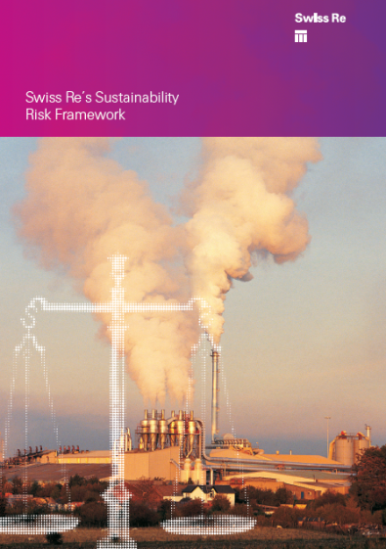
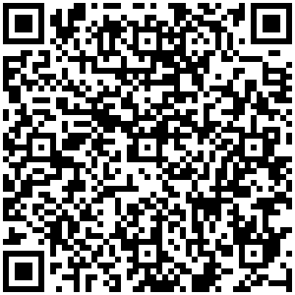
Swiss Re's Sustainability Risk Framework
Integrating sustainability into ongoing business activity
Business solutions
Risk
intelligence
Stakeholder
dialogue
Our footprint
Active in society
Our employees
  Environmental and socio-economic challenges increasingly pose a threat to society's sustainable development
  Sustainability risks have grown in significance for financial services companies. In the face of wider public scrutiny, merely complying with laws and regulations is not sufficient to mitigate such risks
  For re/insurers this creates both new opportunities and risks. Swiss Re's Sustainability Risk Framework is an advanced methodology to identify and address the risks in core re/insurance and investment transactions that arise from sustainability challenges
http://media.swissre.com/documents/
Swiss_Re_Sustainability_Risk_Framework.pdf

Slide 22


Swiss Re's Sustainability Risk Framework
Integrating sustainability into ongoing business activity
Business solutions
Risk
intelligence
Stakeholder
dialogue
Our footprint
Active in society
Our employees
Framework to facilitate the identification, mitigation and elimination of potential environmental, social and ethical risks inherent to our business transactions
  Group-wide framework established in 2009, Sustainability Risk Management in place since 2003
  Applies to insurance and investment biz, rigor of application corresponds to level of influence
  2015: screened 311 business transactions; thereof 8 were stopped
Sector- and issue-specific
policies
Number of Sensitive Business
Risk referrals
Mechanism
    Human rights and environmental
    protection
    Oil and gas
    Defence industry
    Mining
    Dams
    Forestry and logging
    Animal testing
    Nuclear weapons proliferation
    Exclusions
      Companies
      Countries¹ (Central African Republic, Chad, Congo (D.R.), North Korea, Somalia, Sudan (North), South Sudan, Syria)
      Activities as per sust. risk policies
    Due diligence process
      Business practitioner through
      SBR assessment tool
      Group Sustainability Risk SBR referral tool
    Stakeholder engagements
¹ Beyond compliance with International Trade Controls (ITCs) as of December 2015

Slide 23

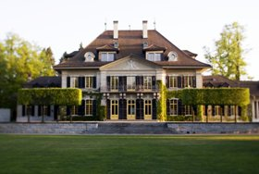
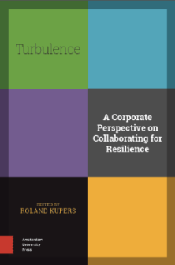
Exploring and shaping the risk landscape through dialogue
Business solutions
Risk
intelligence
Stakeholder
dialogue
Our footprint
Active in society
Our employees
5 Top Topics: Managing climate and natural disaster risk, Advancing sustainable energy solutions, Partnering for food security, Funding longer lives, Supporting financial stability
Stakeholder Engagement
Centre for Global Dialogue
Enhancing Global Partnerships
    Clinton Global Initiative (CGI): Rockefeller100 Resilient cities
    Resilience Action Initiative (RAI): "Turbulence –
    A Corporate Perspective on Collaborating for Resilience"
    and many
    others…
Leveraging knowledge and expertise to improve risk understanding
Building a global risk dialogue community with Swiss Re employees, clients and other experts
Provide lasting social and environmental impact through public private partnerships
Build on genuine needs and affordability of public sector clients
Notes:
23

Slide 24
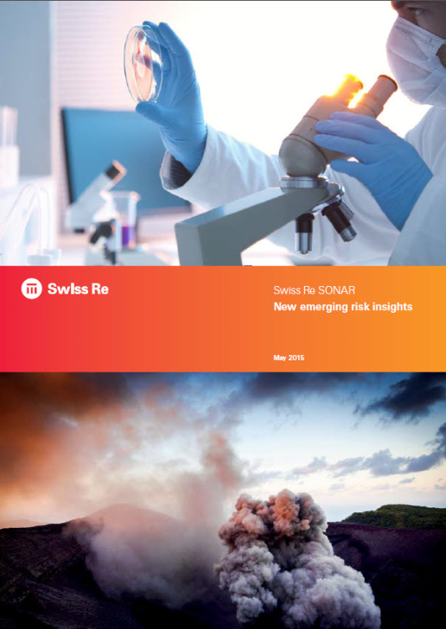

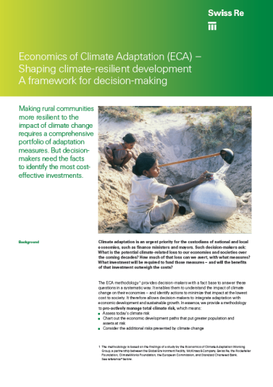
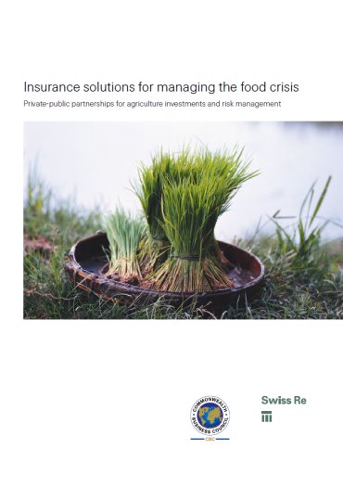
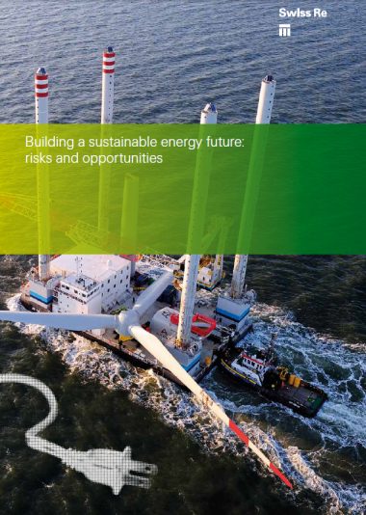
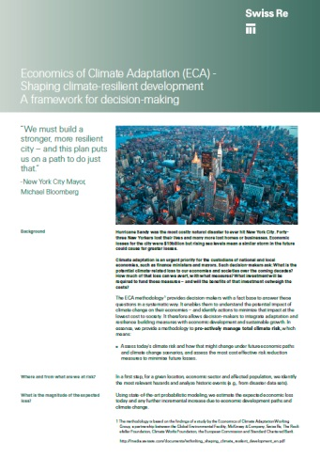
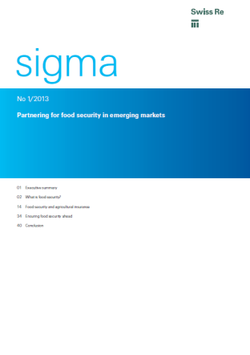
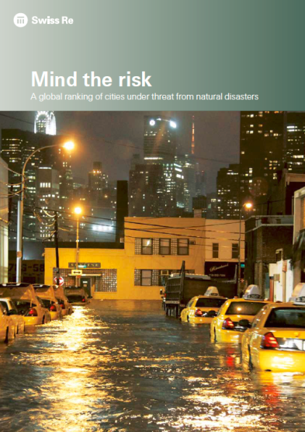
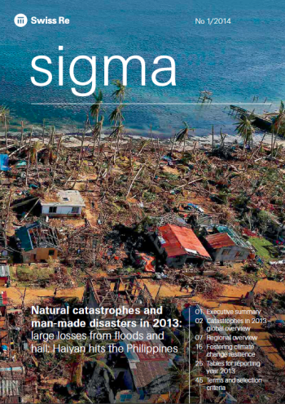
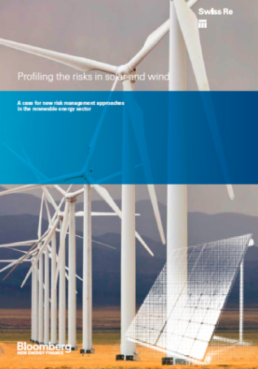
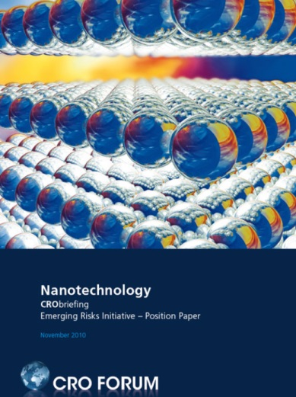
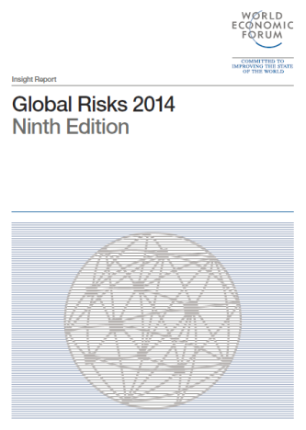
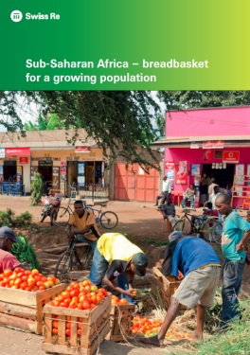
Exploring and shaping the risk landscape by publishing our insights
Business solutions
Risk
intelligence
Stakeholder
dialogue
Our footprint
Active in society
Our employees
http://www.swissre.com/library/
Notes:
Added sigma report and updated pic of the WEF Global Risks report

Slide 25
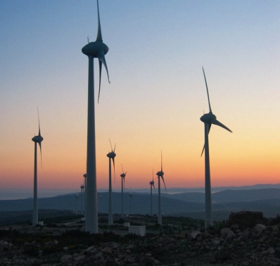

Reducing our environmental footprint
Business solutions
Risk
intelligence
Stakeholder
dialogue
Our footprint
Active in society
Our employees
1995
Energy efficiency target and policies established
First major financial services company to commit to becoming greenhouse neutral, to be reached by 2013
Target of 15% emissions reduction per employee by 2013
Offset remaining emissions via the World Bank Community Development Carbon Fund and high-quality verified emission reduction certificates
Launch of "CO_{You2} Reduce and Gain" programme
Subsidies to employees for emission-cutting investments in their private lives (e.g. hybrid cars, solar collectors)
Over-achievement of original emissions target in 2007
Main measure: switching to renewable energy at Group locations around the world
Reduction target strengthened to 30% per employee
Over-achievement of new emissions target in 2009
Further strengthening of CO₂ reduction target per employee to 45% by 2013 against base year 2003
Goal to have 100% electricity from reliable renewable sources by 2013, wherever technically feasible
Greenhouse gas emissions per employee 49.3% lower than in 2003
46.5% Reduction in energy intensity per employee since 2003
Reached goal of 100% renewable power where possible (25 locations)
Group Climate Strategy confirmed 2014-2020
Maintain GHG emissions efficiency per employee and stay committed to sourcing renewable energy (joined RE100)
Internal price on carbon – levy on travel budgets
2003
2006
2007
2009
2011
2013
2014
Notes:
25
Updated numbers based on 2013 Corporate Responsibility Report

Slide 26
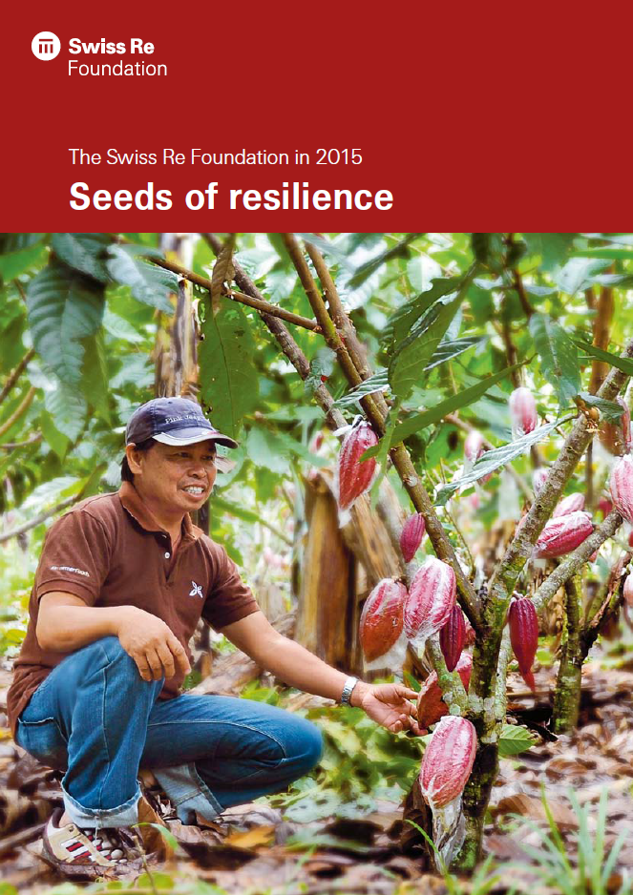
Active in society
Making Swiss Re's values visible and tangible
Business solutions
Risk
intelligence
Stakeholder
dialogue
Our footprint
Active in society
Our employees
Swiss Re Foundation – www.swissrefoundation.org
Global non-profit organisation, founded in 2012
Empowers communities to build resilience in the areas of water, climate,
natural hazards, and other topics relevant to society
We support charitable projects that strengthen the communities and give
Swiss Re employees a possibility to be engaged in volunteering
We work through partnerships with respected governmental and
non-governmental organisations, social entrepreneurs, academic
institutions, Swiss Re and its employees
We believe in the potential of market-based thinking to promote the
resilience of individuals, communities and society as a whole by furthering
entrepreneurship.
  Art & Cultural Engagement
  Swiss Re maintains a long tradition of supporting renowned cultural institutions and important cultural initiatives at Zurich headquarters
  By displaying contemporary art in the company offices Swiss Re contributes to inspiring workplaces, corporate culture and style
  These engagements support the positioning of Swiss Re's brand and corporate identity

Slide 27



Being an employer of choice
Attracting talented and diverse workforce
Business solutions
Risk
intelligence
Stakeholder
dialogue
Our footprint
Active in society
Our employees
Talent development and training
  Talent growth and skill development through Swiss Re Academy
  Talent pools, various development programmes, mentoring
  Two dimensional performance management system ("what" and "how")
  Motivated workforce: 83% of employees expressed an emotional commitment to their work according to the latest engagement survey
Diversity and Inclusion
  Inclusive corporate culture
  Employees from more than 90 nations, in about 70 offices in more than 30 countries
  Gender balance: increasing number of women in management
Employee Engagement
  Own the way you work: flexible work hours and work location
  Volunteering programme (Charity of the Year, Community Days)
  Employee health: help our employees to take a constructive approach to their health
  CO₂ reduction: More than 11 000 subsidies paid to employees to reduce greenhouse gas emissions through the CO_{You2} Reduce and Gain programme
Notes:
Slide code: 20.18

Slide 28
Summary

Slide 29
Summary
Swiss Re is a leading and highly diversified global re/insurance group with more than 150 years experience
Swiss Re contributes with thought leadership and addresses with concrete actions the insurance protection gap
Swiss Re´s vision “We make the world more resilient” is a key element for taking a long-term view and enabling sustainable progress
Our products help to address key environmental and social challenges. We engage our clients to discuss and address those challenges
Swiss Re is part of several inter-governmental and industry working groups and discloses the progress on corporate responsibility on a yearly basis
Swiss Re is included in the main ESG indices and named sector leader in the 2015 Dow Jones Sustainability Indices

