Slide 1
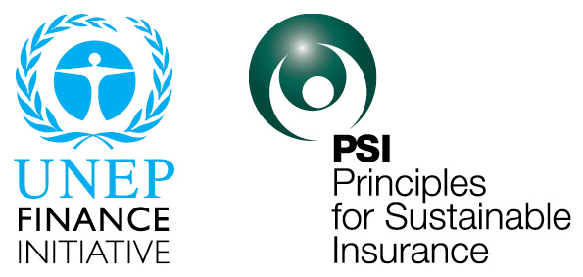

A global sustainability framework and the largest collaborative
initiative between the UN and the insurance industry
The Principles for Sustainable Insurance
Insuring for sustainable development
20 April 2016
Butch Bacani
Programme Leader
The UNEP FI Principles for Sustainable Insurance Initiative
Notes:
1

Slide 2

The triple role of the insurance industry
in sustainable development
Risk carrier role
(financial risk management)
Risk manager role
(physical risk management)
Sustainable development challenges & opportunities
Investor role
(asset management)
Over USD 5 trillion
world premium volume
Understand – Prevent – Reduce – Transfer risk
Insurance risk management value chain
Over USD 30 trillion
global assets
under management
Notes:
2

Slide 3
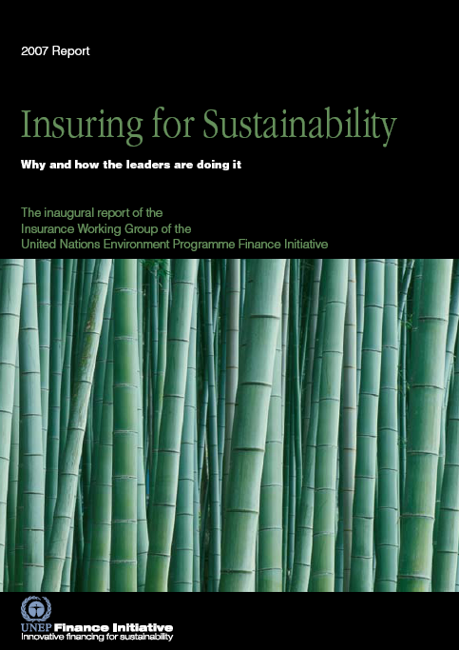
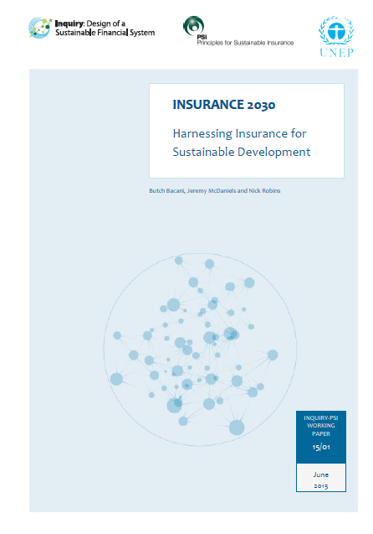
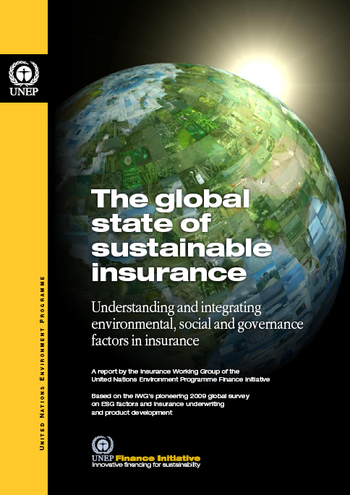
Global studies by the UN and the insurance industry
on environmental, social and governance (ESG) risks
and opportunities relevant to insurance
2007
Examples of key ESG issues (or “sustainability issues”)
Climate change & extreme weather events
Natural disasters
Biodiversity loss & ecosystem degradation
Water scarcity
Food insecurity
Environmental pollution
Violation of human rights & labour standards
Social inequality & financial exclusion
Emerging health risks & pandemics
Ageing populations & demographic change
Technological risks including big data
Accountability & transparency issues
Trust & reputation issues
Unethical business conduct & practices
Corruption
Unfair treatment of customers
2015
2009
Notes:
3

Slide 4
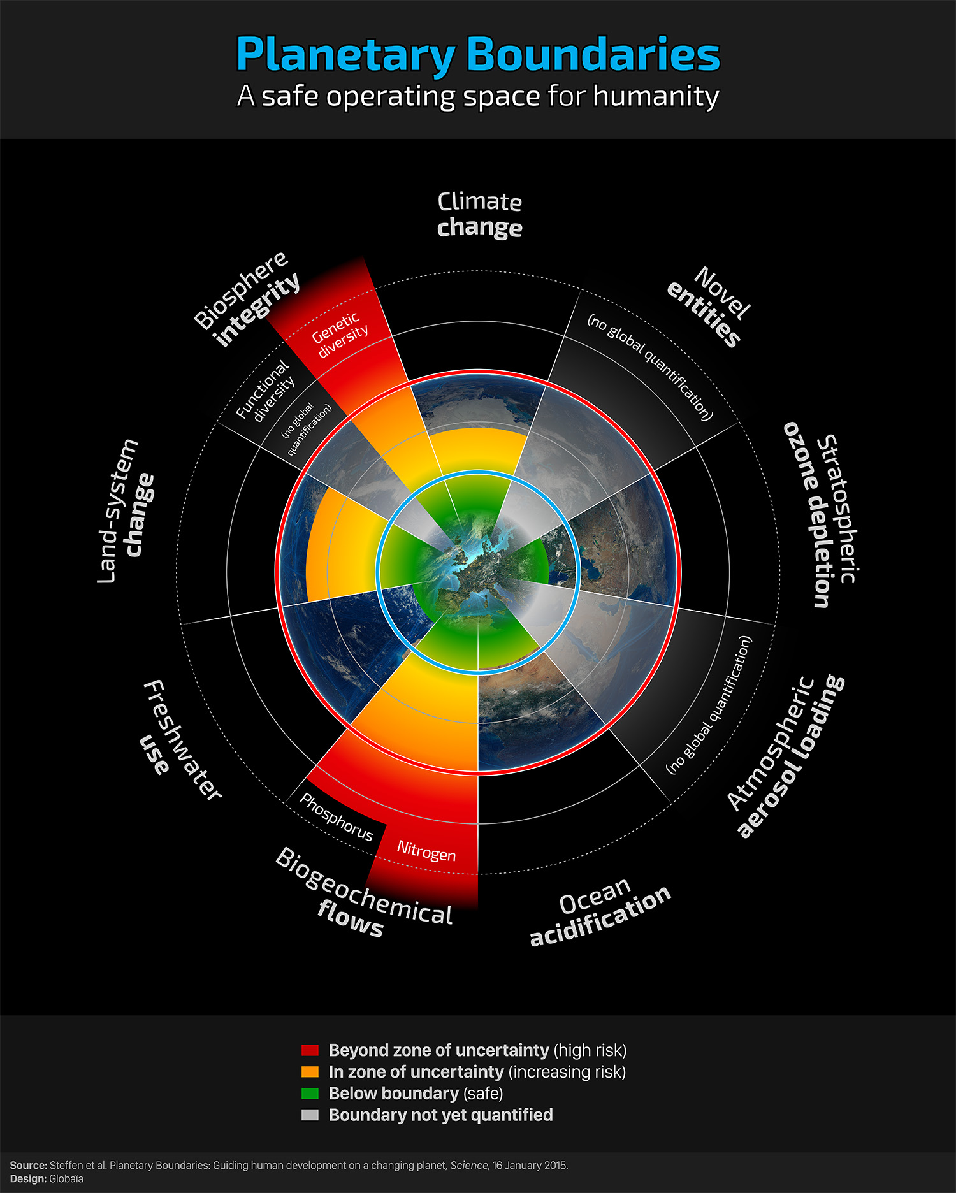
Example of a changing risk landscape
The safe operating space of 4 of 9 interlinked planetary boundaries have already been exceeded
The 9 planetary boundaries
Change in biosphere integrity
(biodiversity loss and species extinction)
2. Biogeochemical flows (nitrogen and phosphorus cycles)
3. Climate change
4. Land-system change (e.g. deforestation)
5. Ocean acidification
6. Freshwater use
7. Stratospheric ozone depletion
8. Novel entities (not yet quantified) (e.g. organic pollutants, radioactive materials, nanomaterials and micro-plastics)
9. Atmospheric aerosol loading (not yet quantified) (microscopic particles in the atmosphere that affect climate and living organisms)
Source: Steffen et al. 2015. Planetary Boundaries: Guiding human development on a changing planet. Science Vol. 347 no. 6223
Notes:
4

Slide 5
Worlds apart: Insurance density
in developed and developing countries
Property insurance premium per capita*
The protection gap for 2014 losses was USD 75 billion (Swiss Re)
In the poorest 100 countries, less than 3% of the population is served by effective insurance protection against natural hazards (UNEP Inquiry)
*Property insurance premium (non-life including health) per capita
Source: Munich Re (as at July 2010)
Notes:
5

Slide 6
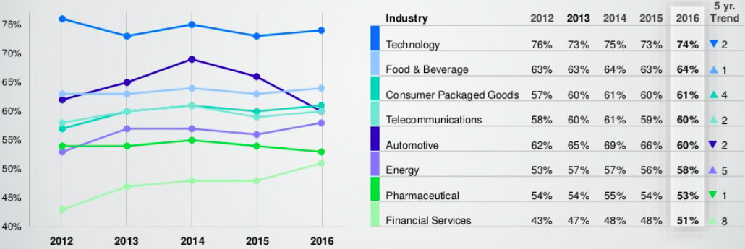
Trust and reputation is a fundamental issue
Global survey: Financial services is least trusted across industries
Trust in each industry sector (2012-2016)
Source: 2016 Edelman Trust Barometer
Notes:
6

Slide 7
The Principles for Sustainable Insurance:
A global commitment to drive systemic change
Public
Governments, regulators & other key stakeholders
Clients & business partners
Own business strategies & operations
Principle 3:
We will work together with governments, regulators and other key stakeholders to promote widespread action across society on environmental, social and governance issues.
Principle 4:
We will demonstrate accountability and transparency in regularly disclosing publicly our progress in implementing the Principles.
Principle 2:
We will work together with our clients and business partners to raise awareness of environmental, social and governance issues, manage risk and develop solutions.
Principle 1:
We will embed in our decision-making environmental, social and governance issues relevant to our insurance business.
Notes:
7

Slide 8
Global launch of the
Principles for Sustainable Insurance
2012 UN Conference on Sustainable Development (Rio+20)
“The Principles for Sustainable Insurance provide a global roadmap to develop and expand the innovative risk management and insurance solutions that we need to promote renewable energy, clean water, food security, sustainable cities and disaster-resilient communities.
“The United Nations looks forward to working with all sectors of society towards the global embrace of this important new initiative as we shape the future we want.”
Ban Ki-moon
UN Secretary-General
Notes:
8

Slide 9

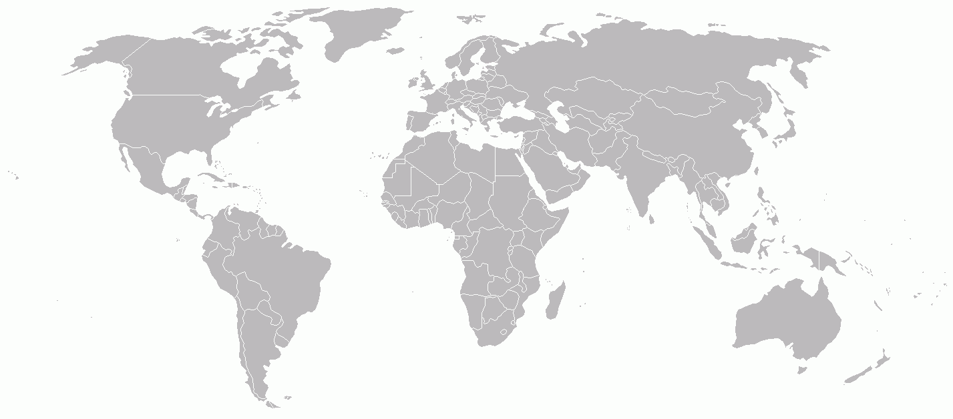
PSI membership by country of domicile
92 members and growing
Insurers representing over 20% of world premium + USD 14 trillion in assets under management
Largest collaborative initiative between the UN and the insurance industry
PSI signatory company
PSI supporting institution
Notes:
9

Slide 10




PSI as insurance industry criteria
Sustainability indices: PSI part of insurance industry criteria of Dow Jones Sustainability Indices, FTSE4Good, and Brazil’s BM&FBOVESPA Corporate Sustainability Index
Interbrand: PSI recognised by organisation that rates the best global brands across all industry sectors
Notes:
10

Slide 11

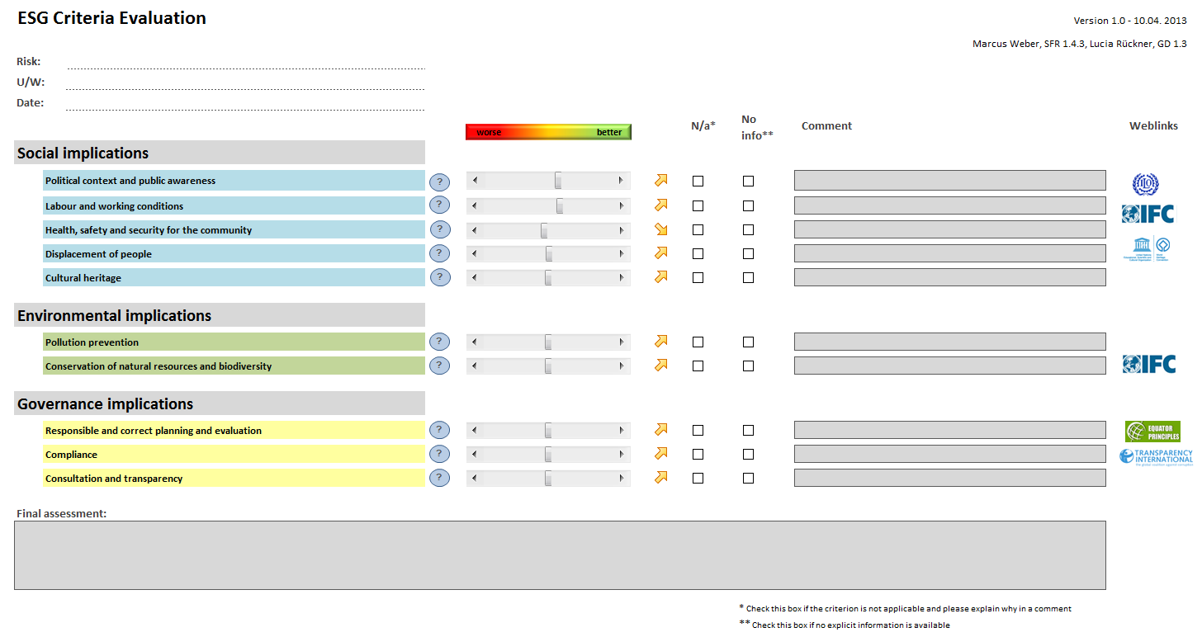
Implementing the Principles: Examples
A company commitment
Swiss Re’s Sustainability Risk Framework spanning industry sectors and environmental, social and governance issues
Oil & gas
Defence
Mining
Dams
Forestry & logging
Animal testing
Nuclear weapons proliferation
Human rights & environmental protection
Munich Re’s underwriting tool to assess environmental, social and governance issues in engineering projects
Notes:
11

Slide 12
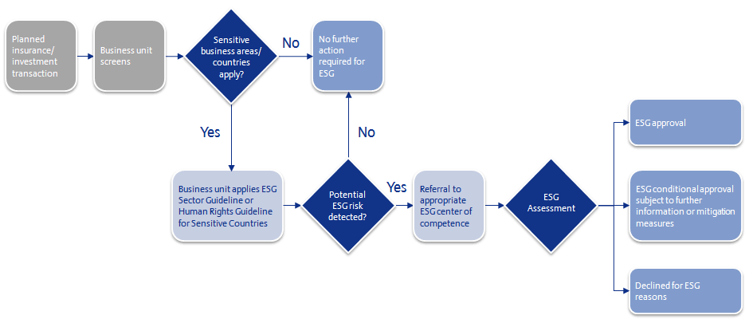
Implementing the Principles: Examples
A company commitment
Allianz’s screening process for environmental, social and governance (ESG) issues
in insurance and investment transactions
Sensitive business areas:
Agriculture, animal testing, animal welfare, betting & gambling, clinical trials, defense, human rights, hydroelectric power, infrastructure, mining, nuclear energy, oil & gas, sex industry
Notes:
12

Slide 13
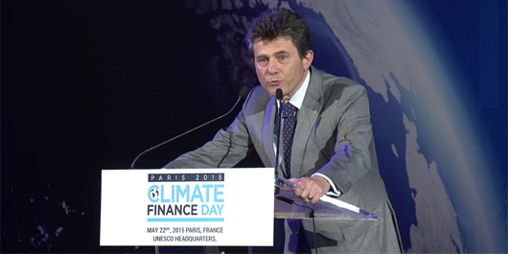
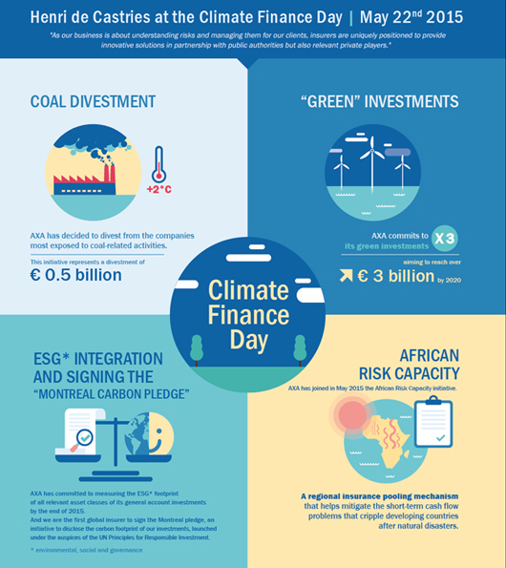
Implementing the Principles: Examples
A company commitment
“The debate is no longer about whether, it's about when.
“As an insurer, I have personally witnessed many times humanity's capacity for resilience. This gives me hope that we will learn from the errors of the past and set ourselves on a path towards a more sustainable future, beginning here today and resulting in a comprehensive, fair and ambitious agreement this December. In any case, we have no choice: a 2°C world might be insurable, a 4°C world certainly would not be.”
Henri de Castries
Chairman & CEO, AXA Group
22 May 2015, Climate Finance Day, Paris
Notes:
13

Slide 14
Collaborating for sustainable development through the PSI Initiative
The case for disaster risk reduction
Disaster losses in the past decade:
Average annual economic losses:
USD 190 billion
Average annual insured losses: USD 60 billion
21st century so far:
More than 1 million deaths due to disasters
Many nations spend more on disaster relief and recovery than on disaster risk reduction
Funds are diverted to dealing with disasters after the fact, rather than being spent on reducing the risk of disasters happening
BUT

Slide 15
The PSI Global Resilience Project:
Building disaster-resilient communities and economies
First phase: Assessing the effectiveness of disaster risk reduction measures in the context of economic and social costs
Disaster risk reduction measures
Behavioural Structural Ecosystems
Multi-hazard measures (cyclone, flood, earthquake)
Education & communication Risk mapping Early warning & evacuation
Cyclone
Mangroves
Sand dunes
Seawalls
Flood
Controlled barriers
Wetlands
Land-use planning
Earthquake
Building codes
Retrofitting
Relocation

Slide 16
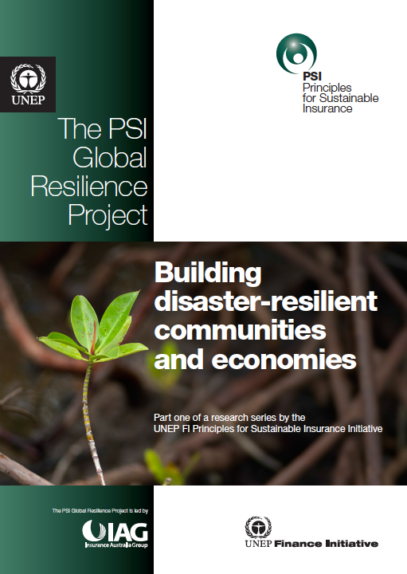
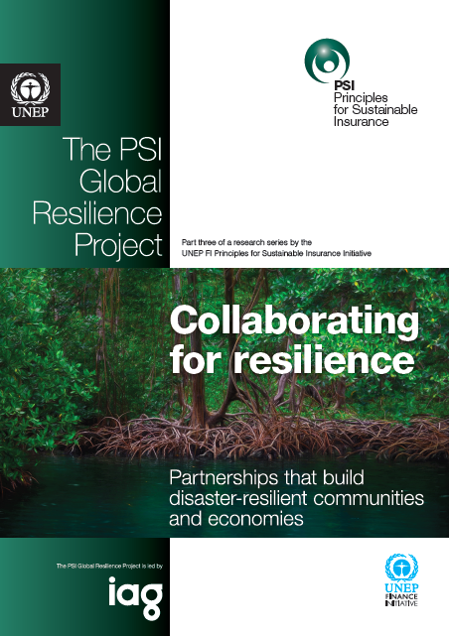
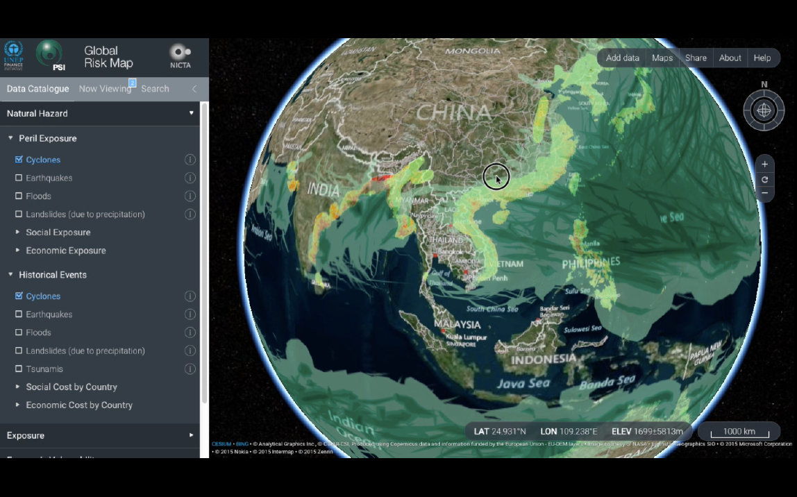
The PSI Global Resilience Project
Building disaster-resilient communities and economies
Collaborative project led by Insurance Australia Group
Phase 1 (2014)
Global research on disaster risk reduction measures
Phase 2 (2015)
Publicly accessible online global risk map
Phase 3 (2015-16)
How-to resilience guide + country engagements
http://globalriskmap.nicta.com.au

Slide 17
The PSI Global Resilience Project:
Linking disaster risk reduction and risk transfer/insurance
Insurance protection gap
Macro level
National governments/sovereigns
National & regional risk transfer solutions
Meso level
Local governments, cities, municipalities
Risk transfer solutions at the local government level: A largely untapped opportunity
Micro level
Commercial lines/Corporate insurance
Individuals, households, companies
Personal lines insurance
Microinsurance
Disaster risk reduction measures
Behavioural Structural Ecosystems
Disaster risk reduction gap

Slide 18
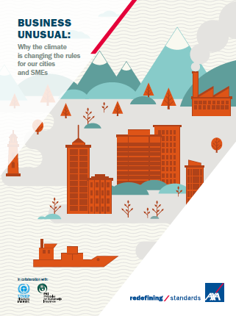
AXA-PSI international climate resilience survey of cities & SMEs
Over 40 city/urban leaders (e.g. mayors) in developed and developing countries
Over 1,100 small-to-medium-sized enterprises (SMEs) in Europe, Asia & the Americas
Cities emphasising need to combine adaptation with mitigation in climate change response
Cities need to be well prepared to withstand climate impacts, including a resilient economy
Only 27% of SMEs are well prepared for consequences of climate change; only 27% adapting their business to be more resilient
79% of SMEs think insurers should do more to help businesses adapt to the consequences of climate change
Adaptation and resilience should be proactive and integrated into business strategies. Private sector engagement is key
Notes:
18

Slide 19
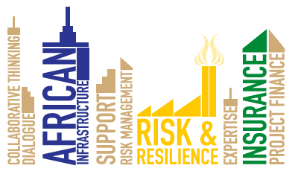







City Innovation Platform for African Infrastructure Risk & Resilience (CIP-AIRR)
Bring together city leaders, private sector and experts (e.g. city management, financiers, insurers, developers, engineers, scientists, community reps) to prototype solutions to major infrastructure and resilience challenges in African cities
Generate bankable and insurable infrastructure projects
Collaborate to lower risk and increase shared value
Share global and regional best practice for critical processes
Lay the foundations for a city-friendly African finance and insurance hub to reduce risk across Africa’s urban infrastructure landscape
Set up CIP-AIRRs in 1 to 2 cities per year
First city: Dar es Salaam (Q3 2016)
Initial commitment of 5 years to allow significant, visible results to manifest
A collaborative project led by Santam, PSI, ICLEI, ClimateWise, Global Infrastructure Basel, Marsh, Moody’s and Sanlam
Notes:
19

Slide 20
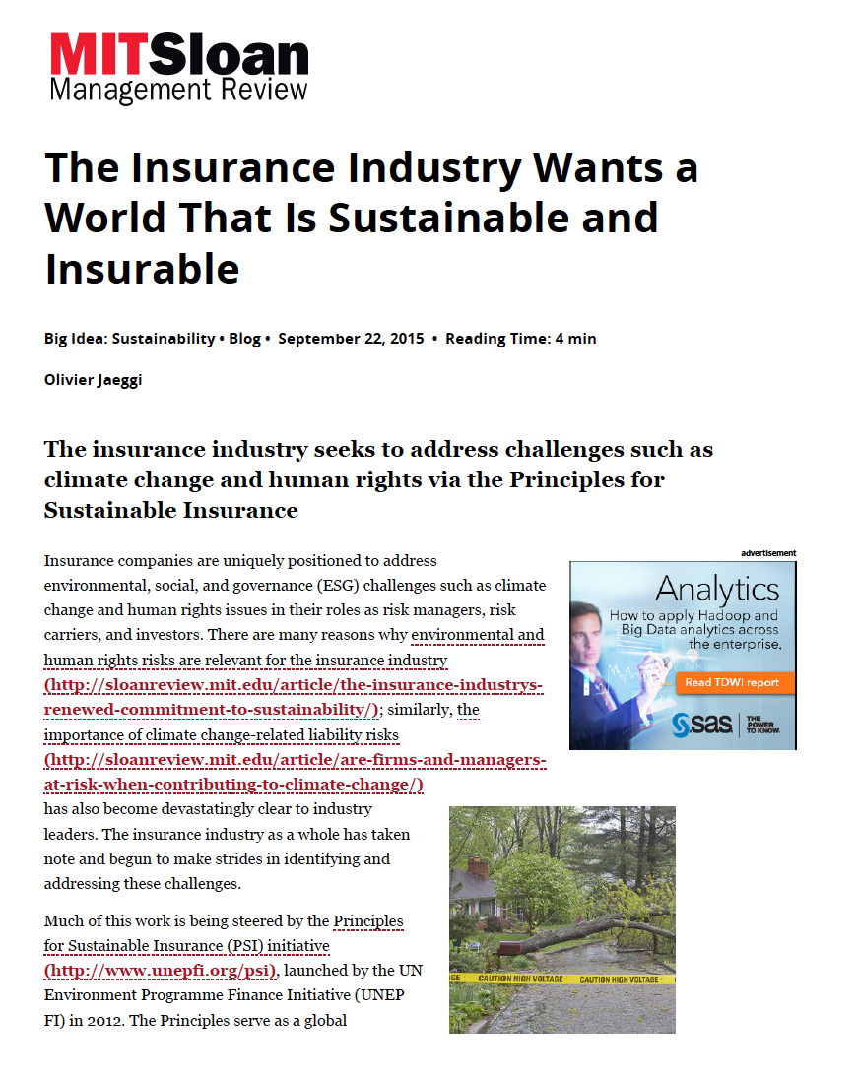
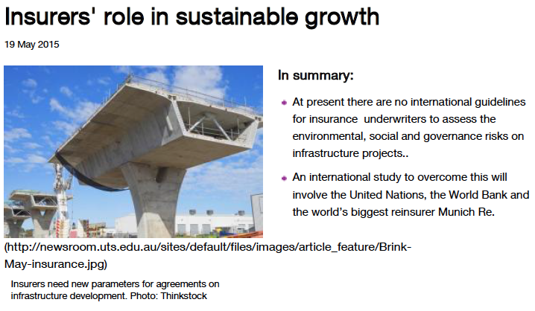
Environmental, social and governance (ESG) criteria,
surety bond underwriting, and infrastructure projects
Collaboration by insurers writing surety bonds, led by Munich Re and the International Finance Corporation of the World Bank Group
Global survey and consultation supported by the International Credit Insurance & Surety Association (ICISA) and the Panamerican Surety Association (PASA)
Survey report and ESG guiding principles for surety bonds
Foundation to develop ESG guiding principles for other lines of insurance business
Notes:
20

Slide 21
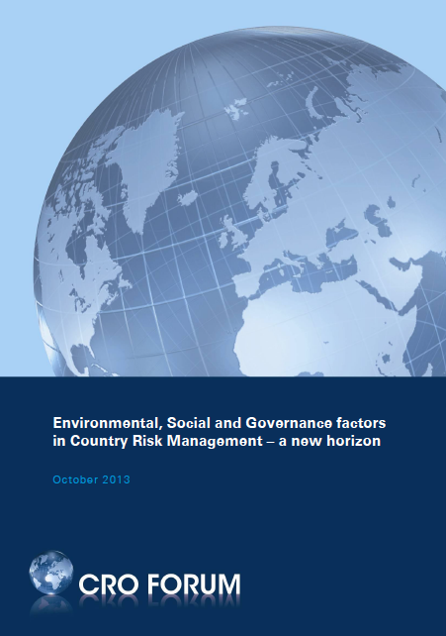
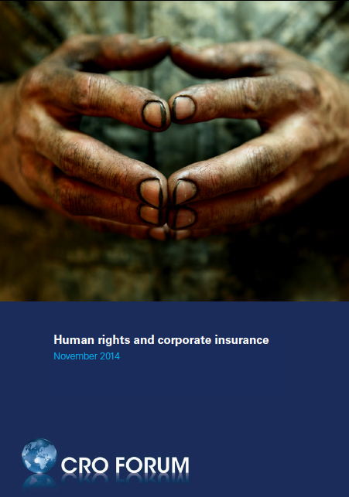
The Chief Risk Officers Forum
Environmental, social and governance factors in country risk management
Insurance underwriting
Investment management
Reputation management
Sustainable development
Human rights and corporate insurance
“Insurers, re-insurers and their brokers also have an opportunity to collaborate and jointly influence projects, companies or industry sectors to prevent and mitigate potential adverse human rights impacts.
“The Principles for Sustainable Insurance provide a platform that can enable such collaboration.”
- Chief Risk Officers Forum
Notes:
21

Slide 22

A Brazilian market collaboration
Goal 1:
40% of insurers will integrate environmental, social and governance criteria into their risk underwriting policy
Goal 2:
30% of insurers will have an environmental, social and governance engagement programme targeted at brokers
Goal 3:
50% of insurance industry will integrate official public policy from municipal, state and federal governments into their social responsibility policy
Goal 4:
50% of insurers will report on environmental, social and governance criteria
2015 environmental, social and governance goals
by the Brazilian insurance industry
Through the work of the Brazilian Insurance Confederation’s (CNseg)
Sustainability & Innovation Committee
CNseg monitoring progress through surveys since 2014
CNseg has developed “Balanced Scorecard for 2016-18” to measure progress in achieving strategic objectives on sustainability, including the ESG goals
Notes:
22

Slide 23












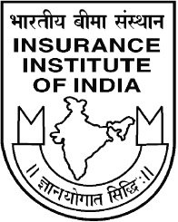




Global consultation on policies and partnerships
for sustainable development
2014-15 project of the PSI and UNEP Inquiry into the Design of a Sustainable Financial System
11 Mar 2014, London, UK
27 Jun 2014, London, UK
Insurance 2030 Roundtable:
Policies and partnerships for sustainable development
4 Nov 2014, Toronto, Canada
24 Sep 2014, California, US
Greening China’s Financial System policy initiative
5-7 Nov 2014, New York and Connecticut, US
16 Oct 2014, Geneva, Switzerland
11-12 May 2015, Rüschlikon, Switzerland
17 Jun 2015, New York, US
2 Sep 2014, Beijing, China
Insurance 2030 Report:
Harnessing insurance for sustainable development
2 Sep 2014, Mumbai, India
27 Feb 2015, Manila,
Philippines
12 Aug 2014, Rio de Janeiro, Brazil
30 Oct 2014, Johannesburg, South Africa
29 Oct 2014, Cape Town, South Africa
Preparatory meeting
Consultation meeting held
Final consultation meeting (Insurance 2030 Roundtable)
Launch of Insurance 2030 Report
Notes:
23

Slide 24
Insurance 2030 report of the PSI & UNEP Inquiry
Key actions to harness insurance for sustainable development
 | Cross-cutting | Risk | Access | Investment
Corporate actions | Principles-driven commitments (Brazilian market PSI targets) | Sharing data and information (Finance Norway) | Product innovations (Index insurance) | Portfolio analysis & disclosure (Montreal Carbon Pledge)
 | Sustainability risk management frameworks | Direct risk resilience support (Swiss Re) | Distribution & deployment (Mobile technology) | Investment frameworks & funding commitments (AXA)
Multi-stakeholder actions | Policy-oriented partnerships (Australian Business Roundtable, Partners for Action) | Partnerships for risk assessment: Sharing capabilities & knowledge (1-in-100 initiative) | Partnerships for access: Engagement, capacity building & implementation (A2ii, IIF, GIIF) | Partnerships to develop project pipelines (G20 GreenInvest)
Policy & regulatory actions | Regional insurance facilities & partnerships (African Risk Capacity) | Mandatory coverage approaches (China) | Policy-directed market provision (India) | Solvency regulations, capital requirements & tax incentives (EU)
 | Insurance development roadmaps | Mandatory risk assessment & disclosure (US, UK) | Support for market development (Philippines)
 | Frameworks for risk reduction |  | Public finance for access (G7 climate insurance)

Slide 25
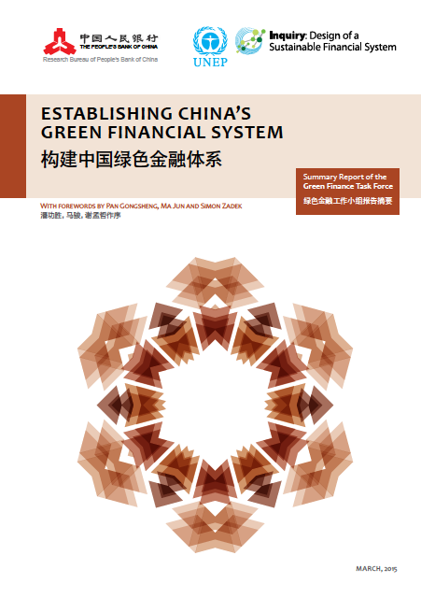
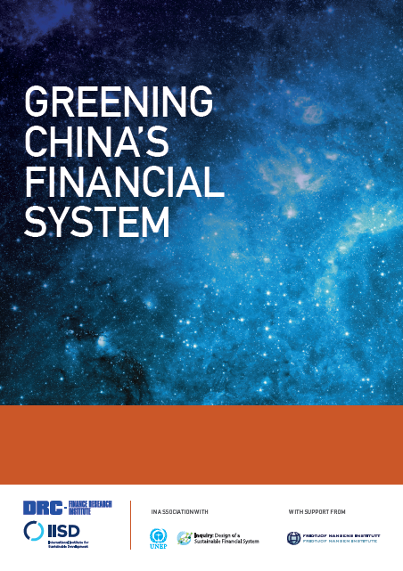
Ground-breaking policy initiatives:
Greening China’s Financial System
& G20 Green Finance Study Group
Led by People’s Bank of China, Development Research Center of the State Council of China, UNEP Inquiry, and International Institute for Sustainable Development (IISD)
PSI Secretariat insurance lead of international group of finance experts
Apr 2015
Sep 2015
Jan 2016
G20 Green Finance Study Group launched by China as part of its 2016 G20 Presidency
Co-chaired by the People’s Bank of China and the Bank of England
Non-G20 countries work stream
International Expert Network 国际专家网络

Slide 26


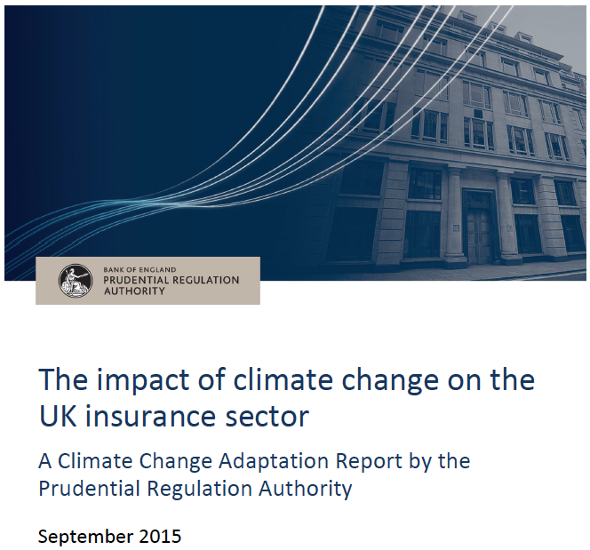
“Climate change is the tragedy of the horizon.”
– Mark Carney, Governor of the Bank of England & Chair of the Financial Stability Board
The impact of climate change on the UK insurance sector
Physical risks
Liability risks
Transition risks
Sep 2015
Report suggests a “network for insurance regulators and associations interested in sustainable insurance policies, guidelines and practices” may be worthy of further consideration
Insurer leadership via the PSI
recognised by the Bank of England
“More widely, insurers had clear views on their role in driving a wider societal response to climate change. They believed that it was their responsibility to show leadership on the issue. This is taking a variety of forms, including participation in industry initiatives, such as…becoming a signatory to the Principles for Sustainable Insurance…”
– Prudential Regulation Authority of the Bank of England
Notes:
26

Slide 27
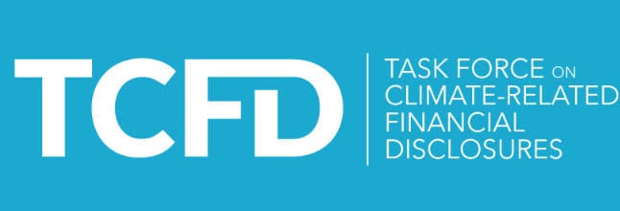
The coming Sustainable Insurance Policy Forum
Insurance regulation and supervision are critical to guide actions on sustainable development
Across the world, insurance regulators are starting to address the sustainability dimension of their mandates
Insurance regulators are now publicly showing their commitment to sustainable insurance aims by signing the PSI themselves
Insurance regulators have been taking action in response to sustainability challenges such as climate change adaptation and mitigation, disaster risk management, and financial inclusion
UNEP working with core leadership group of insurance regulators to establish a Sustainable Insurance Policy Forum in 2016
FSB has created a Task Force on Climate-related Financial Disclosures, including senior executives from the insurance industry
Notes:
27

Slide 28

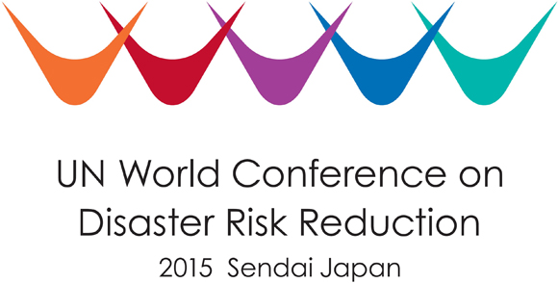


Insurers supporting UN global policy frameworks
on sustainable development
Online PSI global platform for insurance industry commitments to build climate and disaster resilience and promote sustainable development
www.unepfi.org/psi/commitments
March
(Sendai)
July
(Addis Ababa)
September
(New York)
December
(Paris)
Sendai Framework for Disaster Risk Risk Reduction
Addis Ababa Action Agenda
UN Sustainable Development Goals
Paris Agreement on Climate Change
Notes:
28

Slide 29
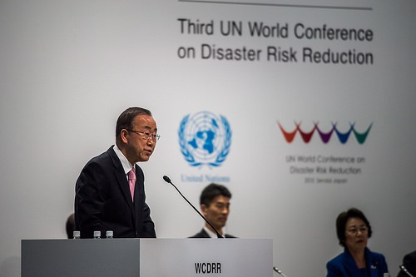

Insurers supporting UN global policy frameworks
on sustainable development
“The Sendai Conference outcome represents the first step of our journey to a new future.” Ban Ki-moon, UN Secretary-General
“United for Disaster Resilience Statement” developed by the PSI
A global commitment by the insurance industry to help implement the
Sendai Framework for Disaster Risk Reduction 2015-2030
Developing risk reduction strategies and risk transfer solutions
Informing the debate on land use, building codes and standards, and zoning through insurance industry insights, data and tools
Protecting investments and economies and creating long-term value through risk reduction and risk transfer strategies
Raising awareness of disaster risk and promoting disaster risk reduction, in addition to developing risk transfer solutions and making risk-sensitive investments
Understanding and reducing risk across industries and public sector entities through strong risk management processes, models, analytics and metrics developed by the insurance industry
Notes:
29

Slide 30


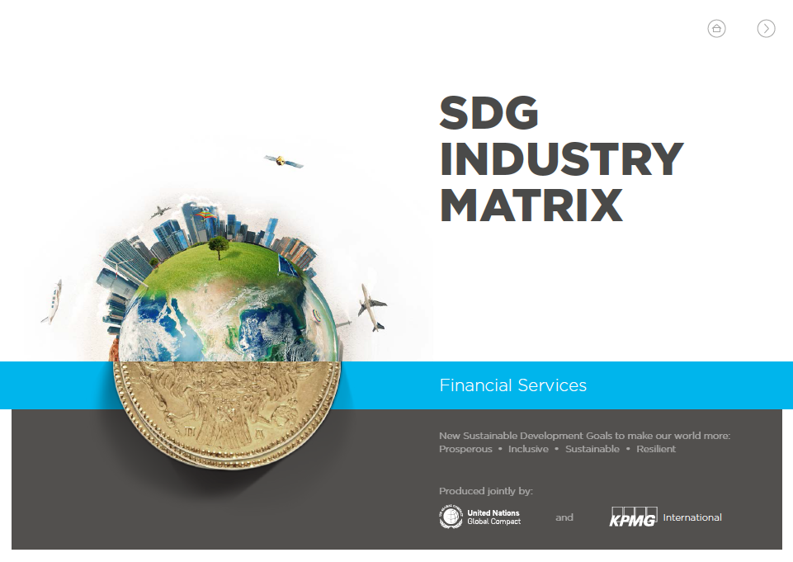
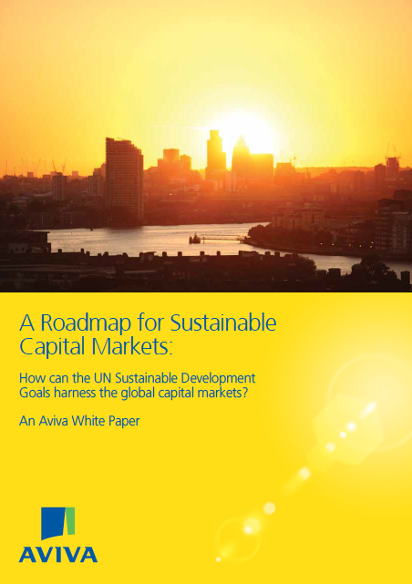
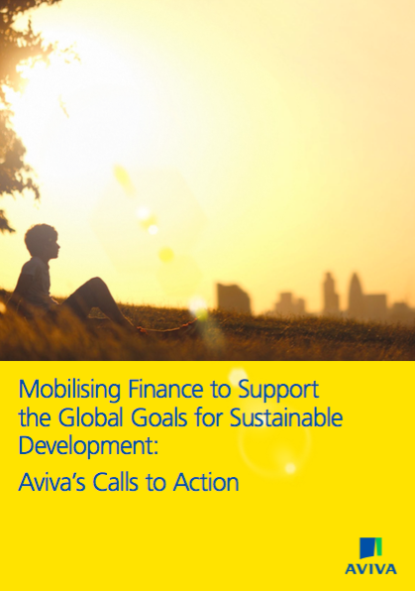
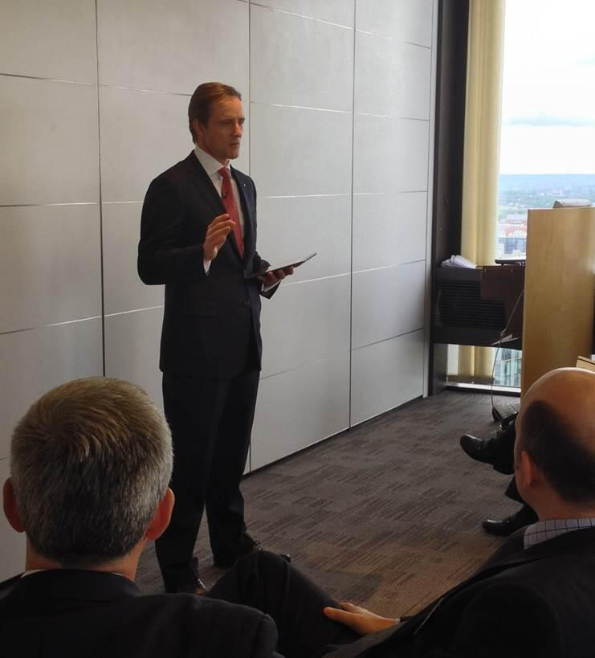
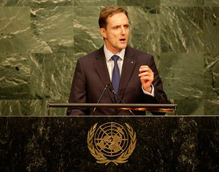
Insurers supporting UN global policy frameworks
on sustainable development
Sep 2015
“Insurance sector initiatives… including the UNEP FI Principles for Sustainable Insurance…are demonstrating leadership in researching, debating and promoting the role of insurers in sustainable development.
“This includes an explicit recommendation to create a set of Insurance Development Goals, based on a pioneering global consultation by the PSI Initiative and the UNEP Inquiry on how insurance companies and insurance regulators could better support development through to 2030.”
– UN Global Compact & KPMG Sustainable Development Goal (SDG) industry matrix for financial services
Jun 2014
Sep 2015
UN General Assembly
Notes:
30

Slide 31

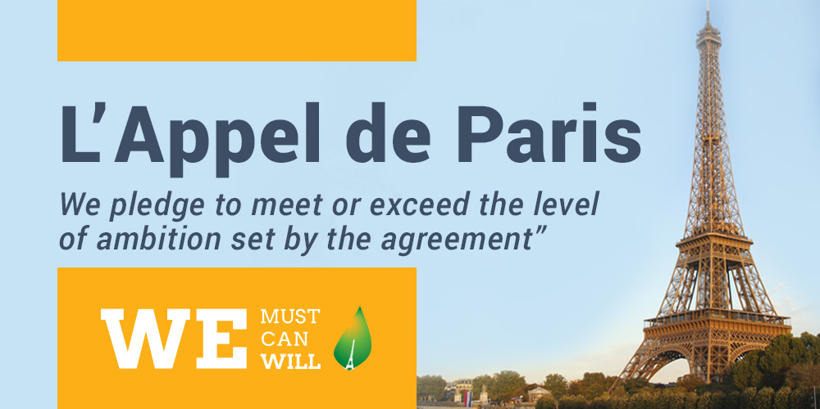

The Paris Agreement on Climate Change
Key elements:
Goal to limit temperature increase
Adaptation and loss & damage
Regular review and enhancement of ambition
Global stock-taking of progress
Climate finance
Over 1,300 non-state actors, including businesses, NGOs, and many insurers have signed the Paris Pledge for Action
Notes:
31

Slide 32


Climate policy: The UN Framework Convention on Climate Change (UNFCCC)
UNFCCC Warsaw International Mechanism for Loss & Damage Against the Adverse Effects of Climate Change
Action Area 7 → “Encourage comprehensive risk management by the diffusion of information related to financial instruments and tools…may include: comprehensive risk management capacity with risk pooling and transfer; catastrophe risk insurance; contingency finance; climate-themed bonds and their certification; catastrophe bonds; and financing approaches to making development climate resilient…”
Paragraph 49 of The Paris Agreement → “Requests the Executive Committee of the Warsaw International Mechanism to establish a clearinghouse for risk transfer that serves as a repository for information on insurance and risk transfer, in order to facilitate the efforts of Parties to develop and implement comprehensive risk management strategies”
UNFCCC Standing Committee on Finance
2016 Forum → “Financial instruments that address the risks of loss and damage associated with the adverse effects of climate change”
Notes:
32

Slide 33


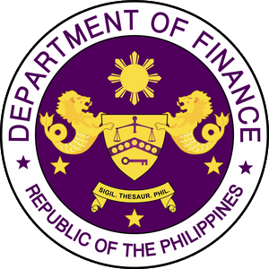
Climate policy: The Vulnerable Twenty Group of Ministers of Finance (V20)
V20 Presidency: Philippines
“The V20 is a group of Finance Ministers from countries most vulnerable to climate change. We established this group recognizing the power and potential of finance as an integral tool in solving the climate challenges we face. Unified in our vulnerability, the economic threats and difficulties arising from climate change, and a heightened sense of urgency on the issue, we stand together on the front lines of a battle we most certainly cannot afford to lose.”
– Cesar Purisima, Secretary of Finance of the Philippines
“In a major first step, we agree to study the creation of a sovereign V20 Climate Risk Pooling Mechanism to distribute economic and financial risks, to improve recovery after climate-induced extreme weather events and disasters, and to enhance security of jobs, livelihoods, businesses and investors.”
– V20 Founding Communiqué
Notes:
33

Slide 34
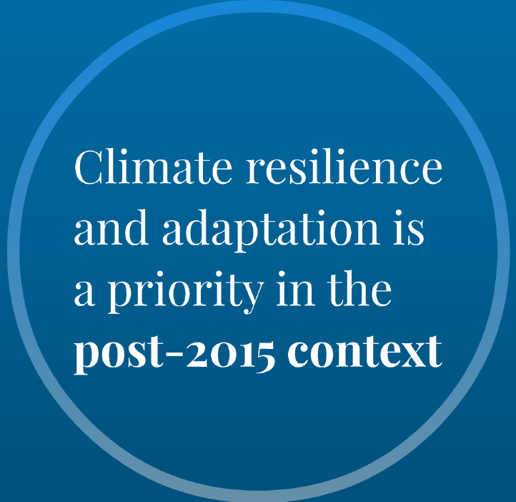
The UN-Secretary-General’s Global Climate Resilience Initiative
“A2R: Anticipate, Absorb, Reshape”
Absorb shocks: Social protection and insurance coverage (individual, sub-national and national)
Absorb
Anticipate
Climate resilience
Reshape
Reshape development pathways: Strengthened adaptive capacities; climate risks integrated into decision-making; resilient physical and natural infrastructure
Launched at COP21
UN system-backed, multi-stakeholder global platform to catalyse action and address gaps
Specific 2020 outcomes
Commitments from governments, UN agencies, private sector, and civil society
Anticipate climate-related hazards:
Early warning and early action systems
Notes:
34

Slide 35
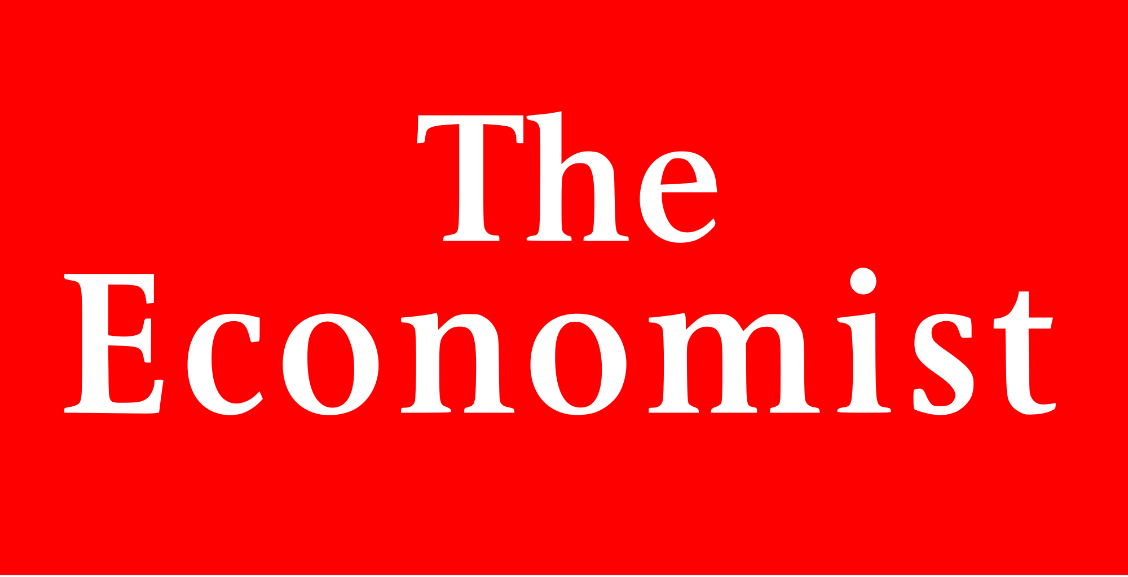
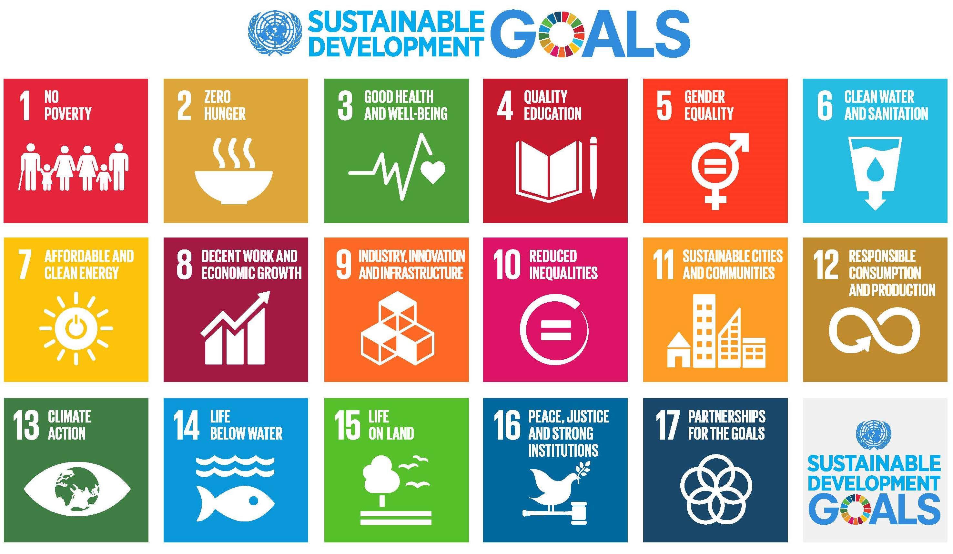
Help achieve the 2030 UN Sustainable Development Goals through “Insurance Development Goals”
Insurance Summit 2016: Guardians of the Future (Feb 2016, London)
“Insurance 2030, a UN report from June 2015, explored how the insurance industry can be harnessed to support sustainable development.
“A recommendation was made to create Insurance Development Goals that align with the UN Sustainable Development Goals, in order to tackle issues of access to insurance, long-term investments, climate change and natural disasters.”
Where should the UN focus these goals?
How do the UN and multilateral organisations hope to involve the insurance sector in achieving them?
What should the priorities for the industry be?
What is the timeline for action?”
– The Economist’s Insurance Summit 2016
Notes:
35

Slide 36
Examples of insurance industry solutions that promote sustainable development
As risk managers
Research on health, disaster risk reduction and climate change adaptation and mitigation
Catastrophe risk analysis and models that integrate natural ecosystems, climate change and socio-economic vulnerability factors
Risk management processes and insurance underwriting guidelines that promote better health, disaster risk reduction and climate change adaptation and mitigation
Literacy programmes on health, climate and disaster risks and insurance
Programmes that improve disaster awareness and preparedness in communities
Risk management tools for clients and suppliers to reduce climate and disaster risk
As risk carriers
Insurance for low-income people, people with disabilities, people with HIV/AIDS, ageing populations
Insurance for climate risks and natural hazards
Insurance for renewables, green buildings, zero and low-emission transportation, energy efficiency, green rebuilding
Insurance based on usage (e.g. pay-as-you-drive, pay-how-you-drive)
Insurance for sustainable agriculture and forestry
Insurance for environmental pollution liabilities
As institutional investors
Investment in inclusive finance, healthcare
Investment in climate and disaster-resilient infrastructure
Investment in sustainable agriculture and forestry
Investment in renewables, green buildings, zero and low-emission transportation
Investment in sustainable water management, sustainable waste management
Notes:
36

Slide 37




Demonstrating leadership and commitment to sustainable development
Insurance regulators who have signed the Principles for Sustainable Insurance
The Philippines
Brazil
The US: California and Washington State
Notes:
37

Slide 38

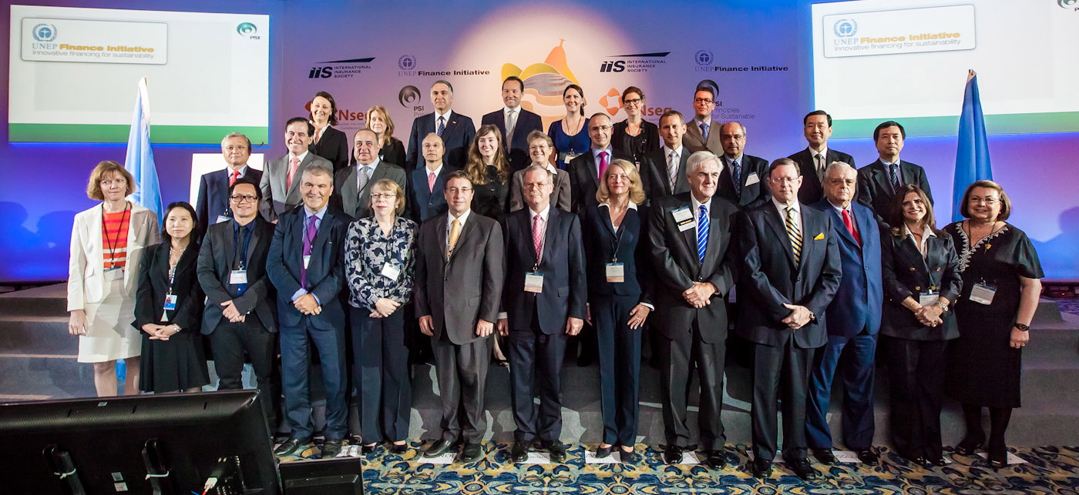
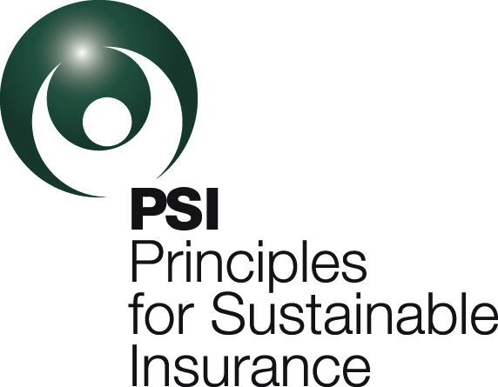


Global launch of the Principles for
Sustainable Insurance (Rio de Janeiro, 2012)
The vision of the PSI Initiative:
“A risk aware world, where the insurance industry is trusted and plays its full role in enabling a healthy, safe, resilient and sustainable society.”
Notes:
38

Slide 39
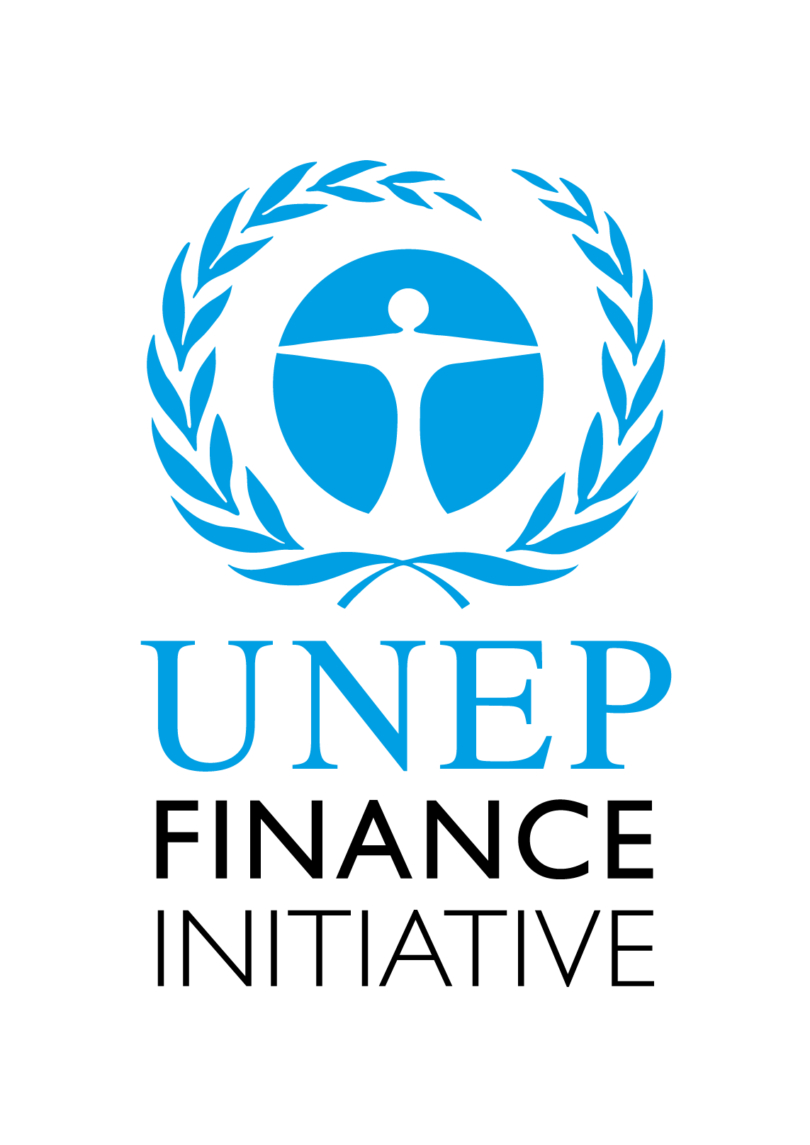
Insuring for sustainable development
www.unepfi.org/psi
Notes:
39

