Slide 1
Regional Seminar for Insurance Supervisors in Latin America on Supervision of Insurance Groups
International Standards on Financial Conglomerates
Jeffery Yong
Senior Financial Sector Specialist, FSI
21 November 2013

Slide 2
Agenda
Cross-sectoral lessons from the 2007 Financial Crisis
Introduction to the financial conglomerates principles
Core elements of the financial conglomerates principles
Summary
2
Notes:
Past, present, future (things for you to think about)

Slide 3

Why Bother Looking Beyond the Insurance Frontier?
“The previous eight years’ profits of $66 billion would be dwarfed by the $99.3 billion loss for this one year, 2008”
- US Financial Crisis Inquiry Commission Report referring to AIG
Contagion risk
Financial conglomerates
Regulatory arbitrage
Notes:
Contagion – macro (from other sectors)
Financial conglomerate - micro (from other business within same group)
Arbitrage – attract bad risk
Key message: whatever channels that may impact on policyholder interest, need to care

Slide 4

Two Main Dimensions of Lessons Learned
Scope of regulations – regulatory gaps
Differentiated nature of regulations – regulatory arbitrage
  E.g. credit default swap vs. financial guarantee insurance
Notes:
Whether the different pieces of jigsaws fit together. Whether regulations are consistent – and they are not, are they justified due to the nature of the underlying business. If unjustified, may lead to regulatory arbitrage and build-up of disproportionate risk in the “weaker” sector.
When look at regulations within each sector, or collectively, whether they adequately capture all the risks that they should do. Or whether there are holes/cracks i.e. the jigsaws doesn’t fit perfectly.
- Each supervisor holds a piece of the jigsaw. The question is whether they fit properly!

Slide 5
Mind the Cross-Sectoral Gap
Banking
Insurance
Time deposit
Term insurance
Deposit administration
Health insurance
Loans
Investment-linked product
Savings account
Motor insurance
Money market funds
Mortgage-backed securities
Mortality bond
Credit default swaps
Options
Equities
Hedge funds
Mutual funds
Securities
“The former director said he was never sure what authority the OTS had over AIG Financial Products, which he said had slipped through a regulatory gap” – US Financial Crisis Inquiry Commission
Notes:
Chart shows various financial products which banking, insurance, securities features – shows blurring of sectoral demarcations.
What about overlaps? – ask for feedback?
deposit administration contract= Pension plan arrangement in which the plan sponsor deposits an asset (such as cash) in an insurance company account. Upon the retirement of the plan's beneficiary, the insurance company withdraws sufficient funds from the account as a lump sum payment for an immediate annuity
Regulatory perimeter needs to be dynamic – incentives to operate outside traditional boundaries.
*Click to reveal question marks

Slide 6
Alarm Bell when Something’s Growing Too Fast
CDS Notional Amounts Outstanding (USD trillion)
Source: BIS
“MBIA provides guarantee in two legal forms: financial guarantee insurance policies and insured CDS contracts. The two forms of guarantee are functionally and economically identical”
- President of MBIA
Notes:
If same, then why write as separate products?! Must be taking advantage of regulatory arbitrage.

Slide 7
Credit Default Swap (CDS) and Financial Guarantee Insurance (FGI)
CDS
Protection Seller
Speculative trading
  Buyer: No “skin-in-the-game” – moral hazard
  Seller: Does not expect credit event to occur
Unregulated – no capital nor reserving requirements
Mark-to-market accounting
Protection Buyer
Fee
Payment upon credit event
FGI
Policyholder
Fee
Insurer
Requires insurable interest
Regulated by insurance supervisors – reserving and capital requirements
Insurance accounting
Payment upon credit event

Slide 8
Gaps in CDS and FGI Regulatory Framework
Inadequate risk governance
Inadequate risk management practices
Insufficient use of collateral
Lack of transparency
Vulnerable market infrastructure
Notes:
As identified by the Joint Forum
Inadequate risk governance: Sellers of credit protection did not, and often could not (given their existing risk management infrastructure) adequately measure the potential losses on their credit risk transfer activities. This was generally true in the CDS market and to a lesser extent in the regulated FG insurance market (where there is at least some financial reporting required by statute). Buyers of protection
did not properly assess sellers’ ability to perform under the contracts, and they permitted imprudent concentrations of credit exposures to uncollateralised counterparties.
• Inadequate risk management practices: Poor management of large counterparty credit risk exposures with CDS and FG insurance transactions contributed to financial instability and eroded market confidence. CDS dealers ramped up their portfolios beyond the capacity of their operational infrastructures.
• Insufficient use of collateral: The absence of collateral posting requirements for highly rated protection sellers (eg AAA-rated monoline firms) allowed those firms to amass portfolios of over-the-counter derivatives, and FG insurance contracts – and thus create for their counterparties excessive credit exposures - far larger and with more risk than would have been the case had they been subject to normal market standards that required collateral posting.
• Lack of transparency: The lack of transparency in the CDS and to a lesser extent in the FG insurance markets made it difficult for supervisors and other market participants to understand the extent to which credit risk was concentrated at individual firms and across the financial system. Market participants could not gauge the level of credit risk assumed by both buyers and sellers of credit protection.
• Vulnerable market infrastructure: The concentration of credit risk transfer products in a small number of market participants created a situation in which the failure of one systemically important firm raised the probability of the failure of others.

Slide 9
AIG: “The Golden Goose for the entire street”
“We see no issues at all emerging. We see no dollar of loss associated with any of the CDO business” – AIG FP CEO, Aug 2007
AIG Financial Products relied on AIG’s AAA rating to write CDS
Did not hold capital against CDS sold – 99.85% confident won’t be realised
Banks bought the CDS to reduce their regulatory capital requirement (from 8% to 1.6%)
AIG’s CDS required posting of collateral should the value of the underlying asset decline or if AIG’s credit rating is cut – the CEO, CFO, CRO did not know of these terms until triggered
Re-valued losses triggered rating downgrades, leading to collateral calls – liquidity crisis
Notes:
Starting in 1998, AIG Financial Products, a Connecticut-based unit with major operations in London, figured out a new way to make money on AIG’s AAA ratings (one of 6 co. with that rating in 2010). Relying on the guarantee of its parent, AIG, AIG Financial Products became a major over-thecounter derivatives dealer, eventually having a portfolio of $2.7 trillion in notional amount. Among other derivatives activities, the unit issued credit default swaps guaranteeing debt obligations held by financial institutions and other investors. In exchange
for a stream of premium-like payments, AIG Financial Products agreed to reimburse the investor in such a debt obligation in the event of any default. The credit default swap (CDS) is often compared to insurance, but when an insurance company sells a policy, regulations require that it set aside a reserve in case of a loss. Because credit default swaps were not regulated insurance contracts, no such requirement was applicable. In this case, the unit predicted with 99.85% confidence that there would be no realized economic loss on the supposedly safest portions of the CDOs on which they wrote CDS protection, and failed to make any provisions whatsoever for declines in value—or unrealized losses—a decision that would prove fatal to AIG in 2008.
AIG Financial Products had a huge business selling CDS to European banks on a variety of financial assets, including bonds, mortgage-backed securities, CDOs, and other debt securities. For AIG, the fee for selling protection via the swap appeared well worth the risk. For the banks purchasing protection, the swap enabled them to neutralize the credit risk and thereby hold less capital against its assets. Purchasing credit default swaps from AIG could reduce the amount of regulatory capital that the bank needed to hold against an asset from 8% to 1.6%. By 2005, AIG had written $107 billion in CDS for such regulatory capital benefits; most were with European banks for a variety of asset types. That total would rise to $379 billion by 2007.
AIG’s business of offering credit protection on assets of many sorts, including mortgage-backed securities and CDOs, grew from $20 billion in 2002 to $211 billion in 2005 and $533 billion in 2007.
AIG did not post any collateral when it wrote these contracts; but unlike monoline insurers, AIG Financial Products agreed to post collateral if the value of the underlying securities dropped, or if the rating agencies downgraded AIG’s long-term debt ratings. Its competitors, the monoline financial guarantors—insurance companies such as MBIA and Ambac that focused on guaranteeing financial contracts— were forbidden under insurance regulations from paying out until actual losses occurred. The collateral posting terms in AIG’s credit default swap contracts would have an enormous impact on the crisis about to unfold.
Greenberg told the FCIC, “When the AAA credit rating disappeared in spring 2005, it would have been logical for AIG to have exited or reduced its business of writing credit default swaps.” But that didn’t happen. Instead, AIG Financial Products wrote another $36 billion in CDS!
AIG FP’s CEO received bonus of at least $38million a year between 2002 and 2007. Since joining AIG FP in Jan 1987 until he retired in 2008, he made more than $300 mil.

Slide 10
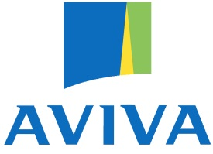


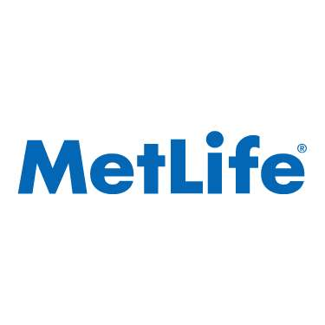


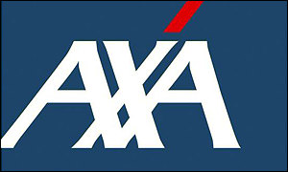




Emergence of Cross-border/Sector Insurance Groups
Mismatch between regulatory framework and group structures

Slide 11
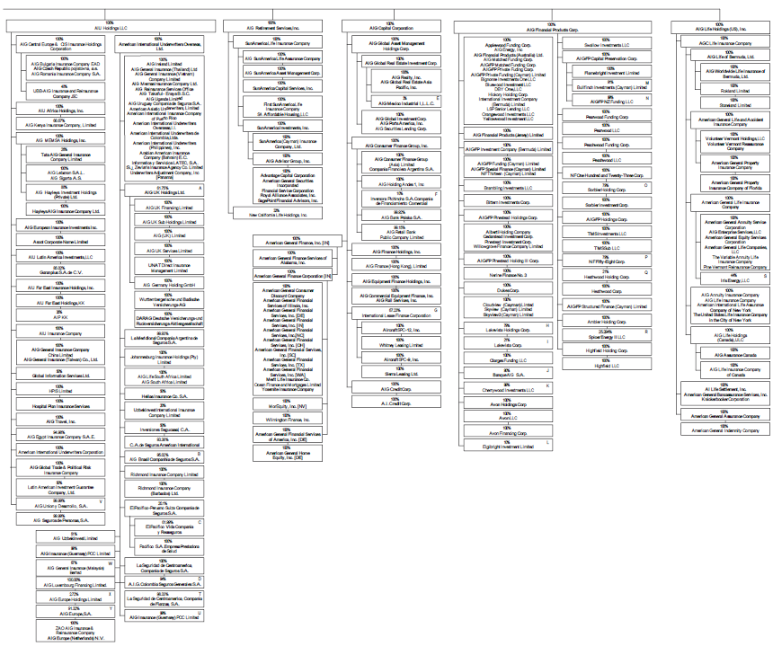
Complexity of Group Structure: AIG
In 2008, AIG comprised of at least 223 companies operating in over 130 countries and employed 106,000 employees.
Notes:
Don’t worry – you’ll get the handout with a clearer chart!

Slide 12
Non-regulated Entities and Activities
Group capital adequacy
  Different definitions of scope of a financial group
  Different methods
  Unregulated entities used to arbitrage regulations
Intra-group transactions and exposures (ITEs)
  Contagion risk
Non-regulated parent companies
  Located in lightly regulated jurisdictions
Notes:
The differences in how a financial group is defined, in how entities are included for calculations, and in the methods for calculating group capital adequacy create problems for supervisors in assessing the risks of a financial group, the capital adequacy of the group, and implications for regulated entities within the group. These differences create gaps when unregulated entities are used to lower capital requirements of individual regulated entities, to reduce group capital adequacy requirements, and to blur the distinction among sectors. This can encourage the creation of group structures that are complex, opaque, and interdependent.
ITEs can create contagion and unintended risks across the group and/or individual legal entities within the group, as shown by the failure of Lehman Brothers. The differences in approaches to supervision and regulation of ITEs can make it difficult for supervisors to assess the risks to the sustainability of the business models of the group and its legal entities.
Differences can create loopholes for financial groups to establish unregulated parent holding companies that end up controlling regulated entities from a completely separate jurisdiction. The unregulated parent holding company’s jurisdiction may not have related regulated entities or not have legal authority to exercise power or oversight over unregulated entities. This hinders supervision. The unregulated parent holding company is under no obligation to provide information to unrelated third parties, such as foreign supervisors, and is not required to produce the information in a meaningful way. Existing protocols for obtaining and sharing critical information do not address unregulated entities that are higher in the
organisational hierarchy of ownership.

Slide 13
Cross-Sectoral Cooperation
Fragmented supervisory structure – silo-based supervision
Lack of a clear “group-wide supervisor”
Lack of cross-sector exchange of information – confidentiality barriers
Crisis management and resolution – lack of preparedness

Slide 14
Agenda
Cross-sectoral lessons from the 2007 Financial Crisis
Introduction to the financial conglomerates principles
Core elements of the financial conglomerates principles
Summary
14
Notes:
Past, present, future (things for you to think about)

Slide 15
Global Financial Regulatory Architecture
SSBs
set sectoral
standards
G20
- drive reform
BCBS
IOSCO
IAIS
FSB
coordinate
policymaking
Joint Forum
IMF/
World Bank
assess
implementation
National
Authorities
implement
standards
Notes:
This chart shows some of the major players. Will refer to them later on in the presentation – so showing them now.

Slide 16
How Global Reforms Impact Countries
DIRECT
INDIRECT
Assessments
  Self-assessment
  FSAP
  Peer Reviews
Equivalence assessment/ supervisory recognition
Corporate restructuring
Peer pressure
Competitive distortion
Attract “bad” risk
Weaker resilience against future crises (contagion)
Reputational risk

Slide 17

Overarching Guiding Principles and Aims
Guiding Principles
Aims
Consistent regulation across sectors - similar activities/products should be subject to similar regulations
Consistent implementation of international standards to avoid regulatory arbitrage and unlevel playing filed
Dynamic scope of financial regulation
Capture full spectrum of risks
Close sectoral and cross-sectoral regulatory gaps
Eliminate supervisory “blind spots”
Ensure effective supervision of risks from non-regulated activities and entities

Slide 18


Definition of “Financial Conglomerate”
“Any group of companies under common control or dominant influence, including any financial holding company, which conducts material financial activities in at least two of the regulated banking, securities or insurance sectors.”

Slide 19
Scope of Application
Supplementary to Sectoral Frameworks
Financial Conglomerates
Insurer
Securities Firm
Bank
Insurer
Securities Firm
Insurer
Bank
Bank
Securities Firm
Sectoral Groups
Insurer
Other material financial activity
Bank
Other material financial activity
Securities Firm
Other material financial activity
*If the other material financial activity is not captured under the sectoral group-wide supervision rules

Slide 20
Preconditions to Effective Conglomerates Supervision
Group-level Supervisor
Clearly identified
Defined responsibilities – supervisory coordination
Supervisory Cooperation
Defined roles and responsibilities of involved supervisors
Dispute Resolution
Effective mechanism to resolve differences among supervisors

Slide 21

Pause for Thought – Relevance of Conglomerates Principles
The Conglomerates Principles are only relevant to group-level supervisors.
Yes
No
Even if you are not a group-level supervisor, the Conglomerates Principles are still relevant to you as host supervisors.

Slide 22
Agenda
Cross-sectoral lessons from the 2007 Financial Crisis
Introduction to the financial conglomerates principles
Core elements of the financial conglomerates principles
Summary
22
Notes:
Past, present, future (things for you to think about)

Slide 23
Key Areas of Conglomerates Supervision
Supervisory Powers and Authority
Supervisory Responsibility
Corporate Governance
Capital and Liquidity
Risk Management

Slide 24
Legal Authority and Supervisory Powers
Supervision
Identify financial conglomerates
Set scope of supervision
Governance
Require transparent structure
Access board and senior management of relevant entities including head of the group
Access information from any entity including from non-regulated entities
Impose requirements on significant owners
Deal with crisis situations
Supervisory Cooperation
Assess risk and support provided by wider group
Take timely preventive and corrective actions
Cooperate with other supervisors - sectoral, foreign
Exchange information on confidential basis

Slide 25
Supervisory Structure and Governance
Independence
Accountability
Transparent Objectives
Legal Protection
Adequate Resources

Slide 26
Group-level Supervisor
Selection Criteria
Main Responsibilities
Challenges
Power and responsibility to supervise the head of the financial conglomerate
Single supervisor responsible for effective group-level supervision
Lead coordination with relevant supervisors – supervisory college, information exchange, joint activities (on/off-site supervision, enforcement actions)
Supervise the largest part of the conglomerate
May not have an obvious candidate due to complex structure of a financial conglomerate
Clear allocation of supervisory responsibilities – depends on structure of the financial conglomerate, supervisory powers and resources
Preservation of confidentiality of information exchanged
Assess risks of the financial conglomerate – forward looking, integrated basis

Slide 27
Pause for Thought – Exchange of Information
ABC Bank is an internationally active bank. 20% of the mortgages it underwrites is on properties in Faraway Land. Does this pose concentration risk to ABC?
A. Yes B. No
123 Insurance Company is an internationally active insurer. 30% of its property insurance portfolio is for properties located in Faraway Land. Does this pose concentration risk to 123?
A. Yes B. No
If ABC and 123 are part of the same financial conglomerate, the combined risk concentration would be significant. A hurricane in Faraway Land will affect both the bank and insurer. But sectoral supervision alone will not reveal this.

Slide 28
Regulation and Supervision
Prudential Standards
  Establish and maintain comprehensive minimum risk-based prudential standards
  Address multiple gearing, risk concentration, contagion, conflict of interest, ITEs
  Public disclosure – financial, governance, risk management
  Clear application – head of the conglomerate/other entities
Monitoring & Supervision
  Collect and assess relevant information from the financial conglomerate including non-regulated entities
  Engage with board and senior management of the head of the financial conglomerate and ultimate parent – drivers of strategy
  On and off-site supervision – assess compliance and controls, verify information
Supervisory Tools
  Compel timely corrective actions – ability and willingness
  Enforce compliance with prudential standards – dividend restrictions, limit growth

Slide 29
Sound Corporate Governance
Responsibility: Board of head of the conglomerate
High Integrity
Balance conflict of interests
Respect policyholders’ interests
Comprehensive – covers all entities
Meet prudential and legal requirements

Slide 30
Structure of Financial Conglomerates
Transparent organisational and managerial structure – consistent with strategy, understood by board, management, supervisors
Assess ownership structure – financial soundness and integrity of significant owners
Require restructuring if structure impedes effective supervision – licensing powers
Board and management understand and can describe structure, its purpose and material risks – unregulated entities, wider group
Assess conglomerate’s process for approving structural changes and creating new entities
Effective information flows and reporting lines within the conglomerate and with the wider group

Slide 31
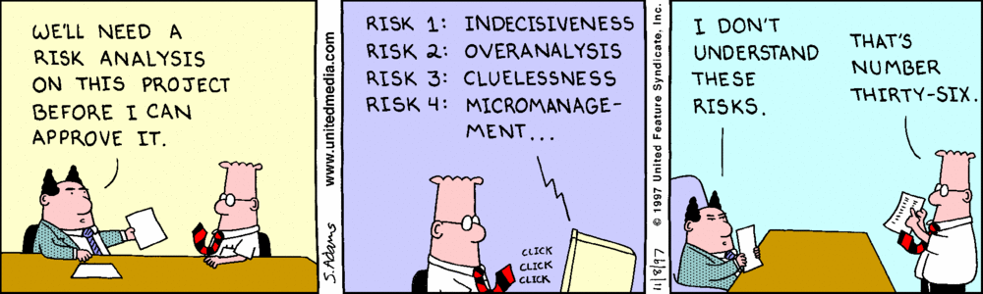
It Starts from the Top

Slide 32
Suitability of Board Members, Senior Management, Key Persons in Control Functions
Integrity
Competence
Experience
Qualified
Sound Judgment
Independent (from wider group, external parties)
Periodic Suitability Assessments

Slide 33
Responsibilities of Board of the Head of a Financial Conglomerate
Define and oversee compliance with strategy and risk appetite – regular reviews and following material changes
Ensure strategy implemented in all entities including non-regulated entities – allocate adequate resources
Manage relationship with wider group – capital and liquidity management, service level agreements
Exercise adequate oversight over the management

Slide 34
Remuneration Policy
Aims
Align remuneration with long-term view value creation
Promote sound and effective risk management
Board, Senior Management and Key Persons in Control Functions
Does not incentivise the disregard of obligation to the conglomerate and its entities
Observed by all entities even on cross-border basis
Consistent application across the conglomerate
Control functions’ remuneration should not be based on financial performance of the business units, rather the units’ adherence to internal controls
Avoid excessive risk-taking

Slide 35
Capital Management Policy
Objectives
Financial conglomerate to maintain adequate capital on group-wide basis
Proactive management of capital – compliance with group-wide and entity capital requirements
Internal Capital Target
Set internal capital target and establish plan to achieve it – exclude management action, future capital injections
Process to notify management and identify management actions of potential breaches
Take account of (lack of) availability of to move capital across entities
Identify and measure all material risks –off-balance sheet and non-regulated entities
Set capital adequacy goals with respect to degree and type of risk exposure - considers group-wide risk profile and appetite, risks from material entities
Capital Planning Process
Independent review (e.g. internal audit) to ascertain integrity of capital management process
Board to approve capital management actions – dividend, capital issuance and redemption – consider stress situations
Board to regularly review and approve policy at least annually
Governance
Current and future business and macroeconomic conditions – forward-looking stress test

Slide 36
Capital Assessment
Considerations
Non-regulated Entities
Multiple Gearing
Excessive Leverage
Minority Interests
Fungibility of Capital

Slide 37
Liquidity Risk Management
Head of Financial Conglomerate
Identify, measure, monitor and manage liquidity risk
Develop and maintain liquidity management process – nature, scale and complexity
Desired Outcomes
Sufficient liquidity at the head and across the conglomerate to meet funding needs – normal and stress
Supervisory Needs
Access to information to assess liquidity, particularly due to relation with wider group
Consider real and potential legal and regulatory constraints to transfer funds
Avoid contagion arising from liquidity stress – e.g. same brand
Strong management information system to measure, monitor, report and control liquidity risk
Adequate policies, procedures and limit on risk taking
Supervisory Requirements
Effective governance and management oversight

Slide 38
Weak Risk Management Can Bring Even a Giant to Its Knees
“The Commission concludes AIG failed and was rescued by the government primarily because… a profound failure in corporate governance, particularly its risk management practices.”
- US Financial Crisis Inquiry Commission

Slide 39
Risk Management Framework
Risk Management Function
Systems and Controls
Risk Management Culture
Risk Management Governance
Led by example, embedded in all levels
Provide staff with training, independence, incentives
Awareness to risks from non-regulated entities
Credible challenge by informed Board members
Whistle-blowing procedures
Independent from business units
Sufficient authority and adequately resourced
Direct reporting to board and senior management
Board-level risk management committee
Sound accounting procedures
Documented processes – ITE reporting
Proportionate to nature, scale and complexity – geographical spread, interconnectedness
Overall responsibility lies with the board of the head of the conglomerate
Enterprise risk management to monitor effectiveness and aggregate risks
Identify, measure, monitor, control risks – linked to capital

Slide 40
Risk Tolerance Level and Risk Appetite Policy
Risk Tolerance Level and
Risk Appetite Policy
Board-approved
Understood by Board and Senior Management
Assess risk exposure against risk tolerance limits
Set tone for unacceptable risk taking
Dynamic
New Business
Undertake robust risk assessment
Assess against risk appetite policy and impact on risk tolerance
Supervisors may review risk assessment
Have adequate process and controls
Outsourcing
Assess risk – quality of provider
Processes and criteria to guide outsourcing
Does not imply transfer of responsibility
Does not impede effective group-wide supervision

Slide 41
Examples of Risk Tolerance Statements
“We use the Group’s 99% Tail VaR in the definition of our risk tolerance, which is the maximum amount of risk we are willing to accept within constraints imposed by our capital resources, as well as by the regulatory and rating agency environment within which we operate.”
“We define and monitor aggregate risk limits (such that)…the Group
meets its internal economic capital requirements the Group
achieves its desired target rating to meet its business objectives
supervisory intervention is avoided.”

Slide 42
Quantitative Elements of Risk Management
Stress and Scenario Testing
Periodic group-wide tests to assess impact on entities– consider interactions between entities, risks
Include reverse stress tests – likelihood of failure, mitigation
Risk Aggregation
Not overly optimistic diversification assumptions
Prudent correlation
Risk Concentration and ITEs
Systems and processes to identify, assess and report group-wide risk concentrations and ITEs – including to supervisors
Quantitative limits on group-wide risk concentrations
Sufficiently severe, forward looking, documented
Appropriate to nature, scale and complexity
Adequate resources and systems

Slide 43
Off-balance Sheet Activities including Special Purpose Entities (SPEs)
Should be included within the scope of supervision even though legally separate
  risk of contagion from liquidity support, reputation
Proportionate or full consolidation for regulatory purposes
Stress and scenario tests to include off-balance sheet activities
On-going risk assessment – nature of risk may change over time
Aggregate, assess and report risk on group-wide basis
Supervisors should challenge the rationale of having SPEs

Slide 44
Agenda
Cross-sectoral lessons from the 2007 Financial Crisis
Introduction to the financial conglomerates principles
Core elements of the financial conglomerates principles
Summary
44
Notes:
Past, present, future (things for you to think about)

Slide 45
Summary
The global financial crisis revealed cross-sectoral gaps that require a concerted efforts to remedy
Global reforms may seem irrelevant but they will impact all jurisdictions – important to be up-to-date
Paradigm shift needed – insurance supervision needs to consider cross-sectoral risk channels

Slide 46



End of Presentation
Any Questions?
              Jeffery.Yong@bis.org
              www.bis.org/fsi
              www.fsiconnect.org

