Slide 1
Internal Controls
Christina Urias
Managing Director – International Regulatory Affairs
NAIC
Notes:
Good morning. I’m pleased to have the opportunity to speak to you today about the importance of an effective system of internal controls and supervisory expectations in this area.

Slide 2
ICP 8 Topics
Control function
ERM function
Compliance function
Actuarial function
Internal audit function
Outsourcing
All Elements Contribute to an Effective System of Internal Controls
Notes:
The primary IAIS standards and guidance related to the internal controls of insurers are contained within ICP 8 – Risk Management and Internal Controls. In reviewing and considering the information included in ICP 8, a number of significant elements can be identified, which are listed on this slide. Each of these elements contribute to an effective overall system of internal controls at an insurer. The elements are generally co-dependent on each other and a weakness in one of the elements may undermine the collective strength of an insurer’s control system. For example, although a company may have a strong control function overseeing its internal IT security, supported by an effective audit function, the company may not be adequately protected from cyber attacks if it has outsourced claims administration to a third party with security weaknesses. Therefore, it is important that each of these elements of an effective system of internal controls be reviewed and assessed on a regular basis.
In the U.S., our primary means of reviewing and assessing the internal control systems of an insurer is through our onsite risk-focused examination process. As each of the elements of an effective system of internal controls are reviewed in the course of a full-scope examination, so we’d like to share a little bit about our process with you.

Slide 3
U.S. Risk-Focused Exams
Performed at least once every 5 years on all U.S. insurers
Frequency varies according to risk level
Focus on the ability of company controls and processes to limit current and prospective solvency risk
Include a review of corporate governance and ERM processes
Findings and recommendations communicate to company and internally to assist in ongoing monitoring process
Notes:
U.S. insurance regulation requires a full-scope examination to be performed on all domestic insurers at least once every 5 years. The actual frequency of the examination period is expected to vary according to the risks each company presents, so many insurers are examined once every 3 years and other insurers are subject to limited scope examinations on a particular topic in addition to the 5 year full-scope exams.
Examinations focus on the ability of an insurer’s controls and processes to identify, address and limit solvency risks impacting the insurer both currently and prospectively. As controls and processes are difficult to assess remotely, regulators are required to be onsite to assess the insurer’s practices in this area.
A critical part of each full-scope examination is a review and assessment of general corporate governance and risk management practices in place within an organization. While Commissioner Donegan covered this at a high-level yesterday, it’s important to note that this review is performed at both a functional level, and through investigation of specific company activities and risks. This allows the regulator to gain not only an understanding of how the functions are organized, but to also get a better understanding of how effective they are at addressing specific risks impacting the solvency of the insurer.
Finally, when specific concerns or deficiencies are identified through the assessment process, the examination process provides a means to communicate those concerns to the company (through a public exam report or management letter) or internally to the financial analysis staff for ongoing consideration and monitoring. This process ensures that concerns are continually tracked and monitored and that the insurer’s supervisory plan is updated to address the issues identified.

Slide 4
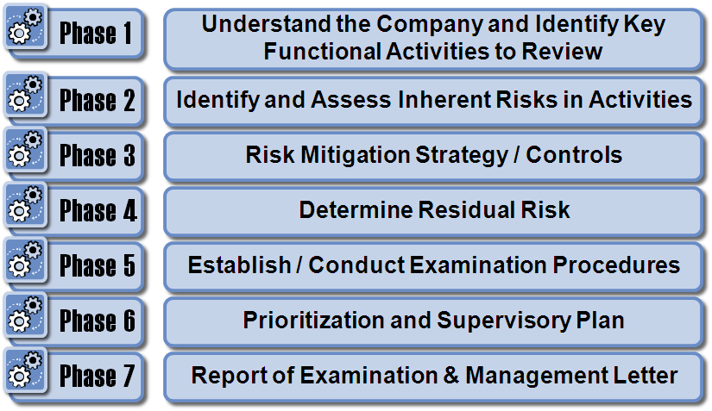
Phases of U.S. Exam Process
Notes:
The U.S. risk-focused examination process is divided up into seven distinct phases that are performed during each full-scope examination to ensure that all significant risks are addressed and concluded upon. To provide an understanding of how the process considers risk management and internal controls, I’d like to walk you through Phases 1, 2 and 3 in a little more detail.

Slide 5
Phase 1
Phase 1 – Understand the Company and Identify Key Functional Activities to be Reviewed
Understand the Company
Understand the Corporate Governance Structure
Assess oversight of control functions, risk-management function, compliance function & actuarial function
Assess the Adequacy of the Audit Function
Includes assessment of internal audit activities
Identify Key Functional Activities
Consider Prospective Risk
Notes:
Phase 1 requires the examination team to gain an understanding of the company to assess overall functions and to assist in identifying the most significant risk areas impacting the company. This includes a documented assessment of the governance structure of the company, which includes internal controls, risk management, compliance and the actuarial function. An assessment tool is included in Exhibit M of the Examiners Handbook to assist in documenting efforts in this area.
In addition, beginning in 2015, large U.S. insurers will be required to conduct and provide a summary report on their Own Risk and Solvency Assessment. The results of this assessment will be reviewed, assessed and verified as part of Phase 1 of the examination process and new guidance, including an assessment tool, has been added to the latest Examiners Handbook to assist in this regard.
In addition to governance and risk management assessments, the adequacy of the insurer’s audit function, including internal audit, is performed through the use of the Handbook’s Exhibit E. Conclusions in this area help the exam team understand what reliance they can place on test work performed by the auditors in conducting exam activities.
Finally, after reviewing and assessing these important control areas, Phase 1 requires the exam team to identify the key functional activities of the insurer that will be subject to review during the exam as well as identify and consider prospective risks that may emerge in the future that are required to be addressed during the exam.

Slide 6
Phase 2
Phase 2 – Identify and Assess Inherent Risk
Ask “What can go wrong?” for each key activity
Includes activities outsourced to a 3rd party
Assess Inherent Risk – Likelihood & Impact
Critical Risk Categories – serve as a double check
Valuation/Impairment of Complex Invested Assets
Liquidity Considerations
Investment Strategy
Adequacy of Reinsurance
Reinsurance Reporting/Collectibility
Underwriting/Pricing Strategy
Reserve Adequacy
Reserve Data
Related Party/Holding Company Considerations
Capital Management
Notes:
After gaining an understanding of the company, assessing general control processes and identifying key functional activities and prospective risks, the exam team is asked to identify and assess risks inherent to each key activity. This is done by requiring the team to identify “what can go wrong” for each key activity. As various components of key activities are often outsourced to service providers (TPAs, MGAs, custodians, etc.), this includes the identification of risks emerging from the use of those service providers. Once significant risks are identified, they are then assessed on a likelihood of occurrence and magnitude of impact scale. The risks identified by the exam team can then be compared back to a list of common critical risks that are to be considered for each exam, which are listed on the slide.

Slide 7
Phase 3
Phase 3 – Control Identification & Evaluation
Identify and understand internal controls that the insurer/service provider has in place for each identified risk
Document Understanding
Consider whether the controls appear to be designed appropriately to mitigate each risk
If design is ineffective, testing is not performed
If design is effective, controls are tested for operating effectiveness
Conclude whether the internal controls effectively mitigate each inherent risk
Strong, Moderate or Weak Risk Mitigation
Notes:
After specific risks are identified, assessed, and placed upon the risk matrix, the exam team is asked to identify and assess controls that the insurer has put in place to mitigate the risks. The examiner utilizes the understanding of general control processes and the audit function gained in Phase 1 of the exam to assist in identifying specific controls in place to mitigate a particular risk. After the controls are identified, the exam team is required to briefly document its understanding of the controls in that area.
After the exam team documents its understanding of controls for a particular risk, the team must determine whether the controls appear to be designed appropriately to mitigate the risk. If the design is found to be ineffective, a control deficiency is identified, the controls are assessed as weak in that area and the exam team moves on to Phase 4 to determine residual risk. However, if the controls do appear to be designed effectively, the exam team is required to test their operating effectiveness through observation, inspection of documents or other means to determine if they can be relied upon. If the controls are proven to be operating effectively, the exam team can assess controls as moderate or strong and use that evaluation to decrease residual risk and independent testing in Phases 4 and 5 of the exam.
On the next couple of slides, I’ll go into a little more detail on how internal controls are identified and tested during onsite exams.

Slide 8
Internal Controls
Systematic measures (such as reviews, checks and balances, methods and procedures) instituted by an organization to:
Conduct its business in an orderly and efficient manner;
Safeguard its assets and resources;
Deter and detect errors, fraud, and theft;
Ensure accuracy and completeness of its accounting data;
Produce reliable and timely financial and management information; and
Ensure adherence to its policies and plans.
Notes:
In identifying internal controls, it is important to understand what is and what is not an internal control. Internal controls can be defined as systematic measures, such as reviews, checks and balances, methods and procedures, that are instituted by an organization for a number of different purposes including:
Conducting business in an orderly and efficient manner;
Safeguarding assets and resources;
Deterring and detecting errors and fraud;
Ensuring accuracy and completeness of accounting data;
Producing reliable and timely financial reports and information; and
Ensuring adherence to policies and strategic plans.
It’s important to highlight the fact that internal controls are systematic measures that happen regularly, as opposed to haphazard reviews performed on an inconsistent basis. In addition, it is important to point out that there is a difference between a company process and an internal control. The company’s process may be for an accountant to adjust reported investment values in the company’s general ledger to an investment statement on a monthly basis. However, this process is not, in and of itself, an internal control. The internal control comes in if there is a review or double check of the process. For example, the controller’s review and approval of the monthly journal entry posted by the accountant could be an internal control in this situation.

Slide 9
Internal Control Testing & Assessment
Purpose Of
Control
Testing
Intended to provide assurance
that control procedures are
operating as prescribed
Control testing is generally performed using
one of the following methods
Walkthrough
Corroborative
inquiry
Observation
Re-performance
Examination of
documents
Notes:
Once internal controls are identified and determined to be designed appropriately to address a specific risk, the controls must be tested before they can be relied upon for examination purposes. When testing controls, there are a number of different methods that can be utilized. Walkthroughs may be used as a component of control testing; however, a walkthrough alone is not sufficient to come to a conclusion on the strength of internal controls and should be paired with additional testing to evaluate the operating effectiveness of controls.
Other examples of control testing procedures include:
First - Corroborative Inquiry - To do this, we inquire of a third party to confirm information on controls that we have received through some other means. Inquiry, like walkthroughs, should typically be paired with complimentary procedures to ensure adequate evidence that the control is effective.
Another testing method is Observation - This is where we literally observe a control being completed. For example, we could observe a mailroom employee opening and logging paper claims received at the insurer. Observation, although similar to performing a walkthrough, typically involves observing the performance of a specific internal control.
Next, we have Reperformance - Reperformance is when we perform the same control as the company personnel to verify that the control is operating as expected.
Finally, another way to test controls is through Examination of documents - In this process we inspect documents or records to ensure that there is an audit trail documenting what control procedures were performed and by who.
Each of these testing methods is used on a typical examination and will be valuable in determining the operating effectiveness of controls. Typically, examination of documents and re-performance give the examiner the most evidence of the operating effectiveness of controls, whereas corroborative inquiry provides the least amount of evidence. However, the performance of internal control testing allows the examiner to reach conclusions regarding their effectiveness, which can be relied upon for examination purposes but also provide comfort to the supervisor regarding the ongoing effectiveness of the insurer in addressing and mitigating risks.

Slide 10
Conclusion
An effective system of internal controls consists of multiple interrelated elements (ERM, audit, etc.)
Controls are most effectively reviewed and assessed during onsite examinations
The U.S. examination process reviews entity level controls in Ph. 1 and specific internal controls in Ph. 3
Controls must be tested to verify their effectiveness
Effective controls provide greater evidence that the insurer will be able to address risks as they emerge
Notes:
In conclusion, an effective system of internal controls consists of multiple elements or processes that are interrelated. To achieve maximum effectiveness, each process must be performing optimally. As controls must be tested and verified to be relied upon, they are most effectively evaluated through the onsite examination process. The U.S. system requires a full-scope examination of each insurer at least once every five years that requires review and assessment of both entity level controls and specific internal control activities. During each examination, controls are tested to ensure that they are designed and operating effectively. This testing allows us to address specific company risks during the examination and also gain greater comfort regarding the company’s ability to mitigate and address risks as they emerge in the future.

Slide 11
Questions
Notes:
Ask for any questions or comments.

