Slide 1
Governance: Pension Funds
Pablo Antolin
Principal Economist, Head Private Pension Unit, OECD Financial Affairs Division

Slide 2
What is pension fund governance?
The governance of private pension plans and funds involves their managerial control
Including the accountability of management to regulator, supervisors and members
The basic goal of pension fund governance regulation is to:
Minimize potential agency problems
Avoid conflicts of interest between fund members and those responsible for the fund‘s management
Maximize the security of pension savings and promises
2

Slide 3
Why is good governance important?
Good governance can help to ensure higher average rates of return, and lower volatility in returns over the long‐term
It is essential a robust governance framework that addresses and monitors all key risks (labour, financial and demographic, e.g. longevity risk) and the uncertainty inherent in saving for retirement
A lower risk of having to call upon plan sponsors and stakeholders for additional contributions (DB schemes)
3

Slide 4
Why is good governance important?
A keener internal awareness of the costs, benefits and risks, but also of market opportunities and innovation
Good Governance can reduce the need for prescriptive regulation and detailed supervision
An efficient and transparent governance structure and supervision of pension funds can help regain public trust (crisis)
Strengthen public confidence to increase coverage and participation in private pension schemes
4

Slide 5
The general approach to good governance
Good governance aims at delivering high pension fund performance while keeping costs low for all stakeholders
Good governance needs to be holistic covering all aspects of pension fund management
Good governance needs to be risk-based
the more sophisticated the investment strategy the pension fund adopts, the stricter the governance oversight required
the more complex the administrative arrangements of the plan, the tighter operational oversight needs to be.
5

Slide 6
The legal form can determine the structure of the governing body
Institutional type (DNK, FIN, HUN, ITA, NOR, NLD, JPN)
The pension fund is an independent legal entity
Typically has its own single governing board chosen by sponsoring employers, employees or members
Contractual type (CZE, MEX, PRT, SVK, TUR)
The fund is without legal personality and is governed by a separate entity (bank, insurance or management company)
Governing body is usually the board of directors of the management entity
Some responsibilities may be shared with some key responsibilities a separate oversight committee
Trusteeship (Anglo-saxon)
The trustees are typically an individual or institution separate from the plan sponsor or members.
They legally own the assets and must administer these in the sole interest of the plan members
6
Notes:
Note: Institutional type
In some countries, like Germany and the Netherlands, there is a dual-board structure. In Germany, there is a supervisory board which is responsible for selecting and monitoring the management board, which in turn is responsible for all strategic decisions.

Slide 7
The duties of the governing board are not always clearly defined
Challenges: (1) leads to weak governance; (2) The governing body may engage operational duties which should be separated from oversight duties and left to internal management staff.
Solutions:
The governing body and other operating functions should have a clear mission statement and objectives
There should be a way of assessing how objectives are met in the best interests of the members
Duties of the governing body should include:
manage, monitor and have oversight of the duties of operational and executive managers, or external service providers
Ensure compliance with the law
Report necessary information about the operation to authorities in compliance with the regulation
7

Slide 8
Governing bodies do not always have sufficient resources
Challenge:
Good governance demands significant resources
Knowledge of the board on pension issues can be weak.
Board members are selected on the basis of their status in a trade union or employer, rather than their specific knowledge or experience
Solution:
The licensing/registration procedure should require minimum suitability requirements for members of the governing body, fiduciaries, and senior management
Transparent selection and succession processes should be identified
Skills and knowledge should be collectively reviewed to ensure that all functions performed by a pension fund can be overseen by the governing body
Training needs should be assessed
8

Slide 9
Size matters: Governance limitations are enhanced in smaller funds
Challenges:
Smaller funds have insufficient scale to establish developed governance structures
Example: Small funds sponsored by small employers can lack workers with relevant skills/experience to govern
Small pension funds may have less economies of scale and thus have higher relative costs
They have less access to good fiduciaries and less incentives to offer them
Yet small funds are more reliant on external advisors who may make risky choices that the governing body may not understand
They are thus more exposed to conflicts of interest
Solution:
Ensure sufficient size and consolidation of pension funds without hampering competition and market entry
Focus supervision on smaller funds with limited resources
Use “Master Trusts” to manage the fund (AUS, DNK, GBR, SWE, NLD) but conflicts of interest need to be supervised closely
9

Slide 10
Conflicts of interest arise when personal or other interests take precedence
Challenges:
Fiduciary duty and accountability of the board are not always effectively identified leading to principle agent problem
Conflicts of interest occur in both for profit and non-profit funds and in many countries a code of conduct is not required
Members often have less knowledge and information which can instigate immoral behavior
Solutions:
Clear and transparent code of conduct for the governing body to act in the best interest of members
Self-assessments and independent reviews of the governing board should include issues related to conflicts of interest
Members should have clear, cost efficient procedures for complaints handling and and redress and should be provided with ample information and education
Strong accountability structures with transparent reporting and decisions processes, and member representation in governing body
Impose supervision and legal requirements to avert conflicts of interest.(i.e. avoid self dealing, fit and proper criteria for members)
10

Slide 11
DB vs DC: Different approaches to pension fund governance are required
DB plans are usually employer sponsored, plan sponsors bear the risk of any shortfall in the promise
DC plans are growing in importance. In DC plans risks are shifted onto the individual
As the individual bears more risks, it augments the the principal agent problem in fund governance
Demographic, labour market, investment
Additional governance challenges in DC Plans
Members involved in key decisions (i.e. investment, contributions) – more focus on closing information gaps
High fees seen as a direct conflict of interest between the plan and the Member
More focus on investments and performance
Financial advisors (e.g. annuities) and conflict of interest: remuneration issues (fees, bonuses, long-term, wages)
11

Slide 12
Meeting governance challenges in DC plans
Enhance transparency and information to mitigate information asymmetry between members and plan managers
This is especially important for contract-based DC plans where the governing body may not cater only to the interest of members
Regulations can strengthen the fiduciary duty of sponsors and providers, through suitable regulation (e.g. conflicts of interest, self dealing, investment regulations) and well designed safe-habor rules (i.e in US safe habor rules are waved only of there is sufficient investment choice and appropriate defaults)
12

Slide 13
Meeting governance challenges in DC plans
Clearly specify investment objectives and strategies
Investment strategy should balance risks and costs with returns
Clear and measurable targets can guide the investment and choice
Appropriate oversight of DC fund investment should be ensured through independent oversight committees (DC management committees) or strengthened supervision.
13

Slide 14
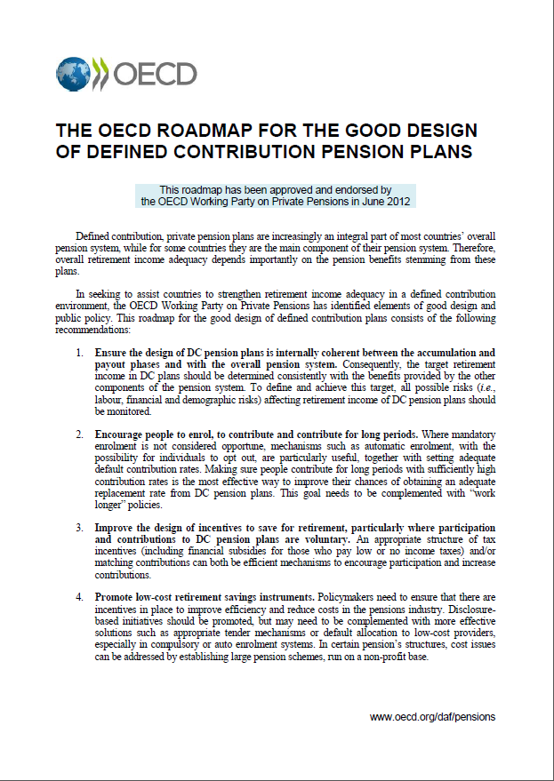
Key OECD recommendations
14

Slide 15
Thank you very much
www.oecd.org/insurance/private-pensions

