Slide 1
Update on IAIS Activities
Conor Donaldson
18 April 2016

Slide 2
Overview
Key IAIS Standard Setting Activities
GSII Policy Measures / ComFrame
Capital
ICP Review
Implementation Programme
Assessments
Supervisory Development

Slide 3
Key IAIS Standard Setting Activities

Slide 4
IAIS - a global standard setter
Mission
Promote effective and globally consistent supervision of the insurance industry in order to develop and maintain fair, safe and stable insurance markets for the benefit and protection of policyholders
Contribute to global financial stability
IAIS membership is broad and diverse:
About 200 jurisdictions in nearly 140 countries
97% of the world's insurance premiums

Slide 5
IAIS policy initiatives
Recognition of different type of institutions which supervision required different tools for:
All authorised insurers (at legal entity and group level)
Insurance core principles
Major review underway
Internationally Active Insurance Groups (IAIGs)
The Common Framework – ComFrame
A global quantitative insurance capital standard (ICS)
Qualitative requirements
Global Systemically Important Insurers (G-SIIs)
Methodology under review
Policy measures
Straightforward basic capital requirement (BCR) + Higher loss absorbency (HLA)
Recovery and Resolutions Plans (RRP) to ensure that in the event of a failure a systemic (re)insurer can be adequately resolved
Crisis Management Group (CMG) to deliver co-ordination in a crisis event

Slide 6
G-SII Assessment Methodology (IAIS 2013)
IAIS Methodology for Recommending List of G-SIIs to FSB:
20 indicators in 5 categories: size, global activity, interconnectedness, non-traditional insurance and non-insurance (NTNI) activities and substitutability
Higher weighting for NTNI and interconnectedness (together 80-90%)
Supervisory judgment plays an important roleg
Methodology (including NTNI definition) is currently under review. See IAIS website for Public Consultation launched 25 November 2015

Slide 7
ComFrame an Overview
Module 1
Module 2
Module 3
Identification of IAIGs
IAIG’s legal and management structures
Group-wide supervisory process
Process of identifying IAIGs
Governance
Supervisory colleges, cooperation and coordination
Scope of supervision
ERM
ERM Policies
Identification of GWS
Capital adequacy assessment
Crisis management and resolution measures among supervisors
ComFrame development began in July 2010
Three consultations - each year from 2011 to 2013
Field testing in 2014/2015

Slide 8
IAIGs identification criteria
Criteria to identify IAIGs are set in the module 1 of ComFrame
Criteria for IAIGs:
A. International Activity
Premiums are written in not fewer than three jurisdictions, and
Percentage of gross premiums written outside the home jurisdiction is not less than 10% of the group’s total gross written premium;
AND
B. Size (based on a rolling three-year average):
Total assets of not less than USD 50 Billion, or
Gross written premiums of not less than USD 10 Billion.

Slide 9
Ultimate goal for the ICS (no date attached)
The ultimate goal of a single ICS will include a common methodology by which one ICS achieves comparable, i.e. substantially the same, outcomes across jurisdictions.
Ongoing work is intended to lead to improved convergence over time on the key elements of the ICS towards the ultimate goal.
Not prejudging the substance, the key elements include valuation, capital resources and capital requirements.

Slide 10
ICS - key points
The ICS is a group-wide, consolidated insurance capital standard applicable to IAIGs
The ICS is not proposed as a legal entity requirement
Once finalised and agreed, the ICS will be a measure of capital adequacy for IAIGs
The ICS will constitute the minimum standard which the supervisors represented in the IAIS will propose for adoption in their respective jurisdiction
Supervisors will be free to adopt additional arrangements that set higher standards.
Moreover, they are free to put in place supplementary measures of capital adequacy for the IAIGs in their jurisdiction
Notes:
Developing global insurance capital standards is a complex matter…. especially if time is at premium
Our goal is to develop a truly global insurance capital standard for the largest internationally active insurers (IAIGs). We are striving to create something unique that works for different firms, markets and supervisors
… this does not mean lifting altogether any of the existing regulatory frameworks into the ICS (e.g. RBC, SST, S2 or APRA’s)
…but lifting the experience of members participating in the capital development & field testing working groups

Slide 11
Process and Timetable
Timing | Key milestone
March-September 2014 | First round of field testing including different valuation approaches for the ICS and BCR
December 2014 | First ICS Consultation
April to September 2015 | Second round of field testing including HLA and ICS standard method (Includes private reporting of BCR)
May to September 2016 | Third round of field testing including ICS standard method (Includes private reporting of BCR and HLA)
June 2016 | Second ICS Consultation
May/June-2017 | Adoption of ICS Version 1.0
June-September 2017 /2018/2019 | Further field testing Includes private reporting of ICS Version 1.0
May/June 2018 | Third ICS consultation
IAIS 2019 General Meeting | Adoption of ComFrame, including ICS Version 2.0
From 2020 | Implementation of ComFrame, including ICS, to commence
Notes:
Version 1.0 (for confidential reporting)
By mid-2017
Two valuation approaches
A standard method
Version 2.0 (for adoption with ComFrame)
By 2019
Achieve an improved level of comparability
May still include two valuations but with reduced differences
May allow for both a standard method and other methods including the use of internal models and variations of the standard method
After ICS Version 2.0 is adopted there will be an implementation period while jurisdictions embed the ICS into regulatory requirements and supervisory practices.

Slide 12
ICP Review
Feedback Loop
Standard Setting and Standards Implementation
Global Policy Work
Developments in Insurance Business (eg, FinTech)
Proportionality –
‘… supervisors … tailor certain supervisory requirements and actions in accordance with the nature, scale and complexity of individual insurers.
… supervisors should have the flexibility to tailor supervisory requirements and actions so that they are commensurate
Long term project
Anticipated to run through 2018

Slide 13
Implementation Programme

Slide 14
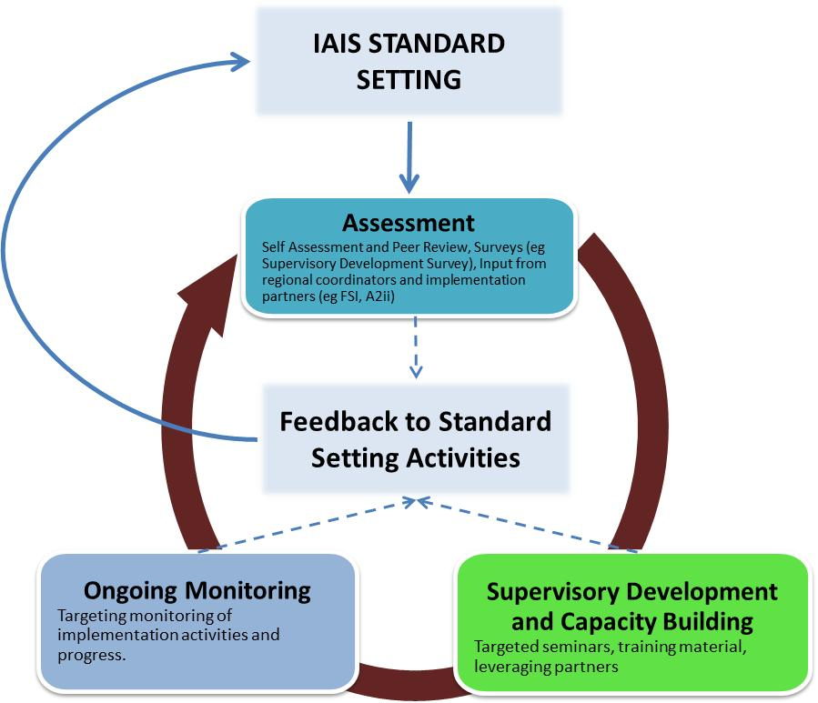
IAIS Implementation Cycle

Slide 15
Coordinated Implementation Framework (CIF)
Response to review of IAIS implementation programme
Recognition that we provided tools, but little coordination of our activities
Under the CIF, the IC commits to:
Regional engagement
Enhance relationships with key implementation partners
Target IAIS resources on areas and activities in line with the unique perspective and voice the IAIS brings
Strengthen alignment of IAIS implementation activities and coordinate implementation perspectives into all standard setting activities of the IAIS

Slide 16
Considerations
The IAIS brings a unique perspective
Not a training institute / technical assistance provider
Best defined as “catalyst” or “facilitator”
Help generate / shape implementation support through:
Understanding needs / challenges (regional contributions and assessment activities)
Coordinating with partners – identifying opportunities to maximise benefits of implementation support
Developing regional plans / monitoring tools to provide regional / IAIS level encouragement, cooperation and “competition”

Slide 17
Self Assessment and Peer Review (SAPR)
Next up is Supervisory Cooperation / Information Exchange covering ICP 3 (information exchange and supervisory cooperation) and ICP 25 (Supervisory Cooperation and Coordination).
IAIS SAPR Objectives:
Gives “independent” and “consistent” assessment of observance
Is manageable from a resource perspective
Provides insights for implementation partners
Does not duplicate existing assessments
Provides input into standard setting work – Feedback loop between assessment and standards development

Slide 18
Supervisory Development Initiatives
FIRST ONE
Programme for new supervisors
Webinars and self directed learning
FSI Connect Licenses
Distributed to IAIS Members based on demand / need
Two year period
Core Curriculum
Compendium of knowledge covering supervision and regulation for insurance
2010 is being refreshed by IAIS and World Bank
Regional Seminars
Budget to support 10 per year
Translations
Framework for translating IAIS supervisory material – member driven

Slide 19
Questions

Slide 20
Contact information
Conor Donaldson
Member of the Secretariat
International Association of Insurance Supervisors
Centralbahnplatz 2 c/o BIS
P:+41 61 280 86 02
M:+41 76 350 86 02
E: conor.donaldson@bis.org
SkypeID: conordonaldson

