Slide 1
ICP 8 – Risk Management and Internal Controls
Ekrem Sarper
Vice Chair, Implementation Committee
San Jose, Costa Rica

Slide 2
Overview
Overview of ICP 8
Principle Statement
ICP 8 Standards
ICP 8 General Observations
Assessment
IAIS Assessment
Corporate and Risk Governance Assessment
ICP 8 results

Slide 3
Overview of ICP 8

Slide 4
Overview of ICP 8
General Observations:
The risk management and internal control system of an insurer is comprised of its strategies, policies, processes and controls to identify, assess, monitor, manage and report risks that it may be exposed to at a legal entity or group level.
Risk management and internal control is part of the fabric of insurer governance.
The systems must include a risk management function, a compliance function, an actuarial function and an internal audit function. These are expected to be commensurate with the nature, scale and complexity of their business.

Slide 5
ICP 8 - Principle Statement
Principle Statement:
The Supervisor requires an insurer to have, as part of its overall corporate governance framework, effective systems of risk management and internal controls, including effective functions for risk management, compliance, actuarial matters and internal audit.

Slide 6
ICP 8 - Standards
The supervisor requires the insurer to establish, and operate within, effective systems of risk management and internal controls.
The supervisor requires the insurer to have effective control functions with the necessary authority, independence, and resources.
The supervisor requires the insurer to have an effective risk management function capable of assisting the insurer to identify, assess, monitor, manage and report on its key risks in a timely way.
The supervisor requires the insurer to have an effective compliance function capable of assisting the insurer to meet its legal and regulatory obligations and promote and sustain a corporate culture of compliance and integrity.

Slide 7
ICP 8 - Standards
The supervisor requires that there is an effective actuarial function capable of evaluating and providing advice to the insurer regarding, at a minimum, technical provisions, premium and pricing activities, and compliance with related statutory and regulatory requirements.
The supervisor requires the insurer to have an effective internal audit function capable of providing the Board with independent assurance in respect of the insurer’s governance, including its risk management and internal controls.
The supervisor requires the insurer to retain at least the same degree of oversight of, and accountability for, any outsourced material activity or function (such as a control function) as applies to non-outsourced activities or functions.

Slide 8
Assessment

Slide 9
IAIS Assessment
For each standard, assessments need to determine:
1) Does the jurisdiction has the legislative authority to achieve the objective?
2) Do the policies and procedures exist to put the legislative framework into practice?
3) Does the supervisor undertakes the activity to achieve the objective?
Assessment Categories
Observed | All criteria observed
Largely Observed | Minor shortcomings
Partly Observed | Shortcoming sufficient to raise doubts regarding achieving the objectives
Not Observed | Significant doubts about achieving the objective
Not Applicable | Not Applicable due to structural, legal, institutional features.

Slide 10
Corporate and Risk Governance Assessment
ICPs 4, 5, 7 and 8 – Corporate Governance
ICP 8 assessed as part of Assessment on theme of “Corporate and Risk Governance”
69 supervisory authorities participated
Some jurisdictions have appropriate regulatory frameworks, have policies and procedures in place – but supervision is done in response to concerns, not proactively.
Some jurisdictions rely on legislative frameworks that are not insurance specific – e.g., existing corporate law or securities law

Slide 11
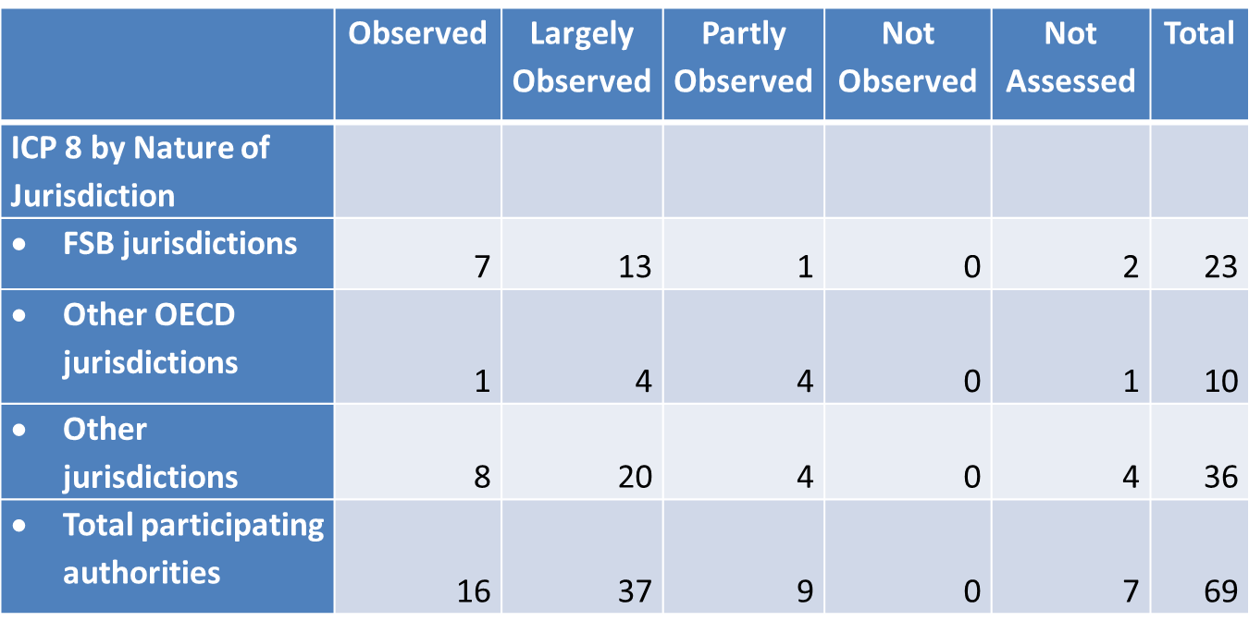
ICP 8 - Results
ICP 8 was significantly revised in 2011, with the new Standards being much more explicit (and consequently difficult to observe)
Expert Team noted that capacity is an issue for a number of jurisdictions

Slide 12
ICP 8 - Results
Observance of ICP 8 in Americas was marginally higher
Standard 8.2 had the highest number of supervisors with an assessment lower than “Observed”. Observance of this standard was lower in the Americas

Slide 13
ICP 8 - Results
General Challenges with Observance
Legislative frameworks should ensure supervisors have the power to require insurers to have all control functions, and that these functions have the necessary resources, independence, and authority.
Some supervisors may require one control function (eg, Internal Audit), while not requiring a Risk Management or a Compliance Function.
In many jurisdictions internal control requirements are defined, at least in part, in legislation other than insurance law.
Supervisors should assess risk management and internal controls proactively, not just when problems are identified.

Slide 14
Questions?

Slide 15
Contact information
Ekrem Sarper
Vice Chair of the Implementation Committee
esarper@naic.org

